Slide 1
Erythropoiesis

Slide 2
All the circulating blood cells derive from pluripotent stem cells in the marrow.
They divide into three main types.
Erythropoiesis, is formation of RBC
Leucopoiesis (myelopoiesis) is formation of WBC
Thrombopoiesis is formation of platelets.

Slide 3
1- Erythropoiesis
ERYTHRON
Collectively, the progenitors, precursors, and mature red cells make up an organ termed the erythron, which arises from pluripotent hematopoietic stem cells. The most numerous are red cells.

Slide 4
Erythropoiesis
Erythropoiesis passes from the pluripotent hematopoietic stem cell through the
progenitor cells,
colony‐forming unit granulocyte-erythroid
burst‐forming unit erythroid (BFUE)
CFU erythroid(CFUE).

Slide 5
Each committed erythroid stem cell (pronormoblast) may give rise to up to an estimated 16 mature red blood cells, each pronormoblast, usually goes through four cell mitotic divisions to produce a total of 16 daughter cells.
The normal process of proliferation and maturation lasts from 3 to 5 days, depending on the urgency of red blood cell needs of the circulating blood.

Slide 6
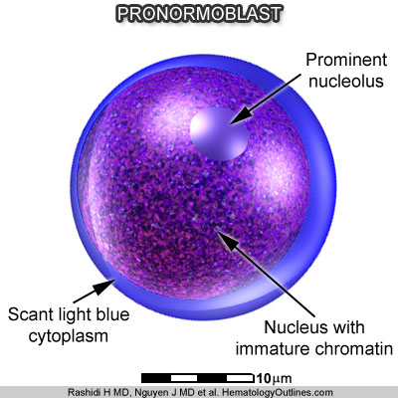
Stages of Erythrocyte Development
Usually six stages in the development of red blood cells are recognized.
1- The pronormoblast (or proerythroblast) is the earliest stage in erythrocyte development.
This pronormoblast is a fairly
__large cell, varying in diameter from 12 to 14 µm.
__The nucleus is prominent; it contains coarse chromatin and one or more nucleoli.
__When stained with Wright's stain, the cytoplasm is a deep blue and lacks inclusions and
__life span 0.8 day.

Slide 7
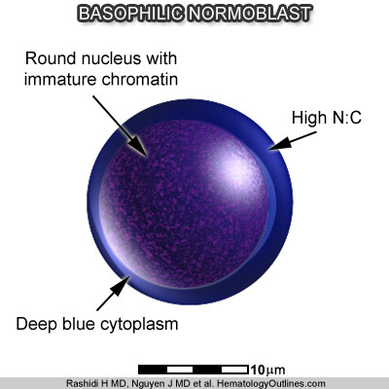
2- Basophilic normoblast (basophilic erythroblast).
__This cell may smaller than the pronormoblast, and
__the chromatin of the nucleus is coarser.
__The cytoplasm of the basophilic normoblast also stains a deep blue with Wright's stain and
__life span 0.8 day.
What distinguishes this cell from the pronormoblast is the absence of nucleoli in the nucleus

Slide 8
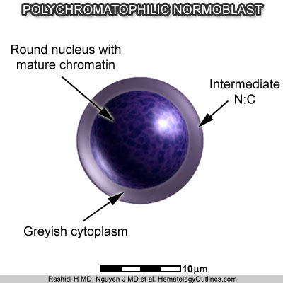
3- Polychromatophilic normoblast (polychromic erythroblast).
__This cell is usually smaller than the previous two cell types, having a diameter of about 10 µm.
__This is the stage in which the hemoglobin appears for the first time in the cytoplasm and
__life span 1.3 days.

Slide 9
It can be easily distinguished from the basophilic normoblast by two major changes.
First, the nucleus! Is much more condensed and stains much darker.
Second, the cytoplasm is no longer deep blue but appears much paler and shows a variable mixture of pink and blue, when stained with Wright's stain.

Slide 10
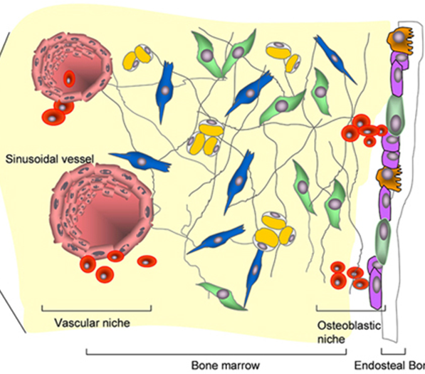
4- Orthochromic normoblast (or pyknotic erythroblast). --It is called "orthochromic" since the cytoplasm is now almost completely pink, and practically all traces of blue have disappeared. --The other distinguishing feature of this cell is the shape and size of the nucleus. The nucleus appears as a dense blue-black sphere, is known as a pyknotic nucleus.
__ At the end of this phase, the nucleus is extruded, and the cell enters the circulation by squeezing itself through an opening in the endothelial lining of the bone marrow sinusoid .
__ The nucleus is then phagocytosed and digested by one of the bone marrow macrophages and life span 2 days.

Slide 11
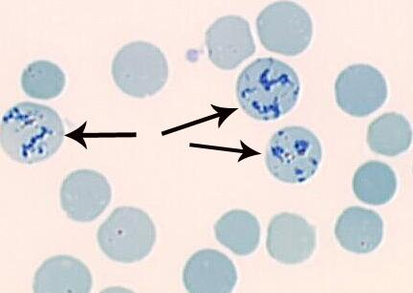
5- Reticulocyte. It is given this name because when stained with supravital dyes, a reticular network of strands can be observed inside the cell. These threads are remnants of RNA strands. This threadlike material disappears in a day or two, and the fell now becomes a fully mature red blood cell. The reticulocyte is slightly larger and less regular in shape than the erythrocyte.

Slide 12
6- Erythrocyte (RBC).
__The maturation of a reticulocyte to an adult erythrocyte takes about 24 to 48 hours.
__In the course of maturation, the ribosomes and mitochondria disappear, and the cell loses its capacity for hemoglobin synthesis and oxidative metabolism.
__The maturing red blood cell enters the circulation as a reticulocyte.
__ and life span 120 days

Slide 13
Q/ What is the importance of the reticulocyte level in the blood?
The reticulocyte level of the blood is the most common clinical index used to measure erythropoietic activity.
Under normal conditions approximately 1% of the red blood cells need to be replacing each day.

Slide 14
Regulation of erythropoiesis
Red Blood Cell Production.
The rate of new red blood cell (RBC) production varies according to the rate of
1- red blood cell destruction and
2- tissue oxygen requirements.
Changes in the oxygen delivery to tissue are sensed by peritubular interstitial cells, fibroblast-like cells in the kidney.

Slide 15
A decrease in the oxygen content of hemoglobin (pulmonary dysfunction ) ,
the hemoglobin level (anemia) , or
the hemoglobin affinity for oxygen will stimulate an increased production of erythropoietin by renal interstitial cells, initiate transcription of erythropoietin by a single gene on chromosome 7.

Slide 16
Erythropoietin then travels to the marrow, where it binds to a specific receptor (EPOR) on the surface of committed erythroid precursors. Within hours, there is a detectable increase in (DNA) synthesis.
This is followed by proliferation and maturation of committed stem cells to produce an increased number of new red blood cells.

Slide 17
The full marrow response takes several days. Given a sustained increase in erythropoietin stimulation, a rise in the reticulocyte index will not occur for 4-5 days and a detectable increase in hematocrit will take a week or more.

Slide 18
Factors Influencing Erythropoietin Level Although the erythropoietin response is primarily a function of
1- the severity of anemia or hypoxia,
2- the erythroid marrow mass

Slide 19
3- Inflammatory cytokines, play a role in regulating erythropoietin production. including
IL-1 (interleukin- 1)
IL-3
IL-4
IL-6
(TNF- a ) Tumor Necrosis Factor
(PDC1F) Platelet-Derived growth factor
Transforming Growth Factor B

Slide 20
4- Therefore, with aplastic anemia, extremely high levels of serum erythropoietin reflect both an increased production and a decreased clearance, and therefore, a higher serum level.
5- In contrast, with chronic hemolytic anemias, the expansion of marrow erythroid precursors results in a more rapid clearance of erythropoietin from circulation and, therefore, a lower serum level.

Slide 21
6- Two other factors, angiotensin II and insulin-like growth factor-I (IGF- 1 )
7- Finally, direct suppression of the erythroid marrow response is seen in patients receiving certain drugs (chemotherapeutic agents, cyclosporin A, and theophylline) or who are infected with human immunodeficiency virus (HIV ) .

