Slide 1
Red blood Cell Inclusions & Shapes

Slide 2
The principles of laboratory hematologic diagnosis is the complete blood count and review of the peripheral smear.
In patients with anemia, the peripheral smear permits interpretation of diagnostically significant red blood cell (RBC) findings.

Slide 3
These include assessment of RBC shape, size, color, inclusions, and arrangement. Abnormalities of RBC shape and other RBC features can provide key information in establishing a differential diagnosis.

Slide 4
Red blood cell inclusion bodies are pieces of stainable material within red blood cells, mainly due to retained remnants of cellular components.

Slide 5
Red Cell Inclusions
Howell-Jolly Bodies
Howell-Jolly bodies are small, spherically shaped nuclear remnants, about 0.5 μm in diameter that have the color of a pyknotic nucleus on Wright-stained films.

Slide 6
They are characteristically present in the blood of splenectomized persons and in patients suffering from megaloblastic anemia, and hyposplenic states.

Slide 7
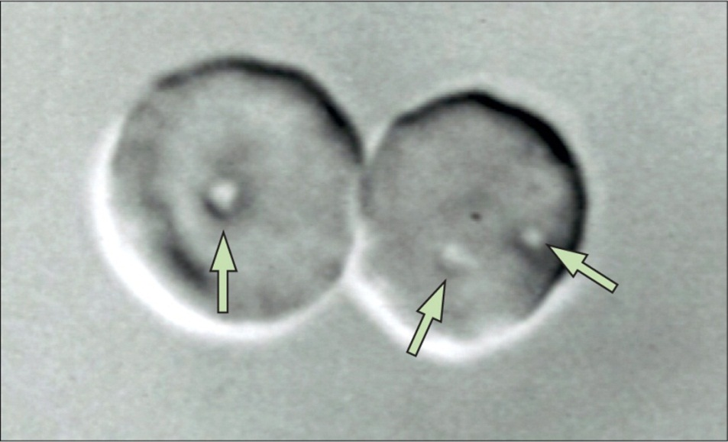
Pocked (or Pitted) Red Cells
Pocked red cells appear to have surface membrane pits or craters. The pits represent autophagic vacuoles adjacent to the cell membrane. Within 1 week following splenectomy, pocked red cell counts begin to rise, reaching a plateau at 2 to 3 months. Pocked red blood cell counts sometimes are used as a surrogate test for splenic function.

Slide 8
Basophilic Stippling
Basophilic stippling consists of granulations of variable size and number that stain deep blue with Wright stain.
Basophilic Stippling represents aggregated ribosomes. The clumped ribosomes may include degenerating mitochondria and siderosomes.

Slide 9
In conditions such as lead intoxication, pyrimidine 5′-nucleotidase deficiency, and thalassemia.

Slide 10
Heinz Bodies
Heinz bodies are composed of denatured proteins, primarily hemoglobin, that form in red cells as a result of chemical insult;
in hereditary defects of the hexose monophosphate shunt;
in the thalassemia.

Slide 11
Heinz bodies are readily visible in red cells stained supravitally with brilliant cresyl blue or crystal violet.

Slide 12
Hemoglobin H Inclusions
Hemoglobin H is composed of β4 tetramers, indicating that β chains are present in excess as a result of impaired α-chain production. Exposure to brilliant cresyl blue, methylene blue, or new methylene blue, results in denaturation and precipitation of abnormal hemoglobin.

Slide 13
These changes are seen most frequently in α-thalassemia but in rare patients with primary myelofibrosis who develop acquired hemoglobin H disease.

Slide 14
Siderosomes and Pappenheimer Bodies
Normal or pathologic red cells in blood containing siderosomes (iron bodies) usually are reticulocytes. Electron microscopy shows that many of siderosomes bodies are mitochondria containing ferruginous micelles rather than the ferritin aggregates characterizing normal siderocytes.
Siderosomes may contain degenerating mitochondria, ribosomes, and other cellular remnants.

Slide 15
Electron microscopy of Pappenheimer bodies shows that the iron often is contained within a lysosome, ferritin aggregates, or mitochondria or phagosomes containing aggregated ferritin.

Slide 16
Structure And Shape Of Erythrocytes
The normal resting shape of the erythrocyte is a biconcave disc.
Variations in the shape and dimensions of the red cell are useful

Slide 17
Spherocytes and Stomatocytes
Spherocytes represent red cells, with the most decreased SA:V ratio seen in
hereditary spherocytosis,
immune hemolytic anemia, stored blood,
Heinz body hemolytic anemia, and caused by cell fragmentation.

Slide 18
Stomatocytes (mouth-like) are seen in
hereditary stomatocytosis,
hereditary spherocytosis,
alcoholism,
cirrhosis, obstructive liver disease, and
erythrocyte sodium pump defects. As a result, they are less deformable and more osmotically fragile.

Slide 19
Elliptocytes (oval cells)
In normal subjects, elliptical cells usually less than 1 percent of the erythrocytes.
In various pathologic situations, the number of elliptocytes can increase to 10 or 50 percent.
Elliptocytes are seen in
hereditary elliptocytosis
in thalassemia,
iron deficiency, and
megaloblastic anemia.

Slide 20
Acanthocytes and Echinocyte (Bur red cells)
The acanthocyte is irregularly shaped, with two to 10 spicules of variable length and diameter. The bases of the spicules on the acanthocyte are of varying diameters, unlike the spicules on echinocytes, which have remarkably uniform dimensions.
Acanthocytes are seen in
neuroacanthocytosis and in a
betalipoproteinemia.

Slide 21
Target Cells (Codocytes)
increased membrane SA:V ratio results in target cells and are osmotically resistant. Target cells may be seen in
obstructive liver disease,
hemoglobinopathies (S and C),
thalassemia,
iron deficiency,
Post-splenectomy, and
lecithin cholesterol acetyltransferase deficiency.

Slide 22
Sickle Cells (Drepanocytes)
The fusiform cell in the crescent shape with two pointed tips is encountered most commonly in deoxygenated blood samples as a result of polymerization of sickle hemoglobin (HbS).
After reoxygenation, the sickle cell return to the normal form.

Slide 23
Fragmented Cells (Schistocytes)
Fibrin strands in damaged blood vessels can be arranged, they filter the passing red cells and stretches it, and led to fragmentation of RBC.

Slide 24
Fragmented Cells (Schistocytes)
Schistocytes are seen in
microangiopathic hemolytic anemias (thrombotic thrombocytopenic purpura [TTP],
disseminated intravascular coagulation [DIC],
vasculitis,
glomerulonephritis,
renal graft rejection),
carcinomatosis,
heart valve hemolysis,
severe burns, and
march hemoglobinuria.

