Slide 1
Chordata & Comparative anatomy
Dr. Sarbaz I. Mohammed

Slide 2
Terminology

Slide 3
Biodiversity found on Earth today consists of many millions of different biological species, the product of four billion years of evolution.
The average half-life of a species is around one million years and 99% of the species that have ever lived on earth are today extinct.
1- Genetic diversity - within a species
2- Species diversity - diversity among species
3- Ecosystem diversity - diversity at a higher level of organization, the ecosystem

Slide 4
 | Iraq |  | World
 | Total No. of species | No. of threatened species | Total No. of species | No. of threatened species
Mammals | 81 | 11 | 5801 | 1220
Birds | 417 | 20 | 11126 | 1492
Reptiles | 99 | 2 | (10793) 7541 | 1367
Amphibian | 11 | x | (8043) 6771 | 2157
Fish | 331 (86) | 2 | (34200) 18449 | 2494
Total | 939 | 35 | (69963) 49688 | 8730

Slide 5
Chordates are organisms that possess a notochord structure, at least during some part of their development.

Slide 6
Comparative anatomy:
The study of the inherited similarities and differences among organisms in the structural organization of the body.
Comparing anatomical features of different organisms often provides evidence to support the theory of evolution.
Or Comparative anatomy is the study of the evolution of the complex morphological systems possessed by vertebrates.

Slide 7
Biologists attempt to classify living things according to their evolutionary relationships.
Classification system. Classification involves the recognition of species and the placing of species in a system of higher categories (taxa) that reflect phylogenetic relationships.
1- Systematics- The first step in classification is the grouping together of related forms.
Simpson (1961) defined systematics as, [the scientific study (morphology, embryology, physiology, ecology, and genetics) of the kinds and diversity of organisms and all relationships among them]
2- Taxonomy- The second step is the application of names to the groups. Concerned with applying names to each of the different kinds of organisms.

Slide 8
Thus,
Systematics is the scientific study of classification, whereas
Taxonomy is the business and laws of classifying organisms.
As a result, the classification of organisms is based primarily on the presence of similarities and differences among groups of living organisms.
These relations reflect genetic similarities and differences, and in turn these reflect evolutionary origins.

Slide 9
Scientific classification ·
- Kingdom: Animalia.
- Phylum: Chordata.
-Class: Mammalia.
-Order: Rodentia.
- Family: Muridae.
- Genus: Rattus.
- Species: R. norvegicus.
Binomial name. Rattus norvegicus. (Berkenhout, 1769).

Slide 10
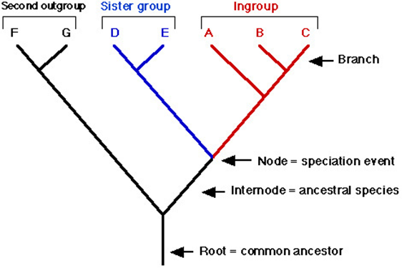
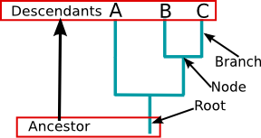
Phylogenetics is a branch of biology that deals with studying and determining the evolutionary relationships, (or patterns of descent,) of groups of organisms.

Slide 11
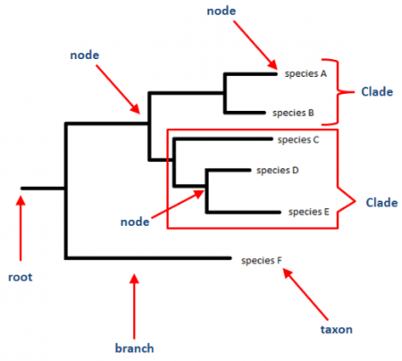

Slide 12
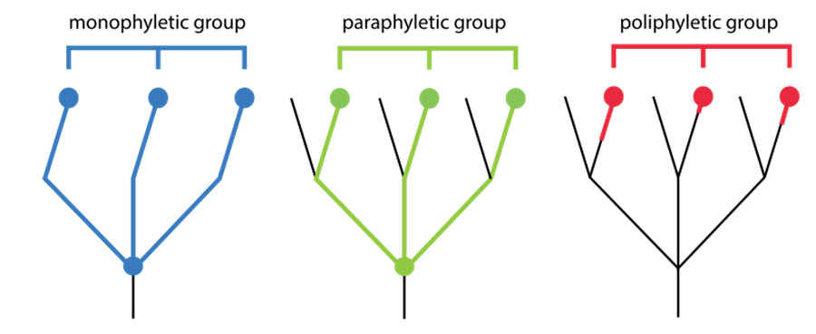
There are three types of phylogenetic groups:
Monophyletic group: Includes an ancestor and all of its descendants
Paraphyletic group: Includes an ancestor but only some of its descendants
Polyphyletic group: Includes various organisms with no recent common ancestor

Slide 13
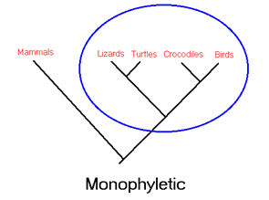
A monophyletic groups (Clade), which include all species derived from one common ancestor (For example, turtles, lizards, crocodilians and birds are all derived from a shared common ancestor) e.g.
All vertebrates are derived from one ancestor,
All mammals from common ancestor).

Slide 14
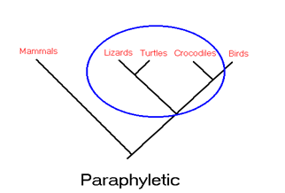
A Paraphyletic groups, which include some species derived from one common ancestor, but not all species derived from that common ancestor are included
(for example, grouping turtles, lizards and crocodiles as "reptiles" and separating that grouping from the birds).

Slide 15
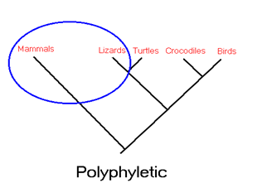
Polyphyletic groups, is taxonomic group that contains organisms evolved from different ancestors.
For example, the group of warm-blooded animals is polyphyletic, because it contains both mammals and birds, but the most recent common ancestor of mammals and birds was cold-blooded.
Warm-bloodedness evolved separately in the ancestors of mammals and the ancestors of birds.

Slide 16
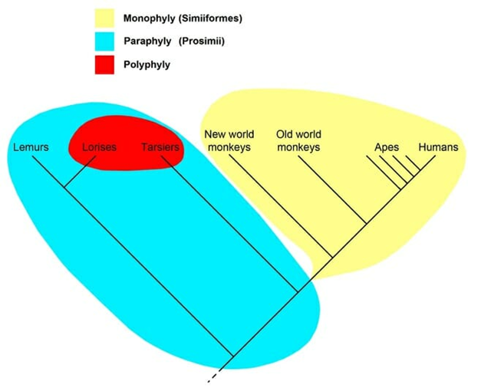

Slide 17
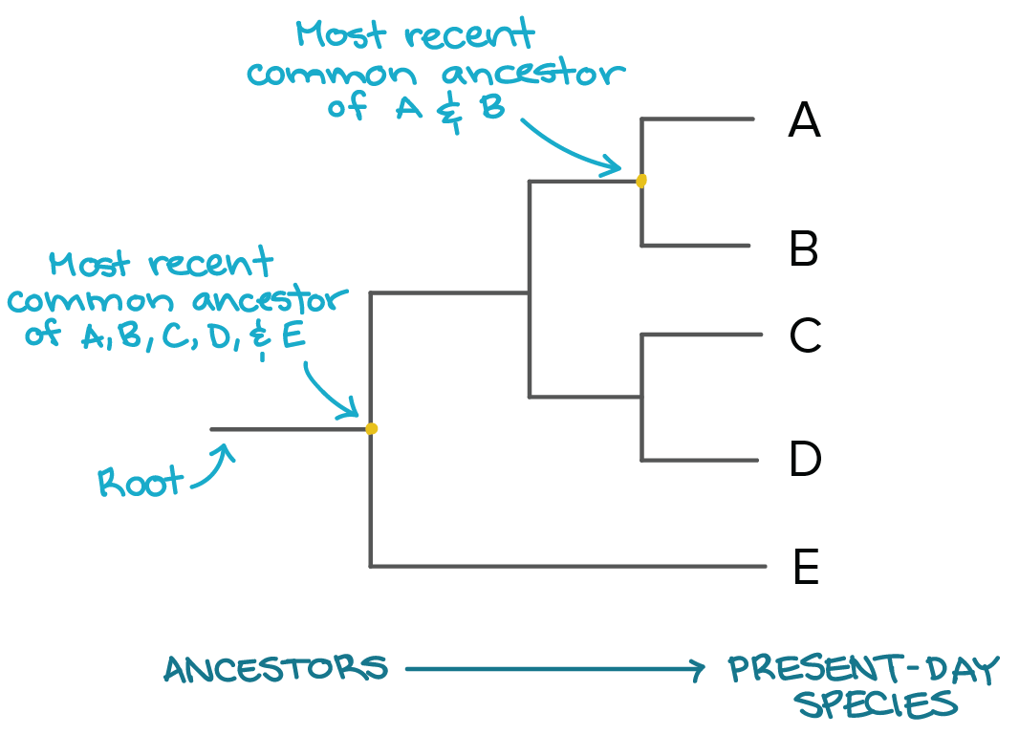
Phylogenetic trees compare organisms over evolutionary time and the amount of change that has occurred over time to figure out the relationships.

Slide 18
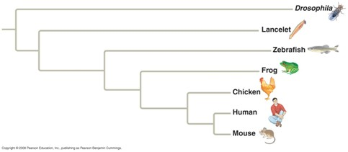
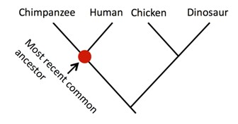
Phylogeny tree
Cladogram

Slide 19
Chordates are organisms that possess a notochord structure, at least during some part of their development.
Anatomy: The study of the body's structures of living things that are easily viewed by the naked eyes.
Comparative anatomy: Is the study of the inherited similarities and differences among organisms in structural organization of the body.

