Slide 1
Chordata & Comparative anatomy
Dr. Sarbaz I. Mohammed

Slide 2
Analogous structure: Are structures that have the same function, but not the same origin. E.g. wings are analogous structures in insects and birds.
Homologous structure: Are structures that have the same origin, but not the same function. E.g. vertebrate forearms, human appendix and tails of mammals vs. human coccyx.
Vestigial organs (Structure) are reduced and rudimentary organs compared to the same structure in other organisms. E.g.
Human appendix and tailbones are useless.

Slide 3
Histology- also known as microscopic anatomy or microanatomy is the branch of biology which studies the microscopic anatomy of tissues.
Cytology - a branch of biology dealing with the structure, function, multiplication, pathology, and life history of cells.
Ancestral is a character that was possessed by the common ancestor of the species on a branch of an evolutionary tree.
Evolution is genetic change in a population of organisms over time.

Slide 4
Natural Selection is a processes that produces descent (offspring) with modification, or evolution.
Adaptation: - Processes that increase an organism's chances of survival and reproductive success in specified environment.
Species; - is a group of organisms (population) that can reproduce naturally with one another and create fertile offspring

Slide 5
Ontology: - Evolutionary history of the development, of the individual organisms.
Protostomes; - in which the blastopore first gives rise to the mouth)
Deuterostomes in which the blastopore first gives rise to the anus, and the mouth arises through secondary invagination of the stomodaeum.

Slide 6
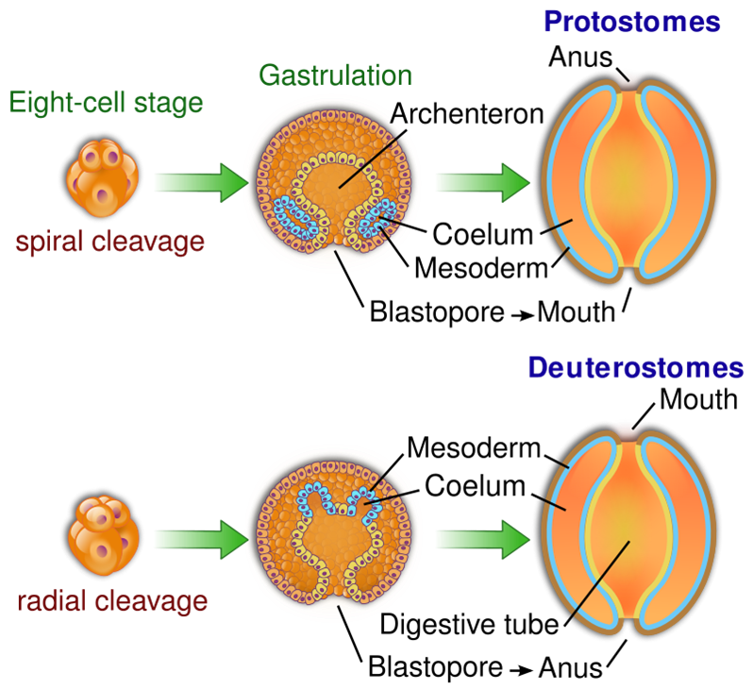

Slide 7
Type specimens should be placed in permanent archival collections (museum) where they can be examined by future researchers.
Holotype - is the original specimen used to describe a new species for the first time. There is only one holotype (single example illustration of an organism). Sometimes just a fragment of an organism is the holotype
Allotype - is a specimen of the opposite sex used to describe the species for the first time (often, but not always, at the same time as the holotype recorded).

Slide 8
Neotype - is a replacement specimen for the holotype, where the original holotype has been lost, destroyed or was never designated.
Paratype - is a specimen of the original series from which holotype, has been selected as the type of a species.
Syntype (Cotype) is a collection of specimens that together serve as the definition of the species where a holotype was never selected.
Isosyntype: - A duplicate of a syntype.

Slide 9
Lectotype - is a single specimen of a syntype (series of specimens) selected to serves as the neotype of the species, where the species was previously defined by the syntype.
Paralectotype - are the specimens left over from the syntype once the lectotype have been selected.
Topotype - A specimen of a plant collected from the same locality as the holotype and usually on a different date.

Slide 10
International Union for Conservation of Nature (IUCN) (1996). IUCN Red List
EX | Extinct | No reasonable doubt that the last individual has died.
EW | Extinct in the wild | It is a group of plants or animals only to survive in captivity.
CR | Critically endangered | The species is at imminent (immediate) risk of extinction in the wild.
EN | Endangered | The species is facing an extremely high risk of extinction in the wild.
VU | Vulnerable | The species is facing a high risk of extinction in the wild.
NT | Near Threatened | as that may be threatened in the near future, but it does not currently qualify for the threatened status
LC | Least concern | There are no current identifiable risks to the species.
DD | Data Deficient | There is inadequate information to assess the risks to this species.

Slide 11
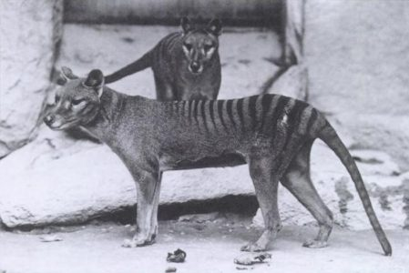
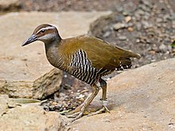
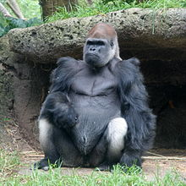
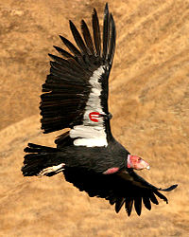
Tasmanian Tiger had been extinct since 1936 after the last known individual had died in Hobart Zoo, Tasmania.
The Guam rail (Kako) disappeared from southern Guam in the early 1970s and was extinct from the entire island by the late 1980s. This species extinct in wild, now being bred in captivity by the Division of Aquatic and Wildlife Resources on Guam and at some mainland U.S.
The California condor is an endangered species.
Western gorilla
Critical endangered

Slide 13
Comparative anatomy established by:
Edward Tyson (1651-1708) Scientist & physician
Georges Cuvier (1769-1832) Paleontology
Lamark (1744-1829) Zoology
Richard Owen (1804-1892) Anatomy
Louis Agassiz (1807-1873) Paleontology
Charles Darwin (1809-1882) Geology & Zoology
Alfred Russel (1823-1913) Zoology
Thomas Henry (1825-1895) Zoology

Slide 14
Thanks

