Slide 1
Organic poultry production
PROF. DR. SARDAR YASEEN ALSARDARY
ANIMAL RESOURCE DEPT.
College Of Agriculture Engineering Sciences
sardar.alsardary@su.edu.krd
2022-2023

Slide 2
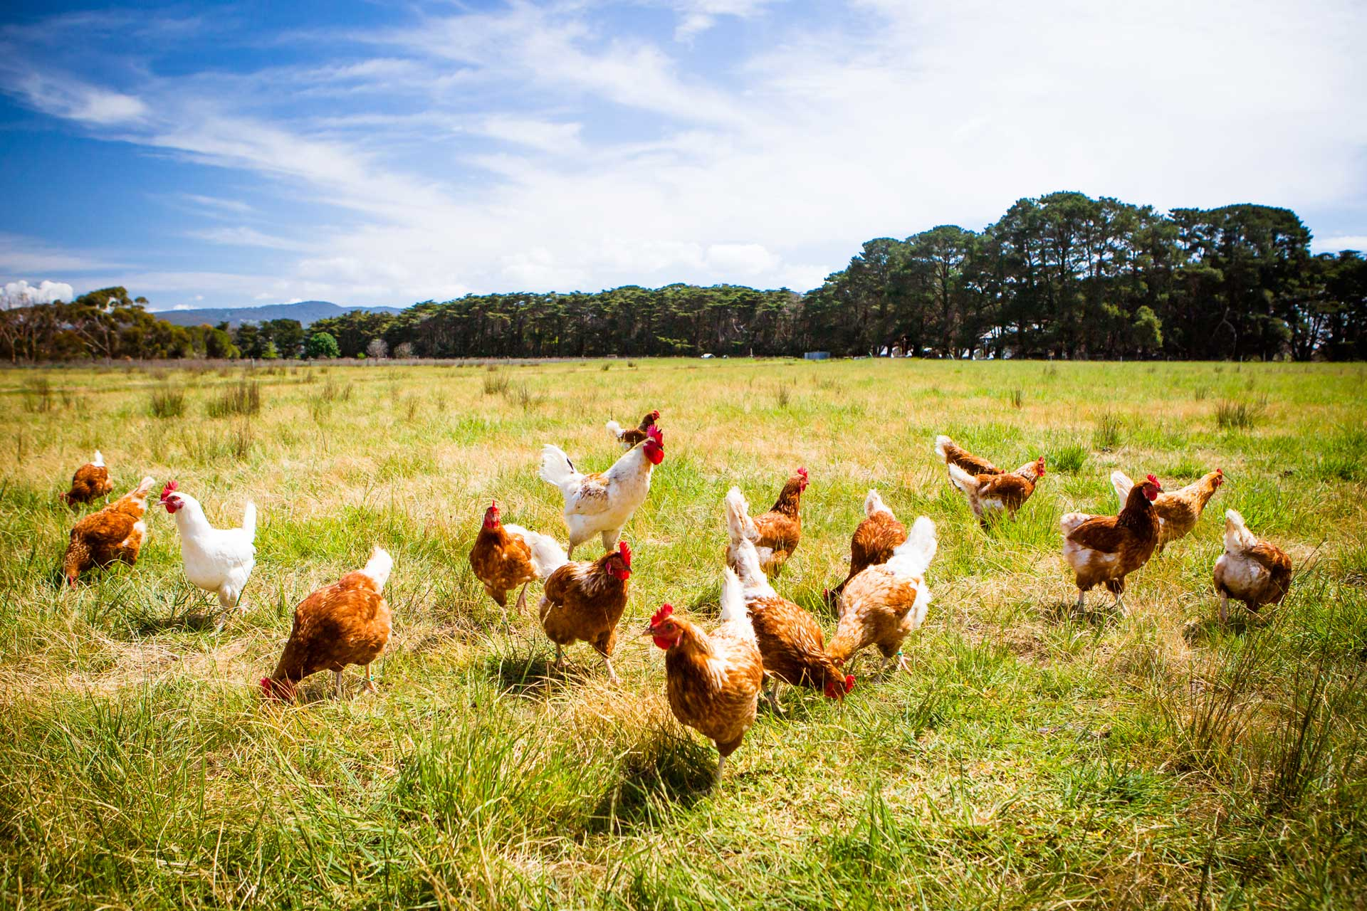

Slide 3
Introduction
What image does the phrase “organic poultry production” conjure up in the mind of the American consumer? Many people are likely to imagine idealized happy hens on verdant pastures (like the pictures in this article). Perceptions of organic production system practices may overlap, and descriptions blur with less rigorous marketing terms, such as “cage-free,” “free-range,” and more rigorous “humane,” and “raised on pasture,” to name just a few. Many branding terms (paired with clever packaging and graphics) vie for customer attention in the marketing of poultry products. The complexity of terms and standards can confuse or even mislead the uniformed consumer.

