Slide 1
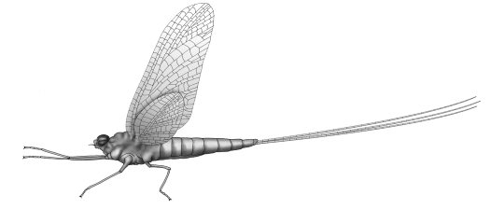
University of Salahaddin Department of Biology 3rd Class Year
ENTOMOLOGY
Entomology
lab1
Insect Relatives-Arthropoda

Slide 2
Characteristics and Classes of Arthropods
Kingdom Animalia
Mollusca (snails, squids)
Porifera (sponges)
Cnidaria (jellyfish, corals)
Platyhelminthe (flatworms, tapeworms)
Nematoda (roundworms)
Annelida (earthworms)
Echinodermata (spiny, starfish)
Chordata
vertebrates, fish
Arthropoda (insects, spiders)
Notes:
Porifera—sponges,
Cnidaria—jellyfish, sea anemones,
Platyhelminthes—flatworms, tapeworms
Nematoda—roundworms
Annelida—segmented worms (earthworms)
Mollusca—shelled animals, snails & slugs, squids
Arthropoda—insects, spiders
Echinodermata—spiny-skinned
Chordata—vertebrates, fish, amphibians, reptiles, birds, mammals

Slide 3
Characteristics of Arthropods
The Arthropoda (from the Greek Arthron, joint and podus, foot) are the largest group of organisms and they occur in all environments on earth.
The group includes: spiders, ticks, mites, centipedes, millipedes, crustaceans, insects and others.
The segmented bodies are arranged into regions, called tagmata (e.g., head, thorax, abdomen). Some have a cephalothorax (head and thorax are fused together).
The paired appendages (e.g., legs, antennae) are jointed.
They posses a chitinous exoskeletons for support and protection ,that must be shed during growth.
Notes:
(arthropod means "jointed foot")

Slide 4
Characteristics of Arthropods
They have bilateral symmetry.
Arthropods use either gills, tracheal tubes, or book lungs for gas exchange.
Arthropods use either coxal or green gland and malpighian tube for excretion.
Acute senses include simple and compound eyes, brains, and many ganglia.
They have open circulatory systems, complete digestive system.
Muscular system is complex and muscles attach to the exoskeleton.
Arthropods reproduce sexually, but some exhibit parthenogenesis.
Notes:
Parthenogenesis: virgin birth

Slide 5
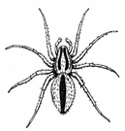
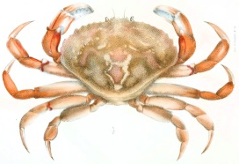
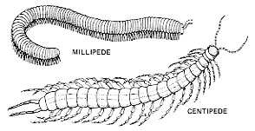
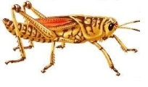
Classes of Arthropods
Class: Arachnida
Class: Crustacea
Class: Myriapoda (Chilopoda and Diplopoda)
Class: Insecta (hexapoda)

Slide 6
Class Arachnida
Spiders, scorpions and mites belong to this class.
Spiders are the largest group of arachnids.
Most arachnids have only 2 body regions- a cephalothorax and the abdomen.
Most arachnids have 4 pairs of legs.
Arachnids have 2 chelicerae for poisoning prey and 2 pedipalps for sensing and handling food.
4 remaining appendages aid in locomotion.
no Antennae
Notes:
aráchnē), meaning "spider”
In some, the first pair of legs may be used for holding their prey and feeding. Unlike other arthropods, arachnids do not have antennae.

Slide 7
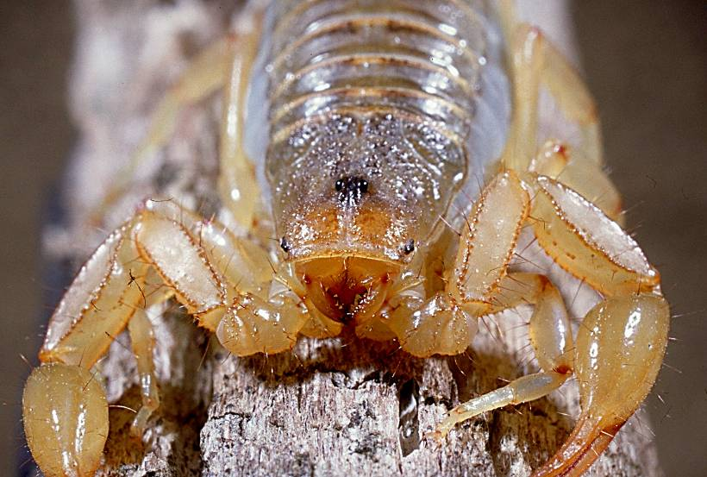
chelicerae
eyes
pedipalp
Notes:
7

Slide 8
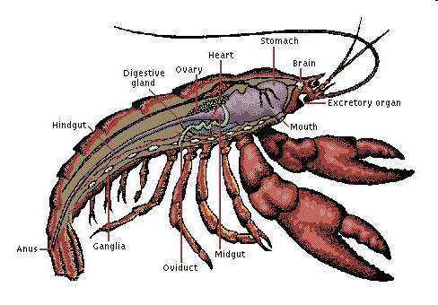
Class Crustacea
Most crustaceans are aquatic and use gills for gas exchange.
2 pairs of antennae for sensing.
Mandibles for crushing food that move side to side.
Many have five pairs of walking legs used for seizing prey and cleaning other appendages.
First pair is often modified into strong claws.
Crabs, lobster, shrimp

Slide 9
Class Chilopoda and Diplopoda
Centipedes belong to class Chilopoda and millipedes belong to class Diplopoda.
Centipedes are carnivorous and eat soil arthropods, snails, slugs, and worms.
Centipedes have one pair of legs per visible segments
Centipede bites are painful to humans (poisonous glands) .
Both have Malpighian tubes for waste excretion.
Both have tracheal tubes for gas exchange.
Millipedes eat mostly plants and dead material.
Millipede have two pairs of legs per visible segments
Millipedes also have stink glands for scaring predators (irritation).

Slide 10
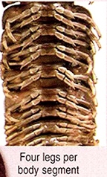
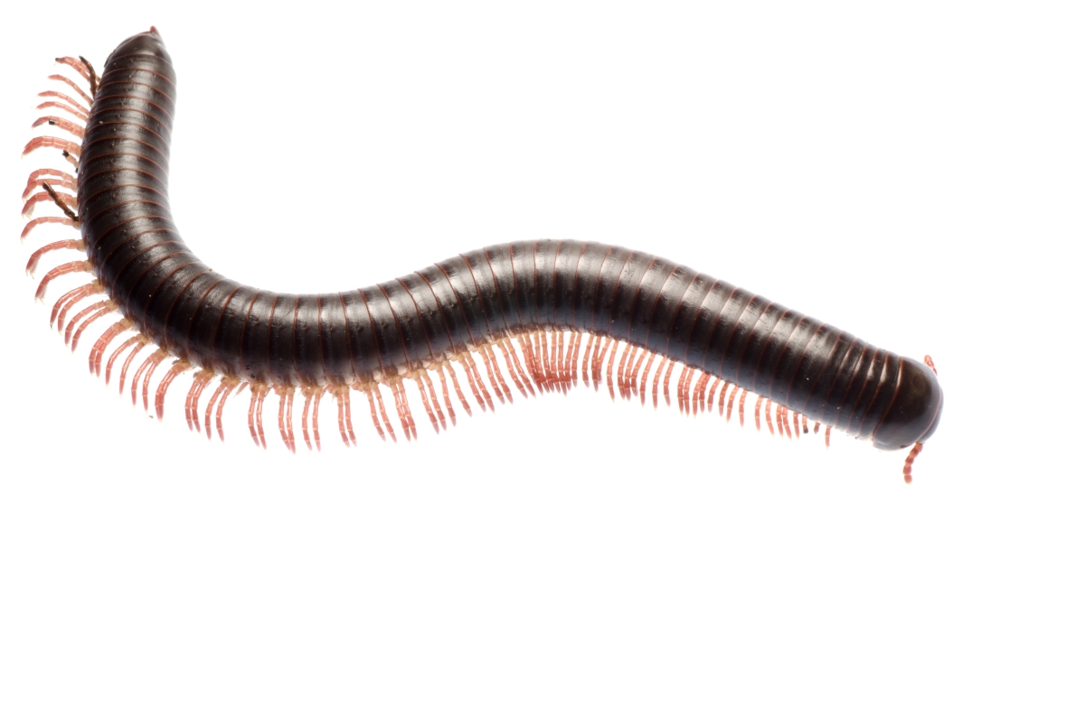
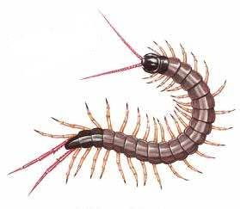
Class: Chilopoda centipedes
Class: Diplopoda
Milllipedes
two pairs of legs
one pairs of legs

Slide 11
Class Insecta (hexapoda)
3 body parts: head, thorax, abdomen
3 pairs of legs on the thorax (fore, mid and hind legs)
1 or 2 pairs of wings on the thorax (fore and hind wings
1 pair of antennae
Life cycle has either incomplete or complete metamorphosis

Slide 12
Class insecta

