Slide 1
University of Sallahadin
College of Engineering
Electrical Engineering Dept.
Renewable Energy
First Lecture Introduction
By:
Sarkar Jawhar
MSc in Electrical Engineering

Slide 2
Contents of This Lecture
Introduction to Renewable Energy
Energy sources
Fossil energy
Advantages and Disadvantages of renewable energy
Natural energies on earth
Estimated Renewable Energy Share
Methods for matching RE supply to end use
Categories of Control

Slide 3
Renewable Energy
Renewable energy is the energy comes from sources that won’t run out.

Slide 4
Energy sources
Sun
The planetary gravitational interaction.
Geothermal energy.
Human induced nuclear reaction.
Chemical reactions from mineral sources.

Slide 5
Renewable Energies
- Solar
- Geothermal
- Hydro Power
- Energy from the Oceans: Tidal and wave
- Wind Power
- Biomass
- Fuel Cell
- Nuclear

Slide 6
Fossil energy
Fossil fuels are fuels formed by natural processes from fossilized remains of prehistoric plants.
Coal
Oil.
Natural Gas.
The plants became buried deep under the land and sea, slowly turning into coal, oil and gas over millions of years.
The burning of fossil fuels by humans is the largest source of carbon dioxide

Slide 7
Why do we need renewable energy?
These ‘fossil fuels’ are running out.
Burning them to provide energy also releases gases that contribute to climate change and pollution.
Renewable sources of energy don’t run out or pollute the environment.

Slide 8
Advantages of renewable energy
Renewable energy will never run out.
Renewable energy facilities generally require less maintenance than traditional generators. This is means the reduce of operation costs.
Renewable energy has minimal impact on the environment.
Renewable energy projects can also bring economic benefits to many regional areas, as most projects are located away from large cities.

Slide 9
Disadvantages of renewable energy
Reliability of Supply: One shortcoming is that renewable energy relies heavily upon the weather for sources of supply: rain, wind, and sunshine.
Difficult to Generate in Large Quantity.
Large Capital Cost:
Large area of Land Required: To meet up with the large quantities of electricity produced by fossil fuels, large amount of solar panels and wind farms need to be set up.

Slide 10
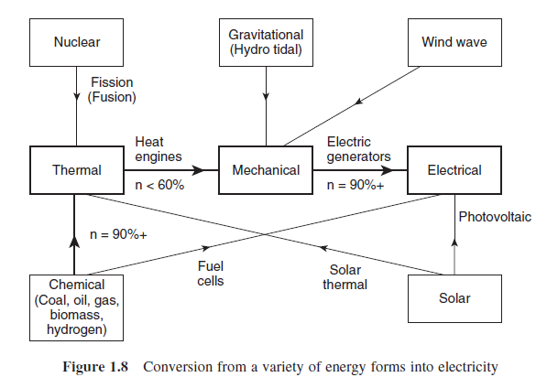
Natural energies on earth

Slide 11
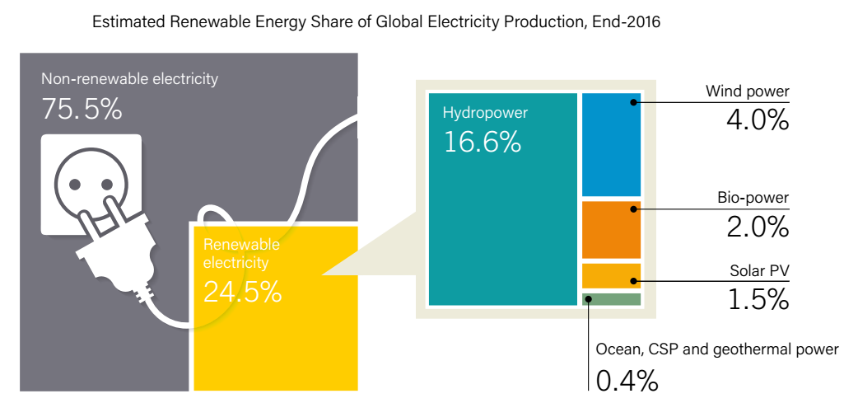
Estimated Renewable Energy Share

Slide 12
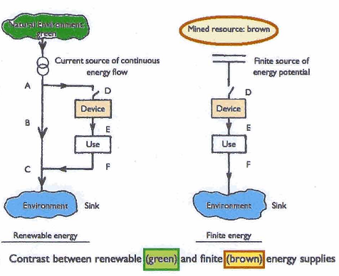
Comparison between flow of energies

Slide 13
Energy flow to end use

Slide 14
Divisions of Renewable Energies
1. Mechanical:
Hydro
Wind
Wave & tidal power
2. Thermal:
Geothermal
Biomass
Solar collectors
3. Radiation:
Photovoltaic
Nuclear

Slide 15
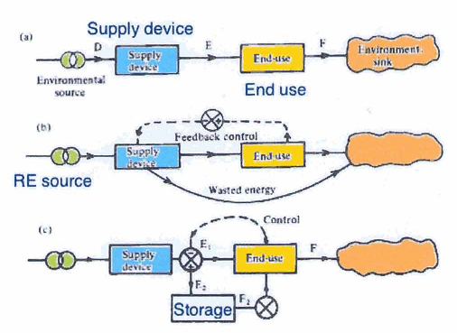
Methods for matching RE supply to end use

Slide 16
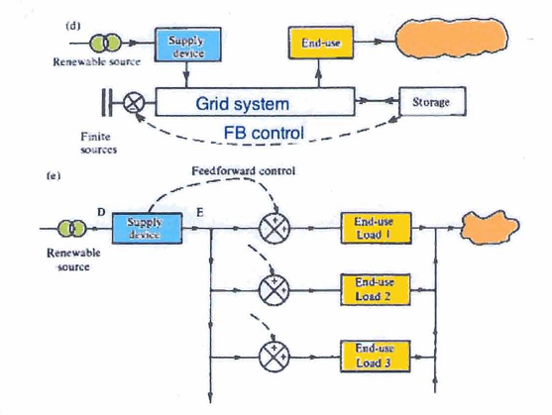
Methods for matching RE supply to end use

Slide 17
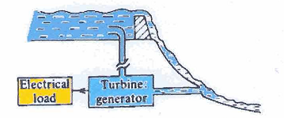
Categories of Control
1. Disposal of excess energy

Slide 18
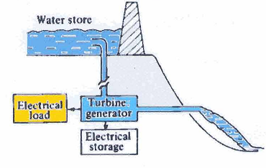
Categories of Control
2. Implementing energy storage

Slide 19
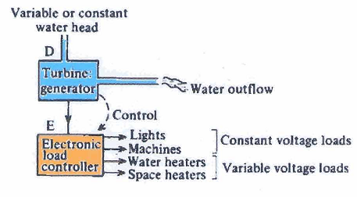
Categories of Control
3. Incorporate control of load management

Slide 20
Next Lecture
Environmental Aspects of Power Generation

