Slide 1
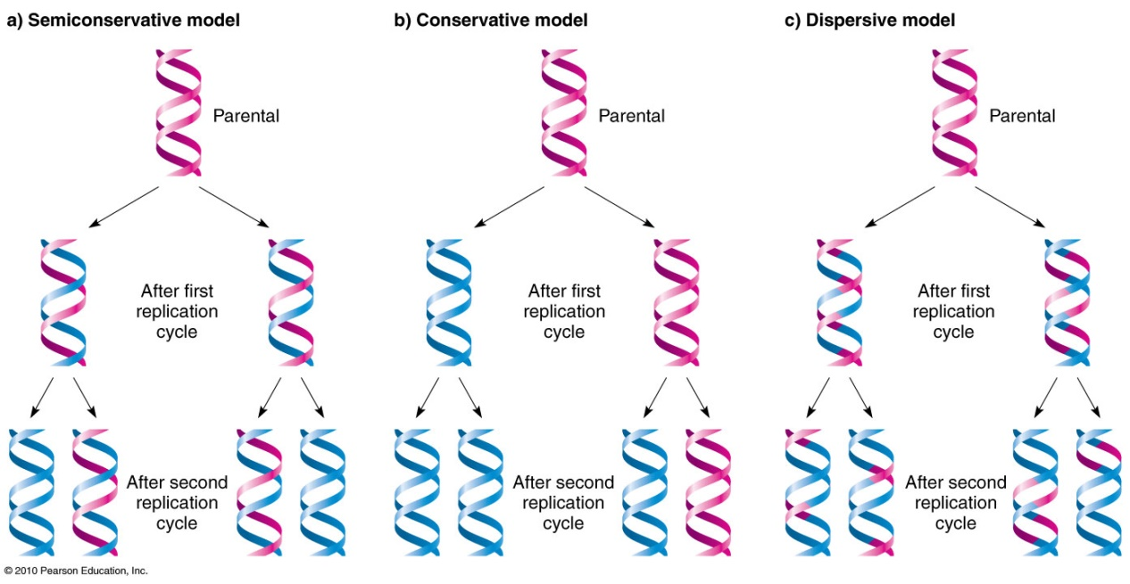
Possible Models for DNA Replication

Slide 2
In the semi-conservative model, the two parental strands separate and each makes a copy of itself. After one round of replication, the two daughter molecules each comprises one old and one new strand. Note that after two rounds, two of the DNA molecules consist only of new material, while the other two contain one old and one new strand.
In the conservative model, the parental molecule directs synthesis of an entirely new double-stranded molecule, such that after one round of replication, one molecule is conserved as two old strands. This is repeated in the second round.

Slide 3
In the dispersive model, material in the two parental strands is distributed more or less randomly between two daughter molecules. In the model shown here, old material is distributed symmetrically between the two daughters molecules. Other distributions are possible.
The semi-conservative model is the intuitively appealing model, because separation of the two strands provides two templates, each of which carries all the information of the original molecule. It also turns out to be the correct one (Meselson & Stahl 1958).

Slide 4
Definition of gene
a specific sequence of nucleotides in DNA that is located usually on a chromosome and controlling the transmission and expression of one or more traits by specifying a particular polypeptide and especially a protein or controlling the function of other genetic material .
It normally codes for a type of protein or for an RNA chain that has a function in the organism.

Slide 5
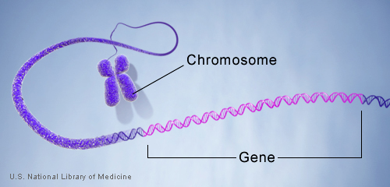
A structural gene is a gene that codes for any RNA or protein product other than a regulatory factor (i.e. regulatory protein). It may code for a structural protein, an enzyme, or an RNA molecule not involved in regulation. Structural genes represent an enormous variety of protein structures and functions, including structural proteins, enzymes with catalytic activities and so on.

Slide 6
These genes are needed for the morphological or functional traits of the cell. In Eukaryotes, these occur in spilt-form, segmented into introns and exons. But Prokaryotes, these are continuous. The structural genes are concerned with the synthesis of polypeptide chain or a number of polypeptide chains and are also concerned with the synthesis of different types of RNA required during protein synthesis.

Slide 7
In the Lac-Operon concept, these genes are associated with the synthesis of those enzymes that are needed for the catabolism of Lactose. In lac-operon, there are three structural genes:
a. Lac Z gene for beta-galactosidase enzyme.
b. Lac Y gene for permease enzyme.
c. Lac A gene for trnsacetylase enzyme.

Slide 8
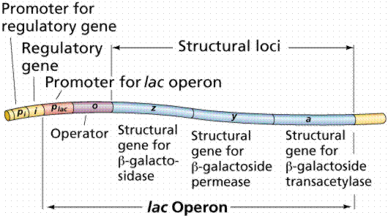
A regulator gene, regulator, or regulatory gene is a gene involved in controlling the expression of one or more other genes. Regulator genes often code for repressor proteins. Repressor proteins bind to operators, preventing RNA polymerase from transcribing RNA. Inducers cause repressor proteins to change shape or otherwise become unable to bind DNA, allowing RNA polymerase to continue transcription. Other regulatory genes code for activator proteins.

Slide 9
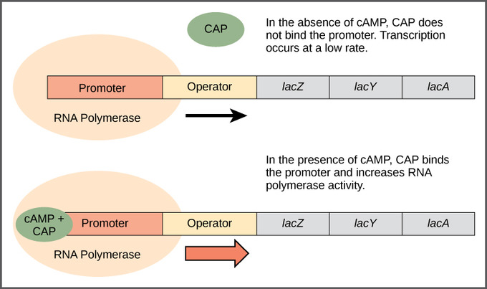
An activator binds to a site on the DNA molecule and causes an increase in transcription of a nearby gene. In prokaryotes, a well-known activator protein is the catabolite activator protein or CAP, involved in positive control of the lac operon.

Slide 10
Transcription: Synthesizing RNA
from a DNA Template
All cellular RNAs are synthesized from a DNA template through the process of transcription . Transcription is in many ways similar to the process of replication, but one fundamental difference relates to the length of the template used. During replication, all the nucleotides in the DNA template are copied, but, during transcription, only small parts of the DNA molecule— usually a single gene or, at most, a few genes—are transcribed into RNA.

Slide 11
Unlike replication, however, transcription typically takes place on only one of the two nucleotide strands of DNA.
Like replication, transcription requires three major
components:
1. a DNA template;
2. the raw materials (substrates) needed to build a new
RNA molecule; and
3. the transcription apparatus, consisting of the proteins
necessary to catalyze the synthesis of RNA.

Slide 12
The transcribed strand
The template for RNA synthesis, as for DNA synthesis, is a single strand of the DNA double helix. The nucleotide strand used for transcription is termed the template strand. The other strand, called the nontemplate strand, is not ordinarily transcribed. Thus, in any one section of DNA, only one of the nucleotide strands normally carries the genetic information that is transcribed into RNA.

Slide 14
???????????????????????????????

