Slide 1
Object Oriented Programming
Inheritance in C++
Safeen H. Rasool
Salahaddin University-Erbil College of Science, Computer Science Department
Second Year Students
Lecture (7) (Theoretical & Practical)

Slide 2
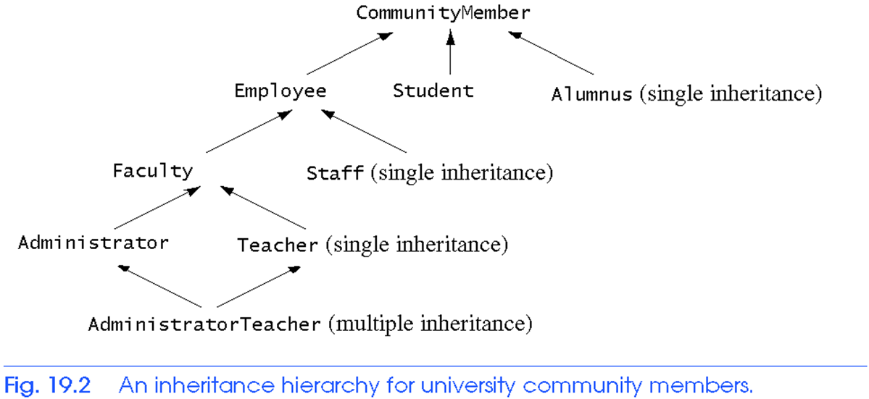
Base and Derived Classes

Slide 3
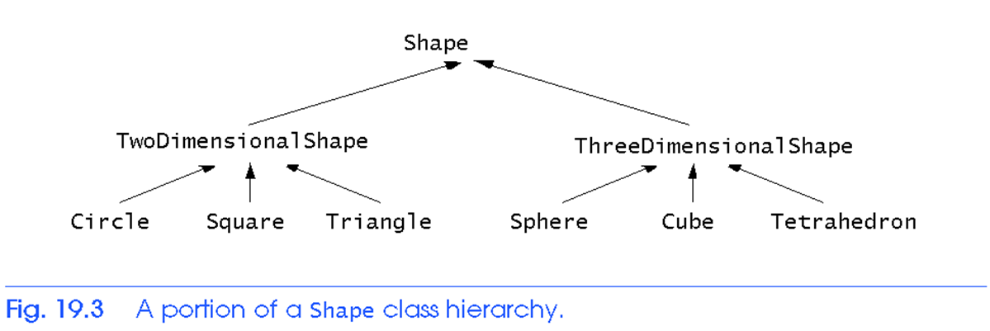
Base and Derived Classes

Slide 4
Inheritance Concept
class Rectangle{
private:
int numVertices;
float *xCoord, *yCoord;
public:
void set(float *x, float *y, int nV);
float area();
};
Polygon
Rectangle
Triangle
class Polygon{
private:
int numVertices;
float *xCoord, *yCoord;
public:
void set(float *x, float *y, int nV);
};
class Triangle{
private:
int numVertices;
float *xCoord, *yCoord;
public:
void set(float *x, float *y, int nV);
float area();
};

Slide 5
Inheritance Concept
class Polygon{
protected:
int numVertices;
float *xCoord, float *yCoord;
public:
void set(float *x, float *y, int nV);
};
Polygon
Rectangle
Triangle
class Rectangle{
protected:
int numVertices;
float *xCoord, float *yCoord;
public:
void set(float *x, float *y, int nV);
float area();
};
class Rectangle : public Polygon{
public:
float area();
};

Slide 6
Inheritance Concept
class Polygon{
protected:
int numVertices;
float *xCoord, float *yCoord;
public:
void set(float *x, float *y, int nV);
};
Polygon
Rectangle
Triangle
class Triangle{
protected:
int numVertices;
float *xCoord, float *yCoord;
public:
void set(float *x, float *y, int nV);
float area();
};
class Triangle : public Polygon{
public:
float area();
};

Slide 7
Inheritance Concept
class Point{
protected:
int x, y;
public:
void set (int a, int b);
};
Point
x
y
Circle
3D-Point
x
y
r
x
y
z
class Circle : public Point{
private:
double r;
};
class 3D-Point: public Point{
private:
int z;
};

Slide 8
Inheritance Concept
Augmenting the original class
Specializing the original class
Polygon
Point
Rectangle
Triangle
Circle
3D-Point
ComplexNumber
real
imag
RealNumber
ImaginaryNumber
imag
real

Slide 9
Why Inheritance ?
Inheritance is a mechanism for
building class types from existing class types
defining new class types to be a
specialization
augmentation
of existing types

Slide 10
Introduction
Inheritance
New classes created from existing classes
Absorb attributes and behaviors.
Polymorphism
Write programs in a general fashion
Handle a wide variety of existing (and unspecified) related classes
Derived class
Class that inherits data members and member functions from a previously defined base class

Slide 11
C++ Inheritance
In C++, inheritance is a process in which one object acquires all the properties and behaviors of its parent object automatically. In such way, you can reuse, extend or modify the attributes and behaviors which are defined in other class.
In C++, the class which inherits the members of another class is called derived class and the class whose members are inherited is called base class.
The derived class is the specialized class for the base class.

Slide 12
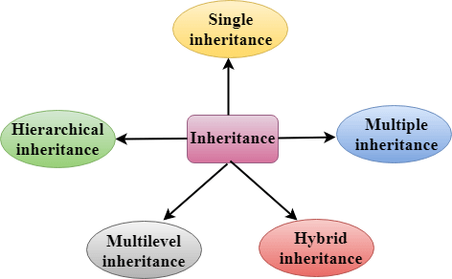
Types Of Inheritance
Single inheritance
Multiple inheritance
Hierarchical inheritance
Multilevel inheritance
Hybrid inheritance

Slide 13
Derived Classes
The Syntax of Derived class:
class derived_class_name :: visibility-mode base_class_name
{ // body of the derived class. }
derived_class_name: It is the name of the derived class.
visibility mode: The visibility mode specifies whether the features of the base class are publicly inherited or privately inherited.
It can be public or private.
base_class_name: It is the name of the base class.

Slide 14
visibility mode:
When deriving a class from a public base class,
public members of the base class become public members of the derived class and protected members of the base class become protected members of the derived class. A base class's
private members are never accessible directly from a derived class, but can be accessed through calls to the public and protected members of the base class.
When deriving a class from a private base class,
public members of the base class becomes the private members of the derived class.
Therefore, the public members of the base class are not accessible by the objects of the derived class only by the member functions of the derived class.

Slide 15
C++ Single Inheritance
Single inheritance is defined as the inheritance in which a derived class is inherited from the only one base class.
Here 'A' is the base class, and 'B' is the derived class.
Note:
In C++, the default mode of visibility is private.
The private members of the base class are never inherited.

Slide 16
C++ Single Inheritance Example
class Account {
public:
float salary = 60000;
};
class Programmer: public Account {
public:
float bonus = 5000;
};
int main(void) {
Programmer p1;
cout<<"Salary: "<<p1.salary<<endl;
cout<<"Bonus: "<<p1.bonus<<endl;
return 0;
}

Slide 17
class A
{
int a = 4; int b = 5;
public:
int mul()
{
int c = a*b;
return c;
}
};
class B : private A
{
public:
void display()
{
int result = mul();
std::cout <<result;
}
};
int main()
{
B b;
b.display();
return 0;
}
class A is privately inherited.
Therefore, the mul() function of class 'A' cannot be accessed by the object of class B.
It can only be accessed by the member function of class B.

Slide 18
C++ Multilevel Inheritance
Multilevel inheritance is a process of deriving a class from another derived class.
Inheritance is transitive so the last derived class acquires all the members of all its base classes.

Slide 19
C++ Multilevel Inheritance Example
class BabyDog: public Dog
{
public:
void weep() {
cout<<"Weeping...";
}
};
int main(void) {
BabyDog d1;
d1.eat();
d1.bark();
d1.weep();
return 0;
}
class Animal {
public:
void eat() {
cout<<"Eating..."<<endl;
}
};
class Dog: public Animal
{
public:
void bark(){
cout<<"Barking..."<<endl;
}
};

