Slide 1
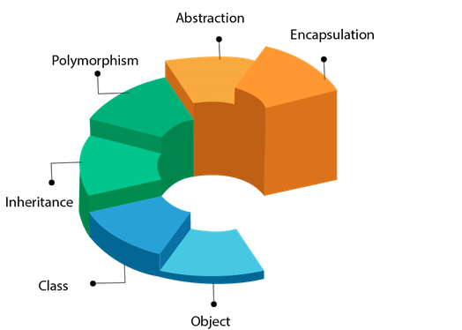
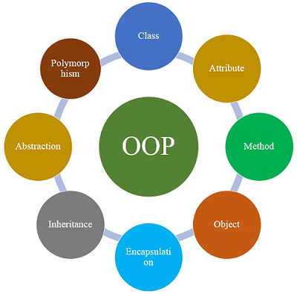
Object Oriented Programming
Safeen H. Rasool
Collage of Science
Computer Department
Lecture 4.1

Slide 2
Procedural and Object-Oriented Programming
Procedural programming is a method of writing software. It is a programming practice centered on the procedures, or actions that take place in a program.
Object-Oriented programming is centered around the object.
Objects are created form abstract data types that encapsulate data and functions together.

Slide 3
What’s Wrong with Procedural Programming?
Programs with excessive global data
Complex and convoluted programs
Programs that are difficult to modify and extend

Slide 4
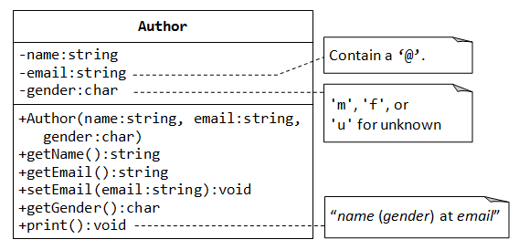
What is Object-Oriented Programming?
OOP is centered around the object, which packages together both the data and the functions that operate on the data.

Slide 5
Terminology
In OOP, an object’s member variables are often called its attributes and its member functions are sometimes referred to as its behaviors or methods.

Slide 6
Introduction to the Class
In C++, the class is the construct primarily used to create objects.
class class-name
{
// declaration statements here
};
a class is a data type.
(1) built-in class such as string class.
(2) User defined class such as Rectangle class.
Encapsulation: An information hiding mechanism.

Slide 7
Defining a Class With a Member Function
Class definition
Tells the compiler what member functions and data members belong to the class.
Keyword class followed by the class’s name.
Class body is enclosed in braces ({})
Specifies data members and member functions

Slide 8
Access Specifiers
The key words private and public are access specifiers.
private means they can only be accessed by the member functions.
public means they can be called from statements outside the class.
In other words, they are accessible to other functions and member functions of other classes.
Note: the default access of a class is private, but it is still a good idea to use the private key word to explicitly declare private members. This clearly documents the access specification of the class.

Slide 9
Private:
Access Specifiers (continued)
Makes any member accessible only to member functions of the class.
May be applied to data members and member functions
Default access for class members
Encourages “information hiding”

Slide 10
keyword class and struct
If struct is used all members default to public.
If class is used all members default to private.

