Slide 1
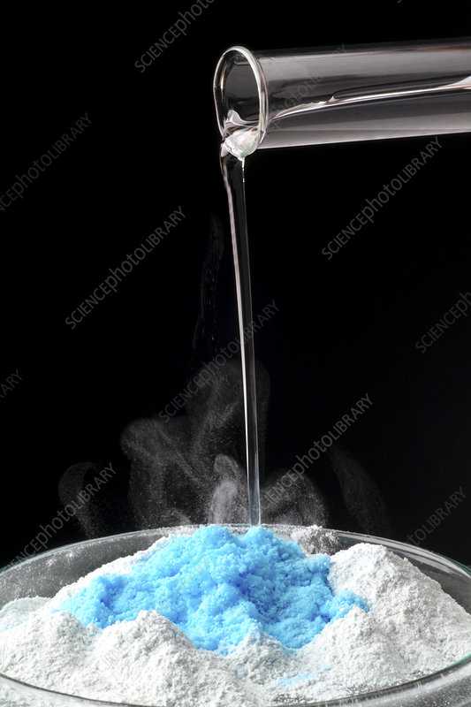
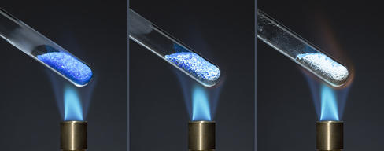
Determination of water hydration in a hydrate compound

Slide 2
WHAT IS HYDRAT
A Hydrate is an ionic compound that contain water molecules in its fundamental solid structure called waters of hydration.
Waters of hydration can be removed by heating.

Slide 3
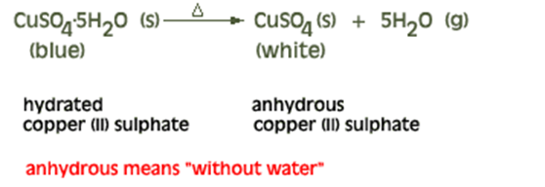
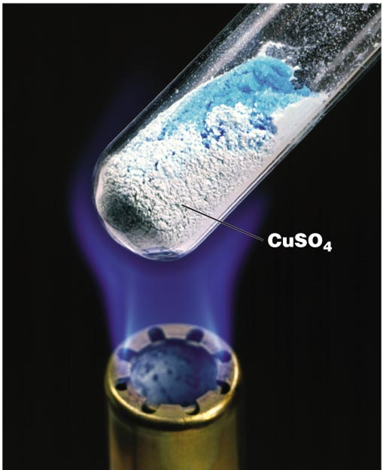
Anhydrous compounds are chemical compounds that have remove water molecules in the chemical structure.

Slide 4
Naming hydrates
Some molecule attaches with water molecules ,this is done set numbers depended of molecules. while named by (Write compound and hydrate connected by the dot).
Example /Gypsum is a hydrate in which two water molecules are present for every formula unit of CaSO4 in the solid. The chemical formula for gypsum is CaSO4 •2 H2O and the chemical name is calcium sulfate dehydrate.
.

Slide 7
Percent error = ( theoretical - experimental / theoretical value) x 100

Slide 8
Example :
When a 1.000 g sample of CuSO₄ ·5 H₂O(s) was heated so that the waters of hydration were driven off, the mass of the anhydrous salt remaining was found to be 0.6390 g.
A-What is the experimental value of the percent water of hydration?
B- Calculate the percent error. ( Cu = 63.55 , S = 32 , O =16 , H =1 g / mol)

Slide 9
Procedure:
Weight a pure, dry and empty crucible.
put 1g of copper(II) sulphate pentahydrate (hydrate compound)in the crucible.
heat the crucible and its content for half hour(the color change from blue to white and finally to grey) .
Cool in desiccators. Weight the crucible with anhydrous compound.
Calculate the percentage of water in that sample.
Write all Chemical Compounds and all Apparatus used in this experiment.

