Slide 1
1.Primary element found in every Fehling's reagent
Iron
Copper
Sulfur
2. The following are the sugars that formed red precipitate during Barfoed test, EXCEPT:
Sucrose
Fructose
Glucose

Slide 2
3.Which of the following is a reducing sugar?
Sucrose
Fructose
Trehalose
4. Define reducing sugar?

Slide 3
1.The barfoed's test is used to distinguish between
a- di- and polysaccharide
b-mono and disaccharide
c- reducing and nonreducing sugar
2. Fehling A solution composed of
a-copper sulphate
b- sodium potassium tartarate
c-sodium hydroxide

Slide 4
3.Which of the following is a non-reducing sugar?
Lactose
Maltose
Sucrose
4.Define reducing sugar?

Slide 5
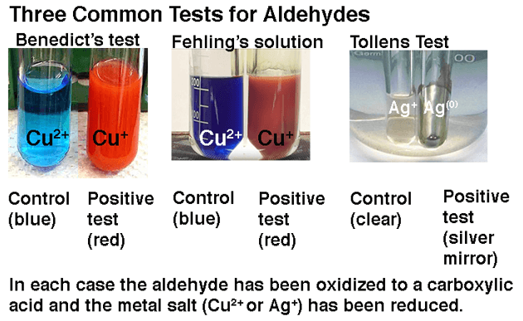
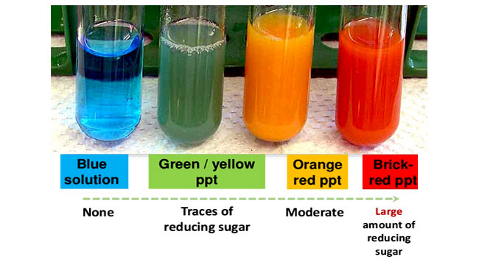
Reducing sugar

Slide 6
Exp. No .6 Reducing sugars
A reducing sugar is any sugar that is capable of acting as a reducing agent because it has a free aldehyde group or a free ketone group.

Slide 8
This reducing ability, which is useful in classifying sugars and in certain clinical tests, is dependent on the presence of (1) aldehyde groups such as in glucose and galactose.
(2) ketone groups such as in fructose.

Slide 9
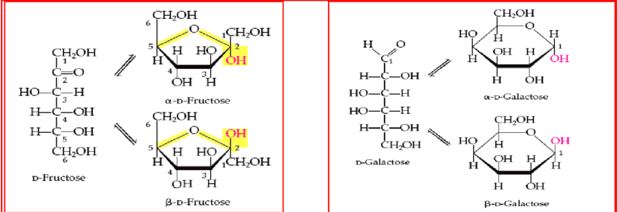
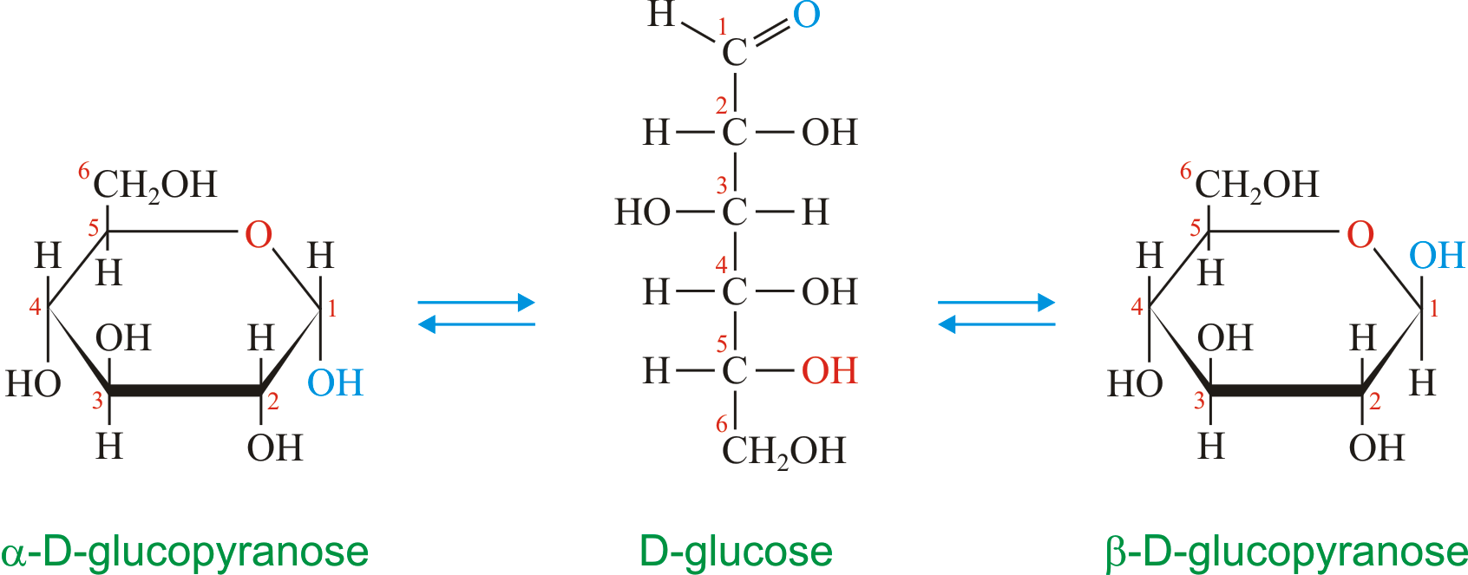
The common dietary monosaccharides galactose, glucose and fructose
are all reducing sugars.

Slide 10
Disaccharides are formed from two monosaccharides and can be classified as either reducing or nonreducing.
Reducing disaccharides like lactose and maltose have only one of their two anomeric carbons involved in the glycosidic bond, meaning that they can convert to an open-chain form with an aldehyde group.

Slide 12
Nonreducing disaccharides like sucrose and trehalose have glycosidic bonds between their anomeric carbons and thus cannot convert to an open-chain form with an aldehyde group; they are stuck in the cyclic form.

Slide 13
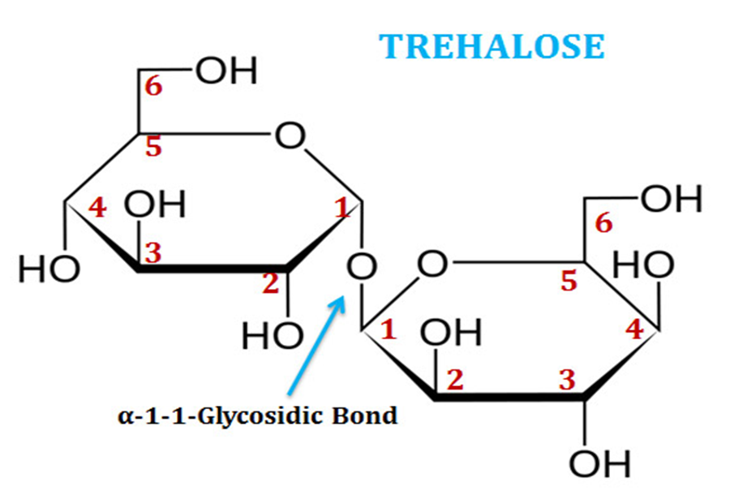

Slide 14
These groups are easily oxidized to carboxylic acid. Several different reagents, including ( Tollen's, Fehling's and Benedict's) reagents are used to detect reducing sugars.
The Benedict, Fehling and Barfoed tests depend on the formation of copper (I) oxide precipitate to indicate a positive reaction.

Slide 15
Barfoed's Test
(Used to distinguish between monosaccharide and disaccharides)
The barfoed’s reagent contains copper [II] or cupric [Cu] ions in a slightly acidic [PH <7] solution. The solution will only oxidize mono saccharides. The Cu [II] ions is reduced to Cu [I] ion which appears as the red copper [I] oxide ,Cu₂O. Several color changes may be observed as the Cu₂O appears

Slide 16
This variation of tests for reducing sugars, but detects if a carbohydrate is a monosaccharide or a disaccharide.
Barfoed's reagent reacts with monosaccharides to produce copper [I] oxide at a faster rate than disaccharides do:
RCHO + 2Cu2+ + 2H2O RCOOH + Cu2O + 4H+
disaccaraides +Cu+2 no reaction no red color

Slide 17
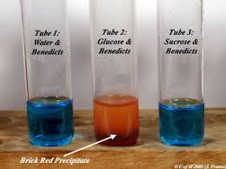
Procedure
1. Place 2ml of Barfoed's Test in test tube .
2. Add 0.5 ml of 1% carbohydrates solution in water .
3. Heat the solution in boiling water bath for (3min).
4. Cooling and red colored precipitates appears with mono saccharides.

Slide 18
Benedict's test
(Used to distinguish between reducing and non reducing sugar)
Benedict's test detects whether a monosaccharide or disaccharide is a reducing sugar, but here the solution slightly basic (pH>7) and both monosaccharide & disaccharide with hemiacetal or hemiketal react. The solution often turns various shades of green , yellow or orange before the red copper [I] oxide ,Cu₂O, appears.

Slide 19
Bendict’s solution –like barfoed’s –also contain copper (II) ions, benedict's solution is a blue colored liquid that contains copper ions. When Benedict's solution and simple carbohydrates are heated, the solution changes to orange red. This reaction is caused by the reducing property of simple carbohydrates.

Slide 20
•Complex carbohydrates such as starch do not react positive with the Benedict's test unless they are broken down through heating or digestion.
•Table sugar (disaccharide) is a non-reducing sugar and also does not react with the iodine or with the Benedict Reagent.
•Mono & disaccharides + Cu+2 red Cu2O

Slide 21
Procedure
1. place 0.5ml of benedicts reagent in test tube.
2. add 2ml of sugar solution and boiled if any reducing sugar are present a red ppt of copper (I)oxide is formed with 3min.

Slide 22
Fehling's Test:
( Used to distinguish between reducing and non reducing sugar)
In this test the presence of aldehydes and ketones is detected by reduction of the deep blue solution of copper (II) to a red precipitate of insoluble copper oxide. The test is commonly used for reducing sugars but is known to be NOT specific for aldehydes. For example, fructose gives a positive test with Fehling's solution.

Slide 23
Two solutions are required:
A positive test is indicated by a green suspension and a red precipitate. there are two types of fehling solution; Fehling A & fehling B
FEHLING A composed of copper sulphate CuSO₄ &FEHLING B composed of sodium hydroxide and sodium potassium tartarate.

Slide 24
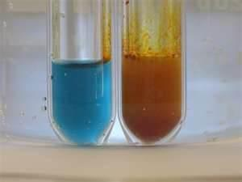
Procedure:
1. Mix 1.5ml of fehling A with 1.5ml of fehling B
2. Add 1ml of sugar solution to the reagent.
3. Boiled if any reducing sugar are present a various shades of yellow to brawn color appears.

