Slide 1
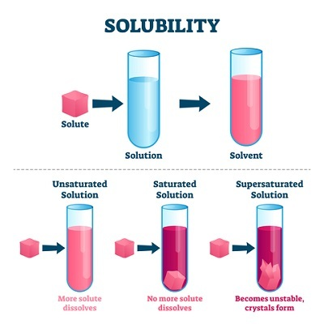
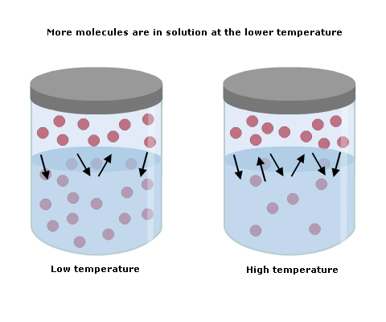
Solubility of KCl at different temperature

Slide 2
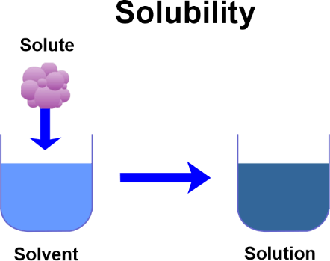
What is Solubility?
the maximum amount of a substance that will dissolve in a given amount of solvent at a specified temperature.( the number of grams of the solute required to saturate 100g of the solvent at a particular temperature. )

Slide 3
Solutions can be classified into 3 types on the bases of an of present in the solution.
1-Unsaturated Solutions: the solution can still dissolve more solute in solvent.
2-Saturated Solution: a solution in which a solvent is not capable of dissolving any more solute at a given temperature.
3-Supersaturated Solutions: The solution in which solute is present in an excess amount, and are dissolved in the solvent forcefully by raising the temperature.

Slide 5
Temperature plays an important role in solubility because the solubility of a substance is different at different temperatures. The solubility of solids and liquids generally increases with increasing temperature. There are many exceptions to this general rule; for examp\e lithium carbonate decreases in solubility as the solution temperature increases and sodium chloride shows practically no change

Slide 6
Importance of Solubility Curve
Solubility curve can be used to determine the amount of substance deposited when the solution is cooled. Solubilities of different substances at a particular temperature can be determined. The importance of solubility curve is listed below.
The solubility of a substance at a particular temperature can be determined.
The solubility curve helps us to predict which substance will crystallize out first from a solution containing two or more solutes.
The solubility curve helps us to compare the solubilities of different substances at the same temperature.
It gives a clear idea that solubility of substance changes with the temperature.

Slide 7
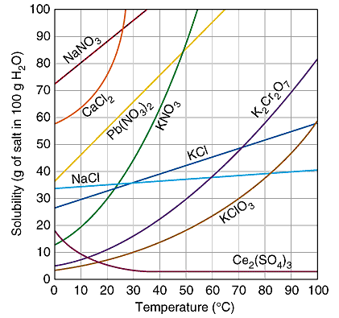

Slide 8
For questions 1 – 4 an amount of solute is given,
and a temperature is stated. If all of the solute
could be dissolved in 100 g of water at the given
temperature, would the resulting solution be
unsaturated, saturated, or supersaturated?
1. 60 g KCl at 70 °C _________
2. 10 g KClO3 at 60 °C _________
3. 80 g NaNO3 at 10 °C _________
4. 70 g CaCl2 at 20 °C _________

Slide 9
For questions 5 – 8 a solute and temperature are given. Tell how many grams of
each solute must be added to 100 g of water to form a saturated solution at the
given temperature.
5. Pb(NO3)2 at 10 °C _________ 7. NaCl at 20 °C _________
6. Ce2(SO4)3 at 50 °C _________ 8. K2Cr2O7 at 50 °C ________

Slide 10
Procedure
1- Put 2gm of potassium chloride in large test tube then add 20 ml of distilled water the volume of solution must be constant before each new addition.
2-Heat the mixture in a water bath until dissolve salt then put a thermometer in the solution.
3- Cool the solution and record the temperature of the appearance of first crystal.
4-Repeat the previous step by adding four different quantities of the potassium chloride on condition that final amount kCl is 8gm in 20ml of the used water.

Slide 11
Question?
Define solution.
What is the different between solution and mixture?
Is temperature effect the solubility?
Explain the effect of concentration on solubility at a given temperature.

