Slide 1
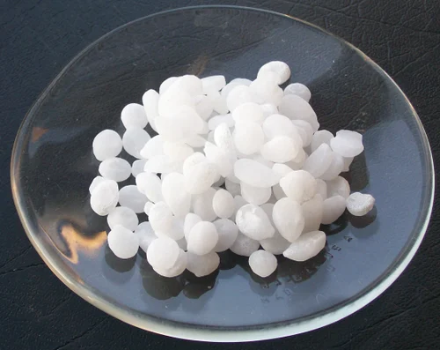
Preparation of sodium hydroxide

Slide 2
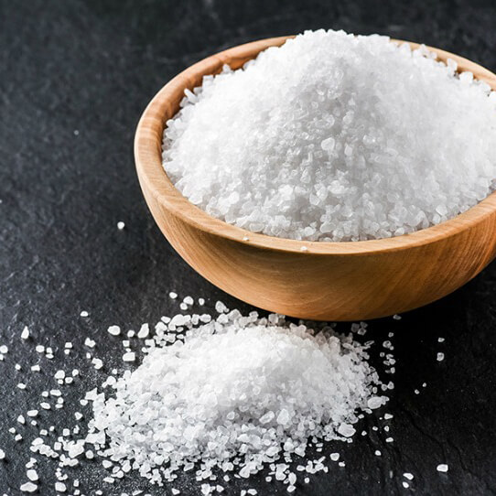
What ıs sodium hydroxide?
Sodium hydroxide is one of the most common inorganic bases or alkalis. It is also called caustic soda or lye.
Formula and structure:
The chemical formula of sodium hydroxide is NaOH, and its molar mass is 40.01 g/mol. It is an ionic compound consisting of sodium cation(Na⁺)and hydroxide (OH⁻)anion.

Slide 3
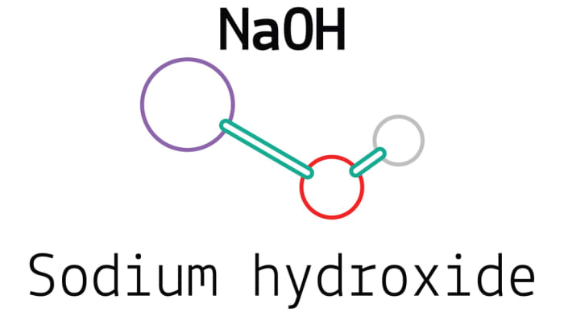
Physical properties:
It is an odorless, white crystalline solid with a density of 2.13 g/mL, and melting point of 318 ⸰C. It is widely available as pellets, flakes, granules, and also as aqueous solution of different concentrations.

Slide 4
Chemical properties:
Sodium hydroxide is soluble in polar solvents such as water, ethanol, and methanol. Dissolving solid NaOH in water is a highly exothermic reaction and the resulting aq. NaOH solution is a colorless, odorless and important base used in the laboratory. As a strong base, sodium hydroxide readily reacts with acids such as HCl, to form the corresponding salts, as shown below:
NaOH + HCl NaCl + H2O

Slide 5
Uses of Sodium hydroxide
Sodium hydroxide is one of the most widely used bases in industry. Its main uses are in the paper industry, Petroleum, industry , textiles industry, in the manufacture of soaps and detergents, in the Bayer process of aluminum production, industrial cleaning , and for pH regulation. It is also used in the food industry for many applications.

Slide 6
Health effects / safety hazards:
It is a strong and highly corrosive alkali, which readily decomposes living tissues. Skin contact of NaOH solutions can result in severe chemical burns, and eye contact can cause permanent blindness. Solid NaOH reacts with water and acids in a very exothermic reaction, and can cause burns through splashing

Slide 7
Preparation of sodium hydroxide by (Cosak) Method.
Ca(OH)2 + Na2CO3 heat CaCO3 + 2NaOH.
PPT
In Bronshted-Lory view, an acid is any substance that is capable of donating a proton. Base is any substance that can accept a proton.
HCl + H2O H3O + Cl-

Slide 8
Procedure
1- Add 3 gm of calcium hydroxide Ca(OH)2 to 100 ml of Na2CO3 solution (0.5 M).
2- Heat the solution to cylinder 100 ml and left to one hour.
3- Transfer the solution to cylinder 100 ml and left to one hour.
4- Separate the filtrate from the precipitation by decantation process.
5- Evaporate the filtrate by hot plate and weight the product.

