Slide 1
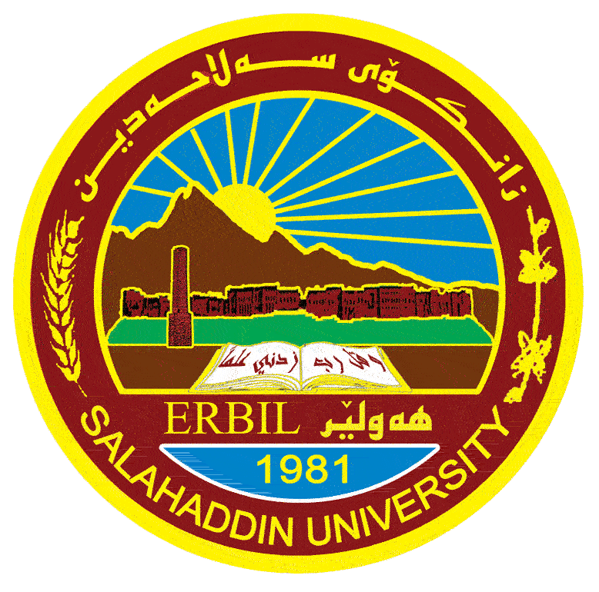
Ministry of Higher Education and Scientific Research
Salahaddin University-Erbil
College of Science
Environmental Health and Sciences Department
Remote Sensing
Lab. 1
By:
Sayran Y. Jalal
10/9/2023

Slide 2
Course Objectives
The aims of the course is to introduce you to the ways in which remote sensing systems are used to acquire data.
How these data may be analyzed, and
How the information is used in studies of the natural, environmental, and agricultural studies.

Slide 3
Introduction: Remote Sensing
Definition: It is the Science and art for obtaining information about an object without physical contact with that object.
Or
Remote sensing is the science of acquiring, processing, interpreting images obtained from aircraft and/ or satellite.
Remote sensing refers to methods that employ electromagnetic energy, such as light, heat, radio waves.

Slide 4
In remote sensing we use two nomenclature for pictures:
1- Photo: that used for pictures which obtained from aircraft, or low latitude pictures taking by camera called (Aerial photographs)
2- Images: the pictures which taken by scanning devices on high altitude or orbital device (i.e. satellite, space shuttle, radar from satellite…)

Slide 5
Application of Remote sensing science:
Agricultural application
Environmental application
Metrological application
Engineering application
Army application
Geographical application
Natural hazard application
Geological application

Slide 6
ER Mapper:
ER Mapper= Earth Resource Mapping
ER Mapper is software program.

Slide 7
A digital image is stored as a two-dimensional array (or grid) of small areas called pixels (picture elements), and each pixel corresponds spatially to an area on the earth’s surface. This array or grid structure is also called a raster, so image data is often referred to as raster data.
The raster data is arranged in horizontal rows called lines, and vertical columns called samples.
Each pixel in the image raster is represented by a digital number (or DN).

Slide 8
Thank You

