Slide 1
Chloride (Clˉ)
Ministry of Higher Education and Scientific Research
Salahaddin University-Erbil
College of Science
Environmental Science and Health
By:
Sayran Yousif Jalal

Slide 2
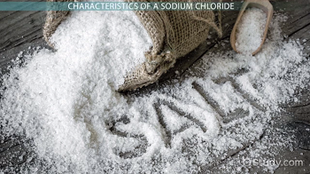
What is chloride?
Chloride: in the form of the Clˉ ion, is one of the major inorganic anions, or negative ions, in saltwater and freshwater.
It originates from the dissociation of salts, such as sodium chloride or calcium chloride, in water.
NaCl(s) → Na⁺ (aq) + Clˉ (aq)
CaCl₂(s) → Ca²⁺ (aq) + 2 Clˉ(aq)

Slide 3
What is chloride?
Nearly all natural waters contain chloride and the concentrations vary greatly depending on the mineral content of the surrounding rock or soil.
Chlorides are salts resulting from the combination of the gas chlorine with a metal.
Some common chlorides include sodium chloride (NaCl), magnesium chloride (MgCl₂), potassium chloride (KCl), and calcium chloride (CaCl₂).

Slide 4
Major uses:
1. Sodium chloride is widely used in the production of industrial chemicals such as caustic soda, chlorine, sodium chlorite, and sodium hypochlorite.
2. Sodium chloride, calcium chloride, and magnesium chloride are extensively used in snow and ice control.
3. Potassium chloride is used in the production of fertilizers.

Slide 5
Environmental fate:
Chlorides are leached from various rocks into soil and water by weathering.
The chloride ion is highly mobile and is transported to closed basins or oceans.

Slide 6
Sources
Chlorides may get into surface water from several sources including:
1) Rocks containing chlorides; Halite (NaCl), Sylvite (KCl).
2)Agricultural runoff; (Ammonium chloride fertilizer)

Slide 7
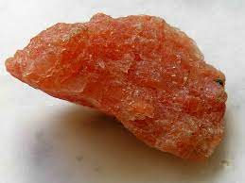
Halite and Sylvite rock

Slide 8
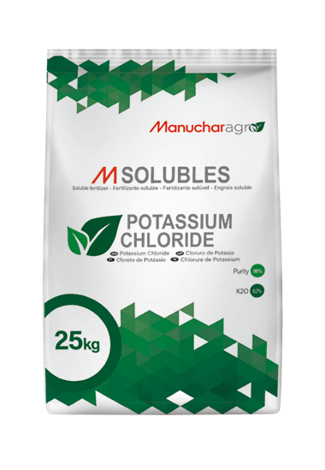
Potassium Chloride and Ammonium Chloride Fertilizer

Slide 9
3) Wastewater from industries;
4) Oil well wastes;
5) Effluent wastewater from wastewater treatment plants, and;
6) Road salting.

Slide 10
Road Salting

Slide 11
Chloride
Chloride is present in all natural water, including rainwater. Concentrations of chloride are very high in seawater, which is known for its saltiness.
In rocks, chloride can occur in salts such as sodium chloride and potassium chloride, which dissolve easily when they come into contact with water.
Salt dissolved from rocks accumulates in oceans and lakes with closed basins, such as the Great Salt Lake in Utah, sometimes to extremely high concentrations.

Slide 12
Effect On Human Health
High chloride concentrations may also be associated with high sodium concentrations. Too much sodium intake can cause high blood pressure and can lead to damage to the heart and arteries.
For people on a low-salt diet, concentrations of sodium in drinking water should be less than 20 milligrams per liter.

Slide 13
How to Remove Chloride from drinking Water
Chloride can be removed from drinking water by:
1) Distillation
2) Reverse osmosis or deionization
3) Boiling

Slide 14
1- Distillation
Distillers are water treatment that use air and heat to get rid of contaminants and bacteria in the water.
The heat is used in a boiling process to kill microorganisms of all types.
This form of water treatment is more expensive than a Reverse Osmosis system due to the process requiring electricity to generate heat.

Slide 16
2- Reverse Osmosis
Reverse Osmosis is the one process that can reduce the most amounts of dissolved solids (TDS) and salts including augmenting chloride removal from water.
The process of Reverse Osmosis Systems consists of pressurizing water through a semipermeable membrane for high quality water.
As high pressure is applied on the feed water, the finely pored filter captures all major contaminants and only allowing water molecules to pass through.

Slide 17
The water from this water treatment system contains about 90-95% less TDS and salt particles; making it one of the cleanest and highest quality forms of water.
For seawater, Reverse Osmosis would be the most effective solution to combat the concentration of chloride from the salty water.

Slide 18
Procedure: Testing of water sample:
1. Take 20 ml of water sample in a clean 250ml conical flask.
2. Add 2 drops of potassium chromate indicator to get yellow colour.
3. Titrate the sample against silver nitrate solution until the colour change from yellow to brick red.
4. Note the volume of silver nitrate added (A).

Slide 19
Testing of blank:
1. Take 20 ml of distilled water in a clean 250ml conical flask.
2. Add 2 drops of potassium chromate indicator to get yellow colour.
3. Titrate the sample against silver nitrate solution until the colour change from yellow to brick red.
4. Note the volume of silver nitrate added for distilled water (B).

Slide 21
Calculation:
Clˉ in mg.lˉ =((A-B)×1000)/ml of sample
Where:
A= Volume of silver nitrate required by the sample (ml)
B= Volume of silver nitrate required by the blank (ml)

