Slide 1
Fourier Transform

Slide 2
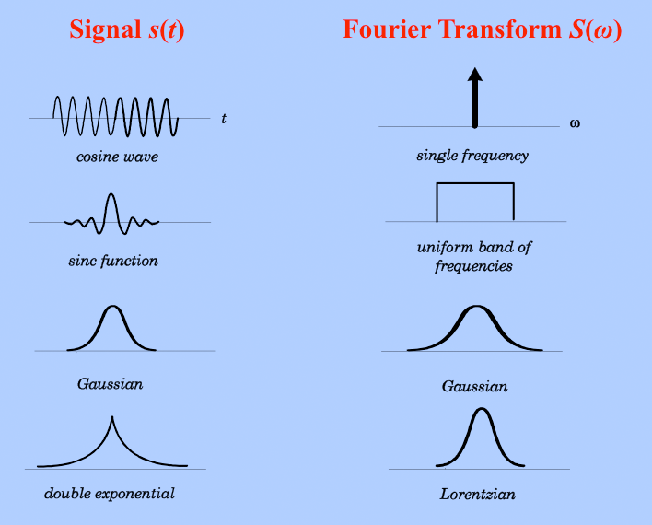
What is Fourier Transform
The Fourier Transform is a mathematical technique that transforms a function of time, x(t), to a function of frequency, X(ω). (used for frequency analysis of signal).

Slide 3
Fourier transform convert a function in the amplitude vs time domain to the amplitude vs frequency domain for non-periodic functions.
(Fourier transform does for non periodic functions) What (Fourier series does for periodic functions).

Slide 4
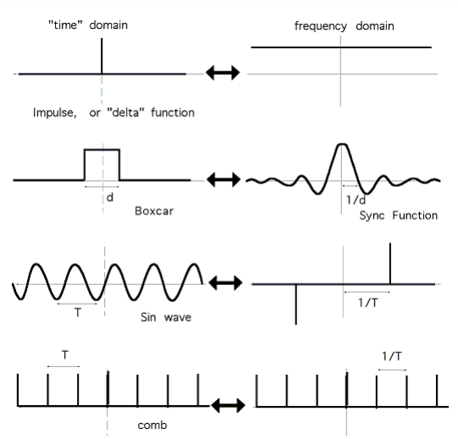
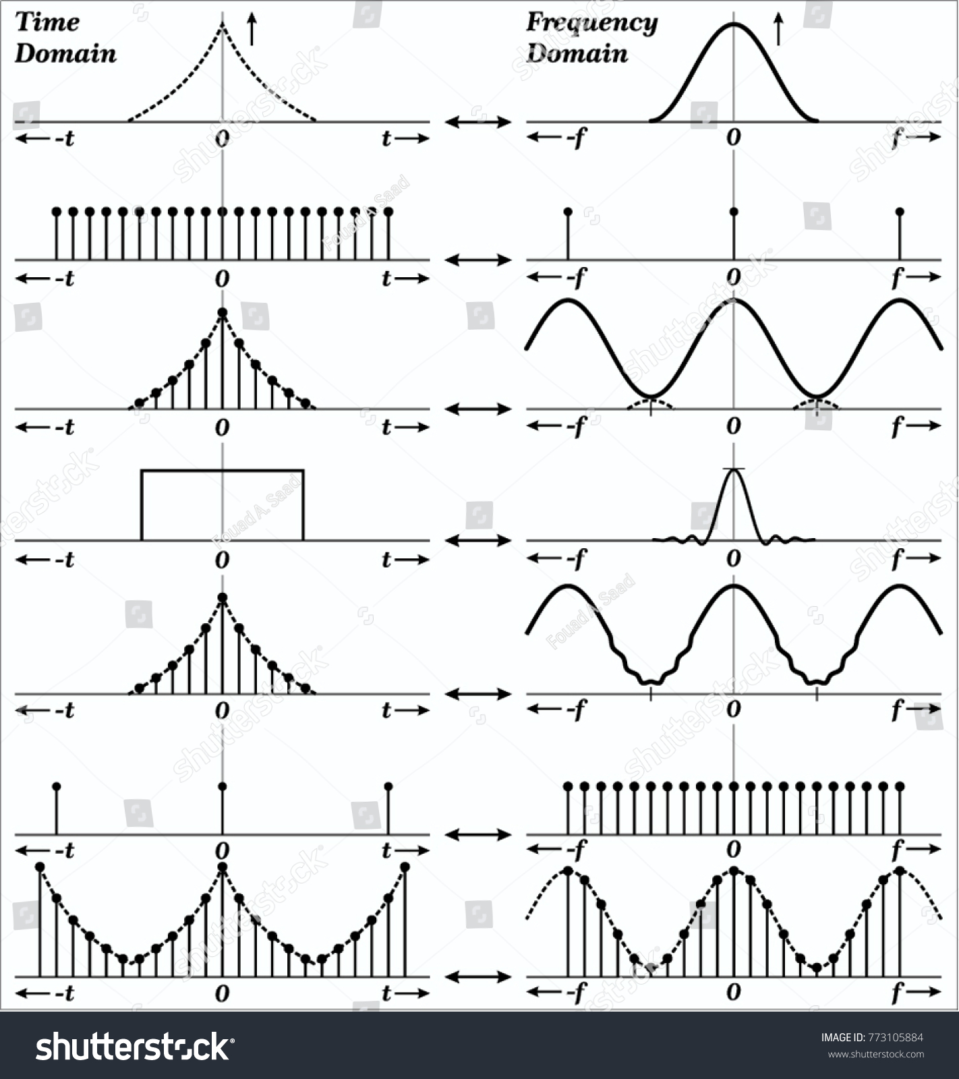

Slide 5
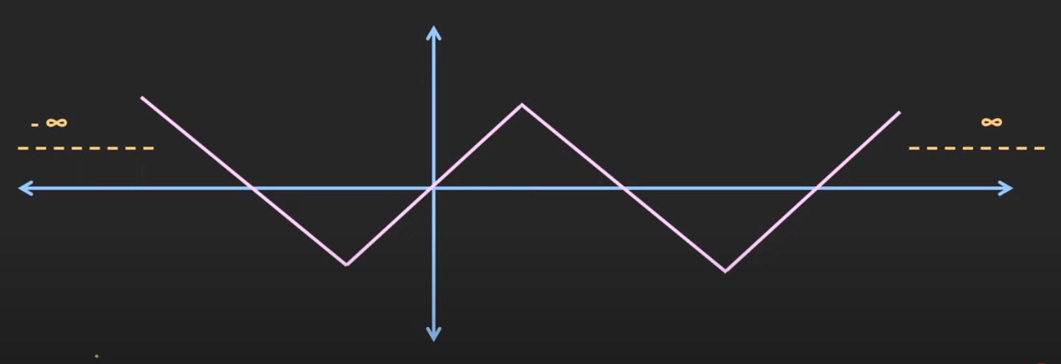
Fourier transform is very useful for frequency domain and periodic signal.
The periodic signal repeated itself at infinite time.

Slide 6
Fourier Transform Inverse Fourier Transform
F(w) = $\int_{−∞}^{∞}{f\left(t\right). e^{−iwt}}. dt$ f(t) = $\frac{1}{2π}\int_{−∞}^{∞}{F\left(w\right). e^{iwt}}. dw$
What is a transform? It is a mapping between two sets of data or domains
Change the information to the information of
in the time domain frequency domain
f(t) F(w)

Slide 7
Example (1): find FT for $x\left(t\right)=δ(t−2)$
F(w) = $\int_{−∞}^{∞}{f\left(t\right). e^{−iwt}}. dt$
F(w) = $\int_{−∞}^{∞}{δ(t−2). e^{−iwt}}. dt$
t = 2
from shifting property F(w) = $e^{−iw2}$
So
F $\left[δ(t)\right]=1 \text{F} \left[δ(t−2)\right]=e^{−iw2}$

Slide 8
Example (2): find IFT for $F\left(w\right)=2π.δ(w−5)$
f(t) = $\frac{1}{2π}\int_{−∞}^{∞}{F\left(w\right). e^{iwt}}. dw$
f(t) = $\frac{1}{2π}\int_{−∞}^{∞}{2π.δ(w−5). e^{iwt}}. dw$
f(t) = $\int_{−∞}^{∞}{δ(w−5). e^{iwt}}. dw$
w = 5
from shifting property f(t) = $e^{i5t}$

Slide 9
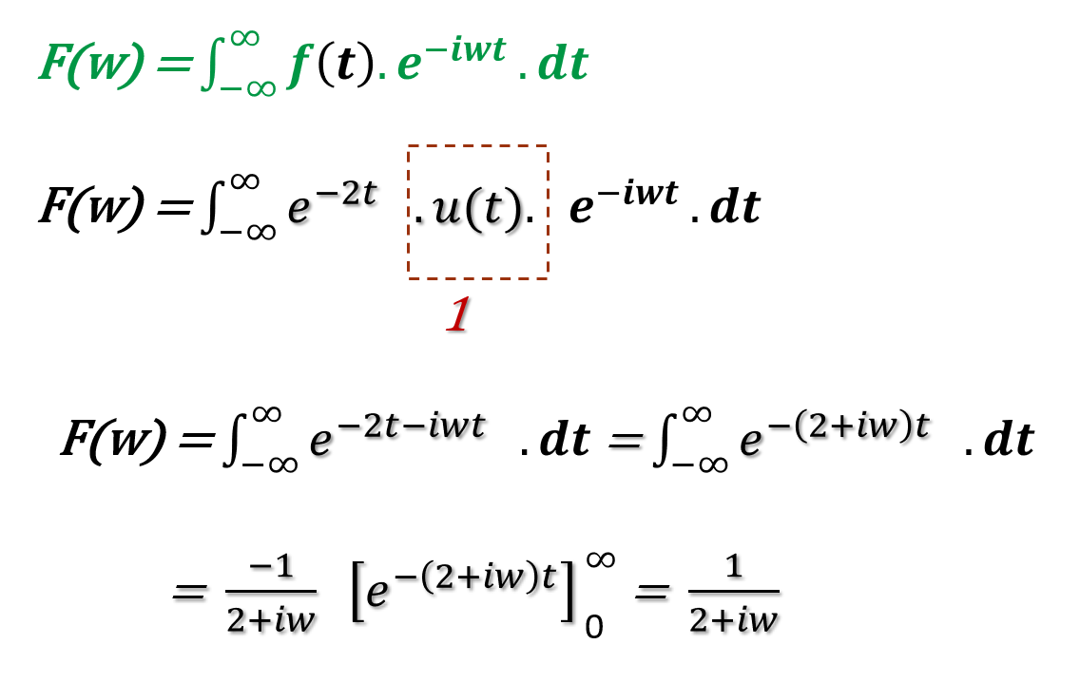
Example (3): find FT for x$\left(t\right)=e^{−2t}.u(t)$
Note:
$u\left(t\right)$= unit step function
At t=0 and t =$∞$, $u\left(t\right)$=1

Slide 10
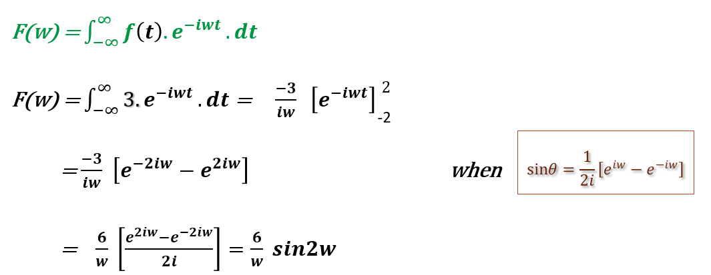
Example (4): calculate the FT for a periodic wave function
f(t) =3 -2 $≤t≤$ 2
f(t) =0 Otherwise
$$also, cos{θ}=\frac{1}{2i}\left(e^{iw}+e^{−iw}\right)$$

Slide 11
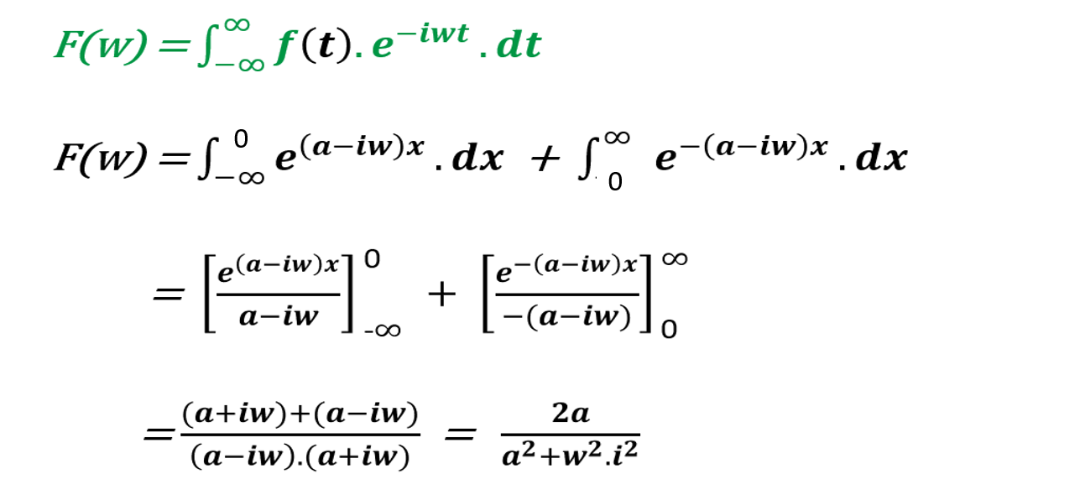
Example (5): let a $>0$ , compute the FT of

