Slide 1
Salahaddin University/Erbil
College of Science - Department of Physics
Lecture of Calculus I
First Semester 2023-2024
Sebar H. Jumha

Slide 2
Chapter one

Slide 10
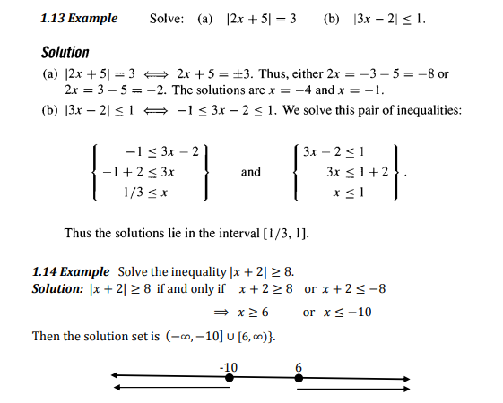

Slide 12
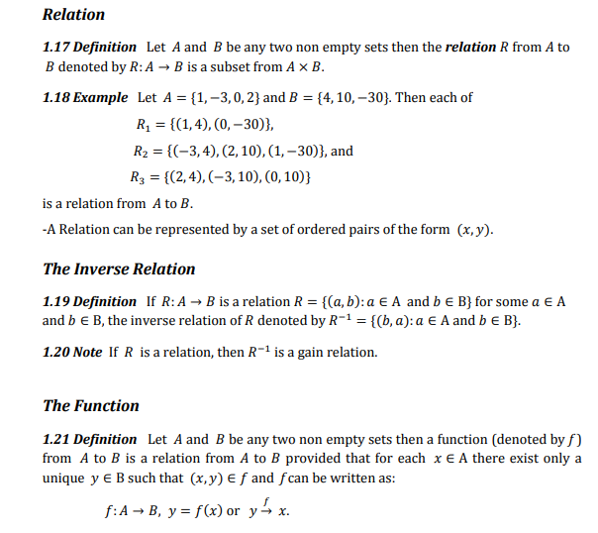

Slide 19
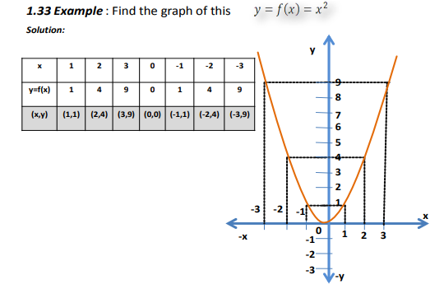

Slide 20
