Slide 1
Salahaddin University/Erbil
College of Science - Department of Physics
Lecture of Calculus I
Second Semester 2023-2024
Sebar H. Jumha

Slide 2
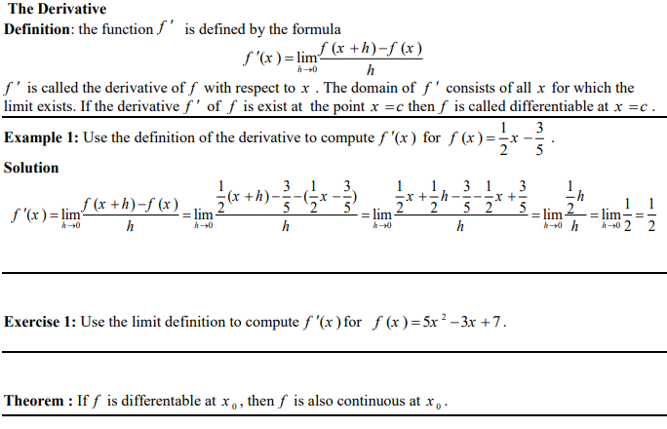
Chapter one Derivative

Slide 3
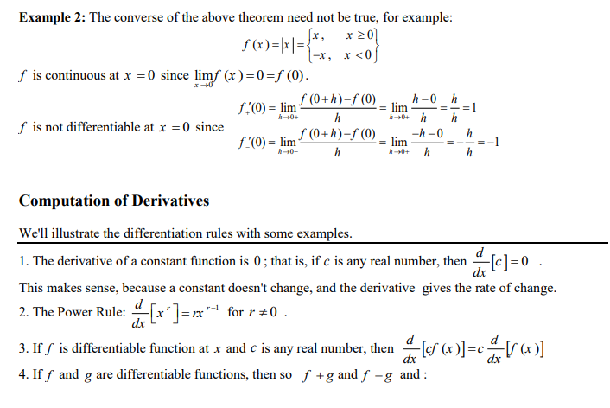

Slide 4
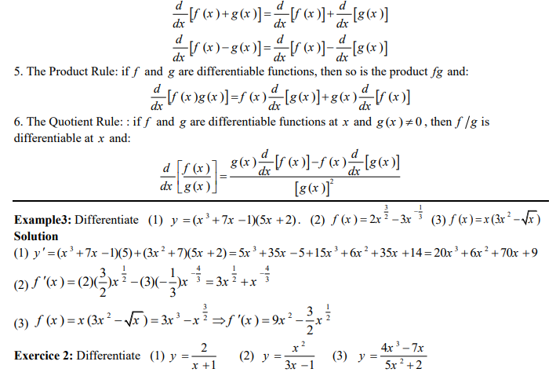

Slide 5
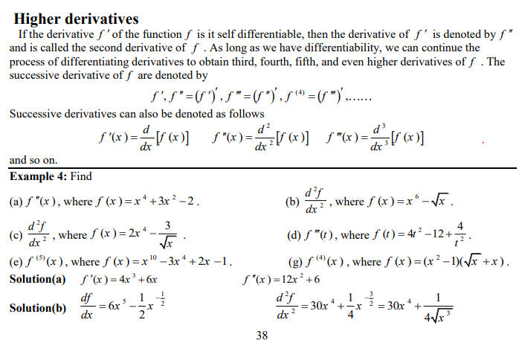

Slide 6
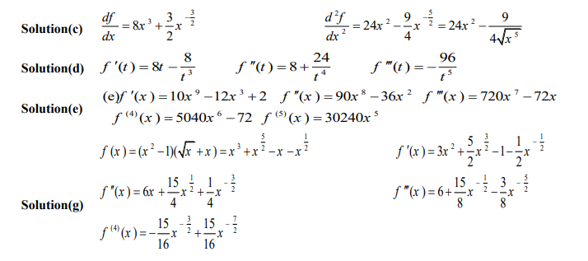

Slide 7
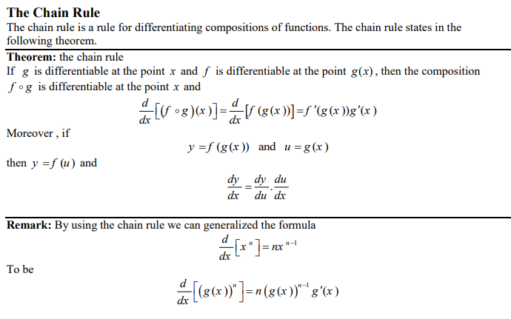

Slide 10
