Slide 1
Acceptance of research paper at Journal of College Administration and Economics – Baghdad University Security and confidentiality of information under the application of cloud accounting compared to traditional accounting
By:
By
Dr. Kawa Wali, Bnar Karim, Shadan Jabbar Abdulfattah

Slide 2
Introduction
Methodology
The problem and research question
the study question can be formulated as follows:
Does access to information secure and confidential under cloud accounting compared to traditional accounting and how effective is cloud accounting according to accounting experts?

Slide 3
Research objectives Cloud accounting as a new model for managing accounting information - To become familiar with cloud accounting and software-based accounting. Specific objectives: - To compare the services of ten major cloud accounting providers around the world in terms of security and confidentiality. -To comprehend the effect of cloud accounting using insights from accounting experts.

Slide 4
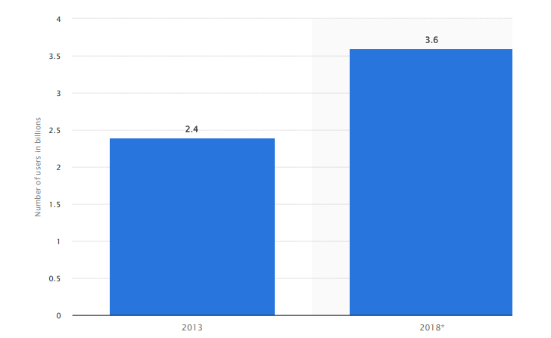
Source: (Consumer cloud computing users worldwide 2018 | Statista, 2022)
Figure 1: Number of consumer cloud-based service users worldwide (2013-2018) (in billions)

Slide 5
Table 1: Presents the services of the top 10 cloud accounting firms around the world
Companies Products | Payroll Management | Tax Calculator | Customizable Invoices | Recurring Billing | Nonprofit Features | Rate
SageIntacct | YES | - | YES | YES | YES | 4
NetSuite | YES | - | - | YES | YES | 3
QuickBooks | YES | - | YES | YES | YES | 4
FreshBooks | YES | - | YES | YES |  | 4
ZohoBooks | YES | - | - | - | YES | 3
WaveAccounting | YES | - | YES | YES | YES | 4
FinancialForce | YES | - | YES | - | YES | 3
Xero | YES | - | YES | YES | YES | 4
ZipBooks | YES | - | - | - | YES | 2
Kashoo | YES | - | YES | YES | - | 3
Source: (Best Accounting Software for Small Businesses in 2022)

Slide 6
Conclusion
Cloud accounting is sure to have great impact on the growth of SMEs. With a plethora of advantages such as cost efficiency, high security, ease of use, and so on, cloud accounting is the right choice for any business looking to stay competitive. Cloud accounting can be highly beneficial as it offers efficient technology and account service at a lesser cost.
According to the results of the survey, which indicates that cloud accounting has a significant impact on the security and confidentiality of information, in contrast to traditional accounting.
The impacts of the current innovations in cloud accounting will eventually affect a wide range of businesses and industries.
Entrepreneurs won't utilize the conventional accounting method anymore since cloud accounting makes essential data easily accessible.
As a result, business owners may confidently make more informed decisions more quickly.
Further Work
The researchers recommend, first of all, that it is necessary to study whether financial institutions, such as banks, due to recent accounting innovations that support these trends in their operations provide significant benefits, as well as how this may affect the future of operations of newly established institutions.
Another possible point for researchers, with security risks in mind, the emergence and growth of cloud accounting also encourage the growth of a market economy.

