Slide 1
Shakar M.A.
SPSS
fourth stage
Shakar.Azeez@su.edu.krd

Slide 2
Data: This menu allows you to make changes to the data editor. The important features are insert variables, which is used to split the file by a grouping variable; and select case, which is used to run analyses on only a selected sample of cases. ئةم ليستة زؤر كارى طرنطمان بؤ ئةنجام دةدات كة بؤ كارى داتاكان ثيَويستمان ثيََيةتى وةك ئم قةرمانانةى خوارةوة
A-Data-------------define variable properties
ليرةدا دةتوانين طورانكارى لة خاسيةتى طؤراوةكان بكةين كة ثيشتر دياريمان كردية وة هةروةها زانيارى تةواومان دةداتى دةربارةى طؤراوةكان
SPSS offers a wizard-type tool that helps you to set all variable properties using an interactive interface. Although it can be used for all types of variables, it is especially useful for categorical variables, as it scans the actual variables for all distinct values. From the menu select Data > Define variable properties ; then a first panel appears that lets you select the variables for which you want to set or change properties:

Slide 3
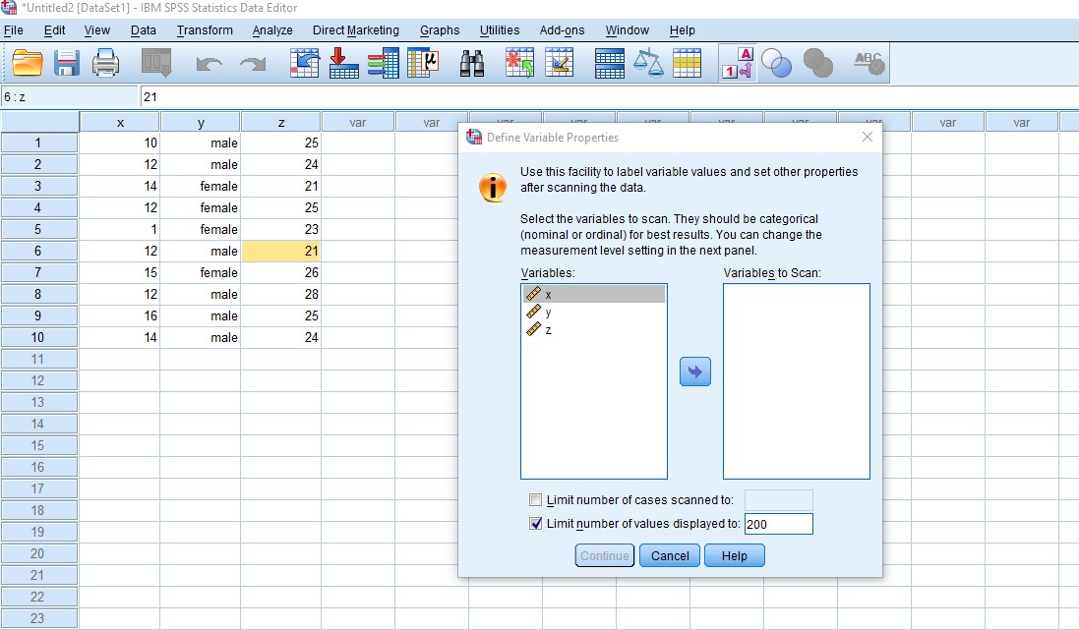

Slide 4
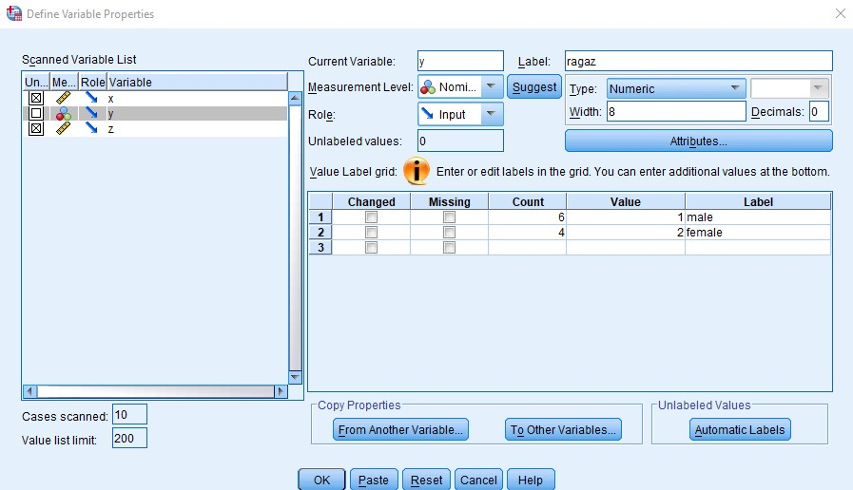
Select the variables; you can also limit the number of cases to scan (useful with very large files) and as the tool is best use with categorical variables, you can also limit the number of values (codes) that should be displayed (to avoid surprises with continuous variables....) When you click continue the next panel will show:

