Slide 1
Salahaddin University/ College of Political Science D. Diplomacy & International Relations
Contemporary policies and issues of national security
Third: New Security Dimensions: how today's interconnected world has changed the nature of the security and security Structure.
Dr. Shallaw A Mohammed
Shallaw.mohammed@su.edu.krd
Spring Semester (2024)

Slide 2
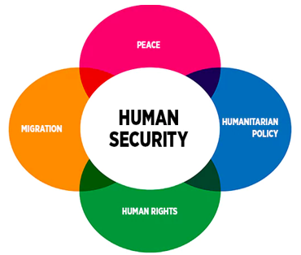
New Security Dimensions in the interconnected world .
The Outline:
1-The Substantive Dimension
2-The Reference Dimension
3-The Geographical Dimension
4-The Danger Dimension
Source: Human Security Division, Federal Department of Foreign Affairs, Switzerland /

Slide 3
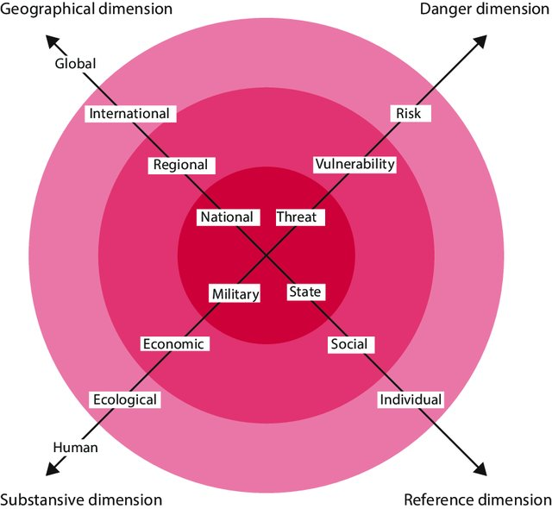
New Security Dimensions in the interconnected world.
1-The Substantive Dimension
The substantive dimension of security relates to the question: in which specific domains are security threats actually being observed? It concerns the type of security that security policy has to guarantee.
Whereas military threats dominated the security discourse in the 1950s and 1960s, economic, ecological and humanitarian issues have come to the forefront in the succeeding decades
Dimensions of security. (Source: DAASE 2013: 13)
Example: In addition to the ‘realistic’ view, in which military threats to the state’s security are central – and which is characteristic of the period after the Second World War and the Cold War − since the oil crises in the 1970s there has been a growing awareness of a new threat: in an economically integrated world, economic security is at least as important as military security. The interest in the economic security of states received a substantial boost with the oil crises in the 1970s and the pursuit of strategic trade policy by emerging powers from the 1980s

Slide 4
New Security Dimensions in the interconnected world
2-The Reference Dimension
The reference dimension of the concept of security turns on the question of whose security must be guaranteed: the nation state’s, the society’s or the individual’s. Here “too” we see an extension of the concept of security beyond the state as the referent object of security policy.
Concerns about security shifted From State Security to Social and Individual Security
Dimensions of security. (Source: DAASE 2013: 13)
The security interests of other referent objects (specific groups or individuals) are deemed to coincide with nation state security. The concept of security then centers not only on physical and inter-state violence, but touches on other types of threats to communities and individuals. Example: After the Cold War, specifically in Western democracies, concerns about security shifted from the state to society and the individual

Slide 5
New Security Dimensions in the interconnected world
3-The Geographical Dimension
The geographical dimension of the concept of security determines the levels of geographic scale to which security policy applies. Is it the territory of a state, based on the idea that domestic and foreign policy are strictly separate and that the limits of the state coincide (or should coincide) with the borders of the society? This defensive ‘container model’ of security has been inadequate for a long time.
Security in a Regional, International and Global Context
Dimensions of security. (Source: DAASE 2013: 13)
The expansion of the geographical dimension has drawn more attention to regional, international and global security complexes, in which states are so interconnected that their national security cannot be considered separately from the security of other states. Unrestrained internal conflicts like those in Ukraine and Syria had an enormous international impact, in one case in the form of political and military interventions by a neighboring country, in the other through the exodus of large numbers of refugees to other countries in the Near East and Europe.

Slide 6
New Security Dimensions in the interconnected world
4-The Danger Dimension
The most recent expansion of the concept of security relates to interpretations of what constitutes danger. It depends on how specifically or diffusely danger is defined. It makes a great deal of difference whether security is viewed as the absence of a military threat to a clearly-defined territory or as the reduction of economic vulnerability in a globalized world. Or as the reduction of risks and insecurity even before there is any question of an acute threat.
Dimensions of security. (Source: DAASE 2013: 13)
Example: Neither the shooting down of Flight mh17 nor the capture of areas in the Near East by Da’esh nor the attacks in Paris, Brussels and Berlin correspond with the traditional image of military conflicts between states seeking to control parts of each other’s jurisdiction, in other words territory.

Slide 7
Thanks
Thanks

Slide 8
Bibliography
Hirsch Ballin, Ernst, Huub Dijstelbloem, and Peter de Goede. Security in an interconnected world: A strategic vision for defence policy. Springer Nature, 2020. Chapter2.
Jones, Peter. "Structuring Middle East Security." Survival 51, no. 6 (2009): 105-122.
Møller, B. (2000). The concept of security: The pros and cons of expansion and contraction. Copenhagen Peace Research Institute.
Mosala, Abram, The Impact of Globalisation on Security, Munich, GRIN Verlag, 2001. https://www.grin.com/document/376713

