Slide 1
Salahaddin University/ College of Political Science D. Diplomacy & International Relations
Contemporary policies and issues of national security
Iran’s National Security Part I
Dr. Shallaw A Mohammed
Shallaw.mohammed@su.edu.krd
Spring Semester (2024)

Slide 2
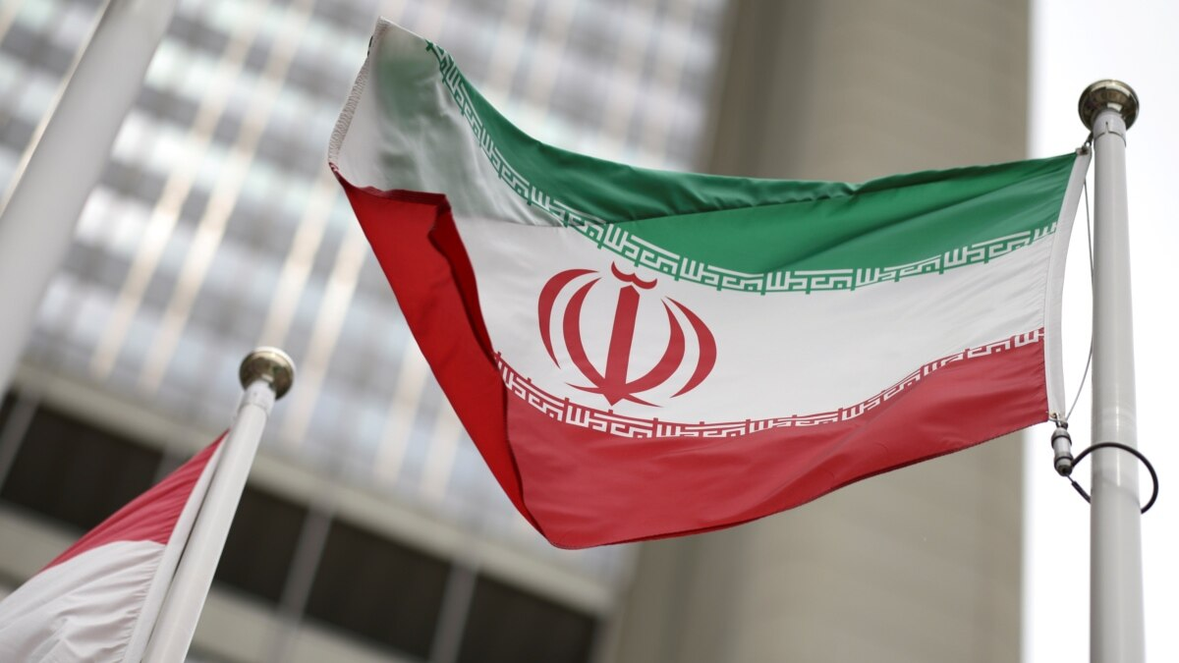
Outline:
The main questions to be answered in this topic are:
What is Iran's conceptualization of security?
Does Iran have a definition of a particular security threat?
What are the methods and tools to deal with these threats?
From which parameters does the national security definition be made?
What role does the military and economic capacity play in Iran's national security strategy?

Slide 3
Iran’s National Security Strategy and Threat Perceptions
The most basic national interest of states is to protect the “self-existence”, that is to protect the national security of the country.
We can divide the factors that provide national security into two factors:
First: is the natural factors such as the emergence of the countries or the geography (territorial integrity), the understanding of military service, the unity and solidarity of the nation.
The second is the legal factors such as contracts between countries, treaties of disarmament, and alliances.
So, for examining Iran’s national security strategy, the concepts of national security, power, peace and conflict, as well as the concept of “capacity” are important to be considered.

Slide 4
Iran's national security strategy
Iran's national security strategy and political discourse totally changed after the 1979 Islamic Revolution. The security strategies of Iran, focused on its security priorities, and interests due to its intent to become a regional power.
“Iran is pursuing a pragmatic and ideological foreign policy aimed at: enhancing its nuclear, military, economic and political capacity in the context of “securitization” policy and thus protecting national interest by determining national security strategy through threat perceptions”.
Why does Iran need a strong defense and nuclear power?
Because Having strong defense systems and obtaining nuclear power for Iran is an important way to counterbalance the weakness of the conventional military power. So, in the context of national security, Iran's main goal is to rely on its own strength and deterrence.

Slide 5
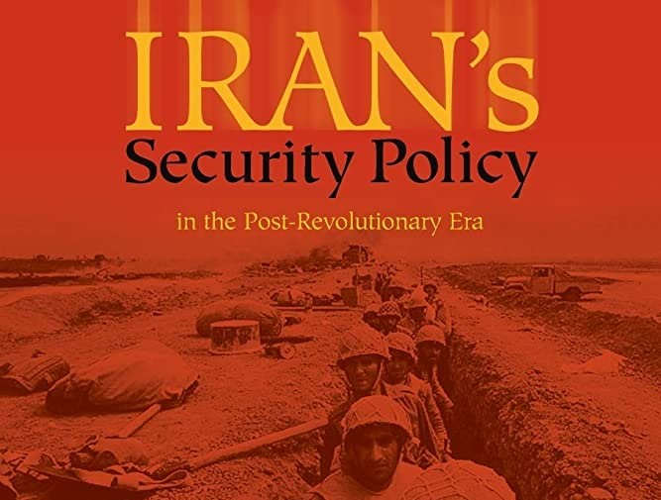
Iran’s security policies
When we come back to the main objective of Iran’s security policies, is:
1- To protect the territorial integrity of Iran,
2- To ensure the political independence of the Islamic Republic.
3- and to play an active and leading role in the Islamic world as a regional power,
As stated in Article 152 of the Iranian Constitution. While rejecting the “Neither East, Nor West” policy adopted by Iranian Khomeini, refusing to intervene in the domination and superintendence of superpowers, Article 146 of the Iranian Constitution prohibits any power to establish a military base in Iran.

Slide 6
Salahaddin University/ College of Political Science D. Diplomacy & International Relations
Contemporary policies and issues of national security
Iran’s National Security Part II
Dr. Shallaw A Mohammed
Shallaw.mohammed@su.edu.krd
Spring Semester (2024)

Slide 7
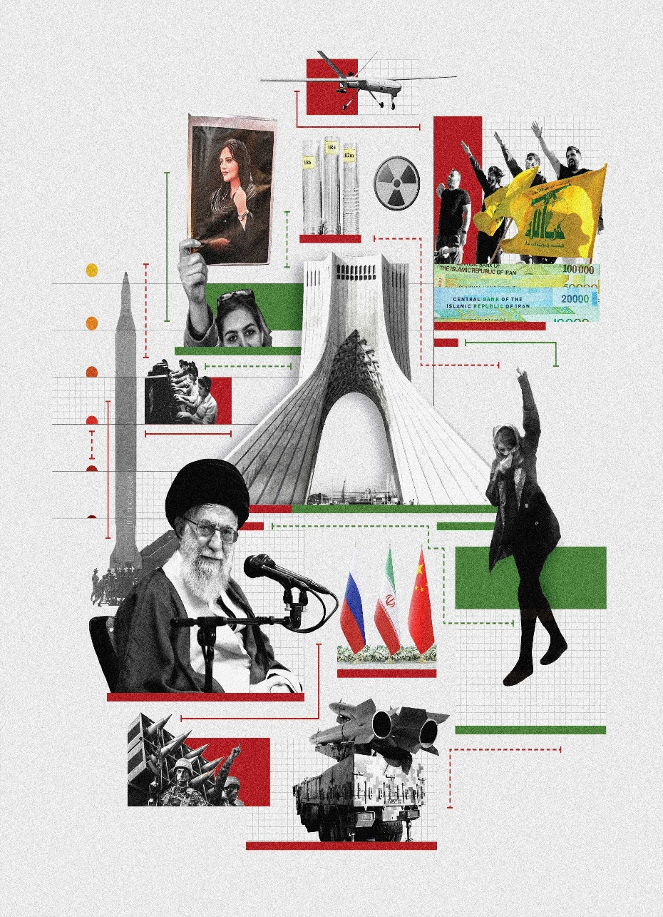
What are the most important issues that direct Iran's security policy?
Islamic revolution has caused a deep break and change in all Iranian policies. From this date on, internal policy issues in Iran’s security policies have become more influential than many other issues. But
Beside the internal issues, also There are four important issues that direct Iran’s security policies such as:
1- Persian nationalism coupled with Shiite sects.
2- Other important determinants of Iran’s security policies are Iran’s geopolitical position and its dependence on oil revenues. Iran is one of the countries with the world’s most important oil and natural gas reserves,
3- as well as an important country in many issues, from the Arab-Israeli conflict to the fight against terrorism (fighting against the Daesh and Al Qaeda organizations).
4- and nuclear disarmament.

Slide 8
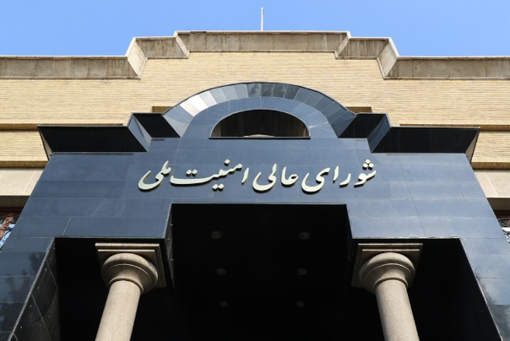
Iran’s national security concept
Iran’s national security concept includes the protection of the existence of the motherland, as well as religious and ethnic areas of influence, and especially its national interests.
In this context, in order to understand the security policies of Iran, which is a wide national security conceptualization, it is necessary and important to consider historical, political and social fields together with geographical integrity and geopolitical position in the framework of sectoral securitization.
Why is Iran's geopolitical position becoming increasingly important in the creation of security policies?
Since, in recent years, Iran has begun to focus on centralizing its economic interests, taking into account more geopolitical sensitivities, and developing policies on ethnic and regional issues, while setting foreign and security policies.
Iran’s Supreme National Security Council
شورای عالی امنیت ملی ایران

Slide 9
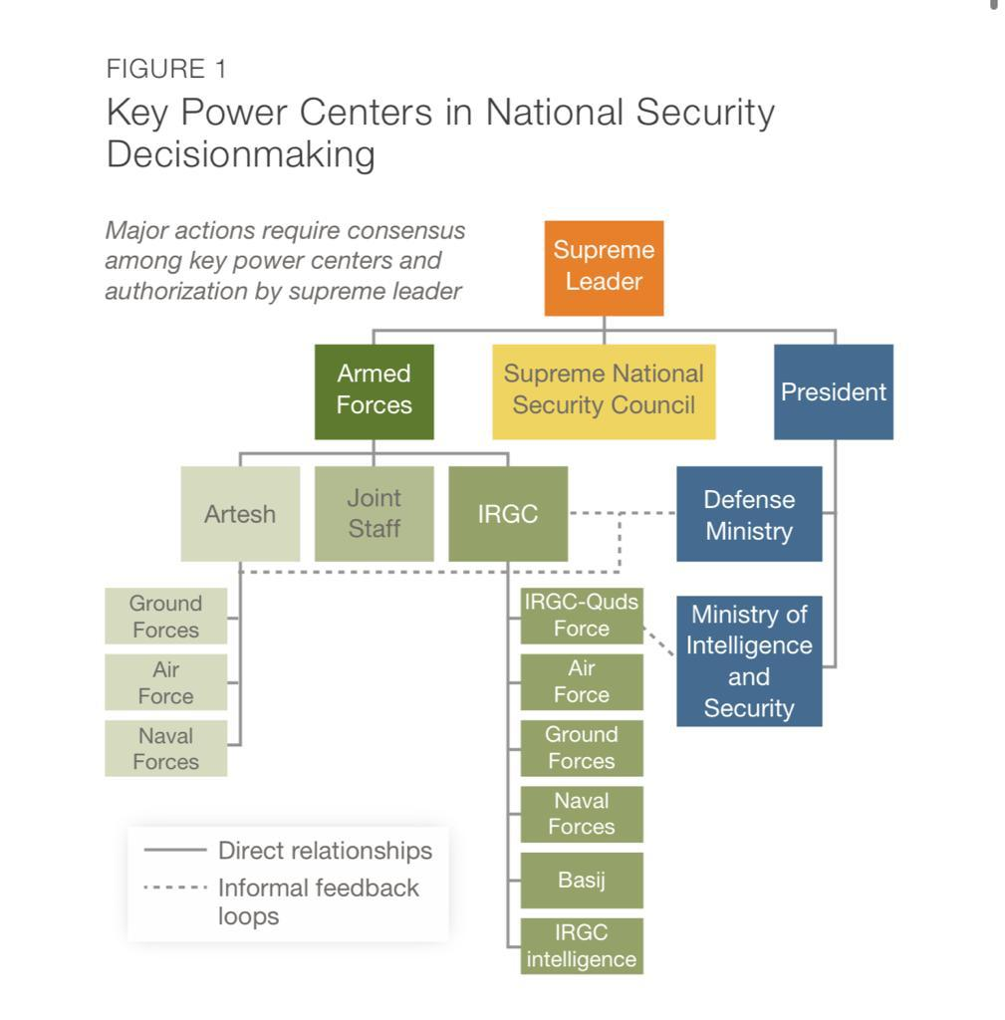
National Security and Military Capabilities
Although elites do not always agree on the nature and level of the threat posed by their adversaries and how best to approach them, the broad consensus within the system is that Iran should have a strong military and the capabilities to deter enemies and raise the costs of conflict.
So,
Fundamentally, Iran’s defense posture is based on deterrence. Because of its status within the international community as a pariah state, the general isolation of the Islamic Republic over the course of its existence, and sanctions, Iran is unable to acquire the military technology needed to compete with other nations. As a result, the country lacks the conventional capabilities of its adversaries and rivals. Since the 1980s, Iran has acquired two key deterrents: its missile program and its non-state partners in the region. More recently, it has also invested in building its cyber capabilities to serve as a force multiplier.

Slide 10
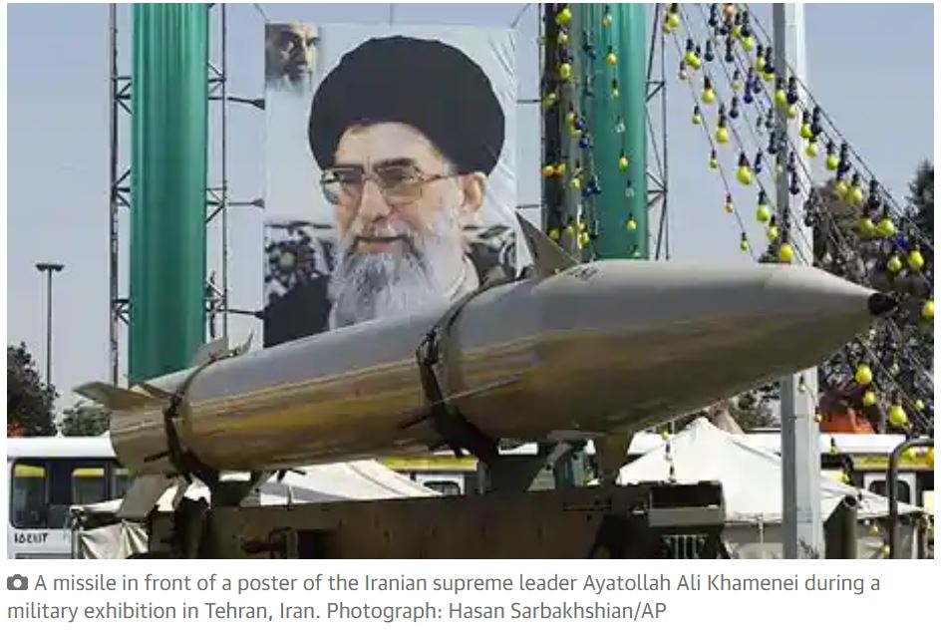
Why does nuclear weapons have become an indispensable issue in Iran’s security policies?
The US government has taken the list of countries that have nuclear weapons in the framework of the Bush Doctrine and Preventive War strategy and that have links to terrorist organizations to rogue countries and they have also been described as “Axis of Evil] In particular, the Middle East countries, Iran and Syria, the increased pressure of the invasion of Iraq and the military forces of US further threatened Iran. Iran understands that it is not enough to deter the conventional power of the US after this occupation, and that it should plan its defense for an asymmetric war strategy.
For this reason, nuclear weapons have become an indispensable issue in Iran’s security policies. Iran is perceiving the greatest threat to national security from within the country. The most obvious of these threats is economic problems. The Iranian economy is experiencing great difficulties due to embargos, intense military expenditures and commercial problems. The ongoing adverse effects of the Iran-Iraq War, the petroleum-dependent economy, the economic and political embargoes imposed by the US both affect Iran’s security policy and cause social problems.

