Slide 1

Salahaddin University/ College of Political Science
D. Diplomacy & International Relations
Contemporary policies and issues of national security
Second: Some special events that changed the nature and structure of security in an interconnected world.
Dr. Shallaw A Mohammed
Shallaw.mohammed@su.edu.krd
Spring Semester (2024)

Slide 2
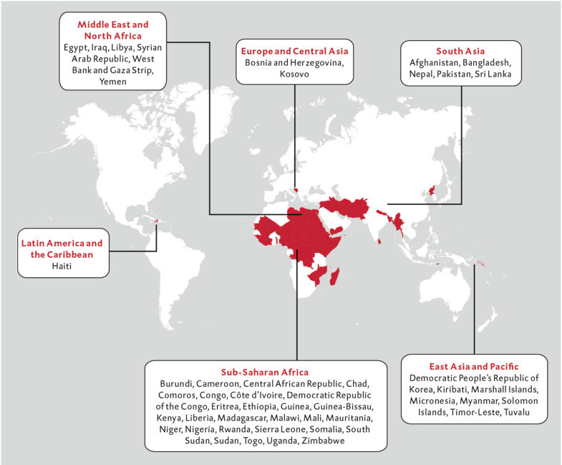
      First: Globalization
      (From the second half of the twentieth century to the present day)
The relationship between globalization and security is widening.
As a result of globalization, the state is no longer able to fully provide security to its citizens.
1-Some scholars assert that the link between globalization and security is imposed from the outside and is transforming the security environment within which states operate. Consequently, the state is portrayed as having a diminished capacity to produce security.
2-The opposing view holds that such accounts of the relations between globalization and security are deeply flawed and misleading, since they project an image of globalization as a disembodied process taking place over and beyond states, and simply impacting upon states, as a new constraining influence from the outside (Clark, 1999:107).
Fig. 2.3Fragile states. (Source: oecd, States of fragility 2015: 15; other states, such as Kazakhstan, Uzbekistan and Venezuela, could also be added to the list). Derived from: Hirsch Ballin E, Dijstelbloem H, de Goede P, 2020.

Slide 3
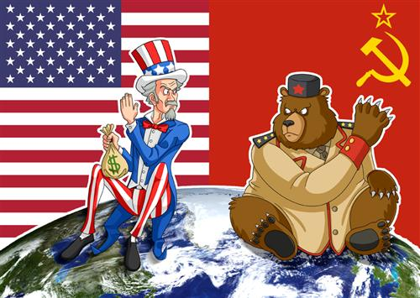
      Second: The Cold War
Since the 1980s, and to an even greater extent since the end of the Cold War, there has been a significant increase in concern for human rights and for economic and social development (human security).
National and international security are therefore linked to the security of the society and the individual. The security of the nation state is not a goal in itself, but is for the benefit of the society.
For example, the bipolar Cold War was followed by a unipolar world order, in which issues such as human security and the importance of multilateral institutions gained wider recognition, at least in many Western countries.

Slide 4
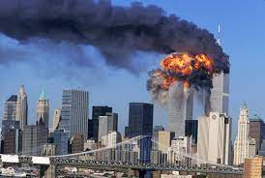
Third: 11 September 2001
Since 11 September 2001, the blurring of the boundaries between internal and external security has also entered the debate about security policy¹ with the realization that non-state actors such as Al Qaida and Da’esh have come to form part of the landscape of security and insecurity.
The sovereignty of states over their own territory only offers limited protection against transnational networks of this type.
An adequate geographic concept of security encompasses both the territories defined by individual states and the networks that override the borders between states.
Source: https://www.latimes.com/travel/la-xpm-2001-sep-12-na-sept-11-attack-201105-01-story.html

Slide 5
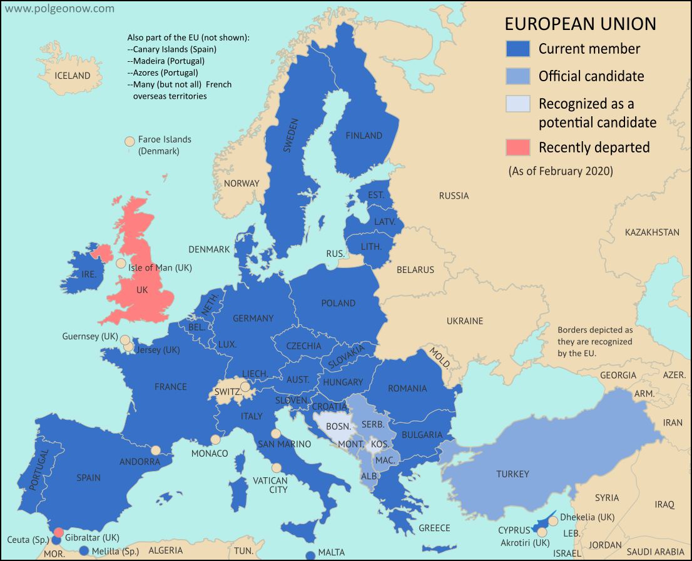
Forth: Transnational issues
Transnational issues such as migration, terrorism and climate change also mean that security is increasingly a matter for regional and international communities of states, such as the EU and NATO.
For example: Dutch security policy is part of European and North Atlantic security policy, although that does not mean that the Netherlands cannot set its own priorities within the security strategies of these alliances.
The European Union after the January 2020 departure of the UK and Gibraltar (pre-Brexit version here). Map by Evan Centanni, from blank map by Ssolbergj. License: CC BY-SA

Slide 6
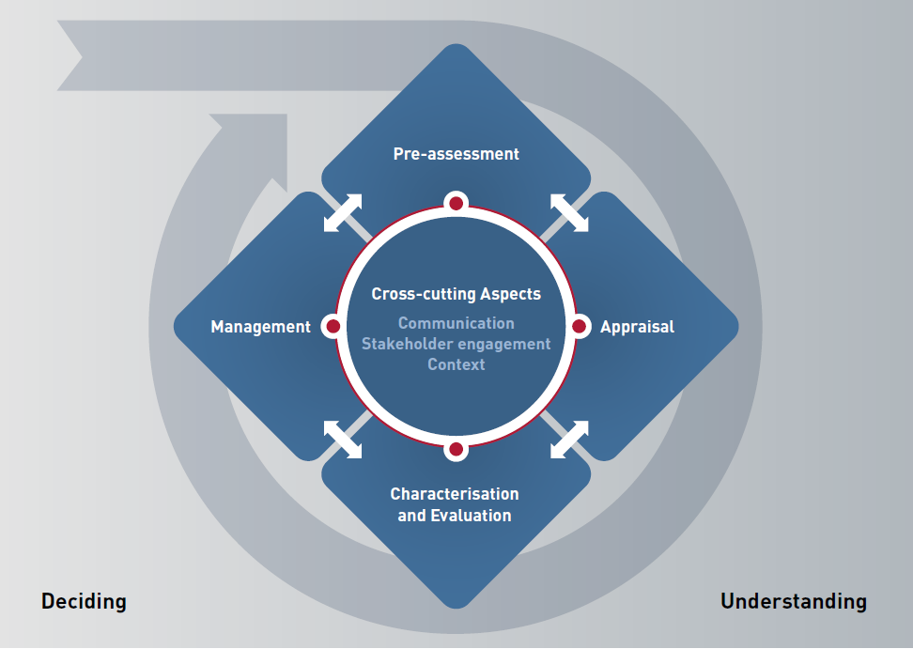
Fifth: Risk governance framework
Risk governance framework is a comprehensive approach to help understand, analyze and manage important risk issues for which there are deficits (shortfall ) in risk governance structures and processes. ...
Researchers call for improved governance to clarify, classify and confront emerging systemic risks.
The rise of risk governance is part of a trend towards ‘securitization’, by which we mean the enormous increase in recent years in concern for security, both in the sense of a desired situation and in the sense of policy or other activities aimed at achieving it.
https://irgc.org/risk-governance/irgc-risk-governance-framework/

Slide 7
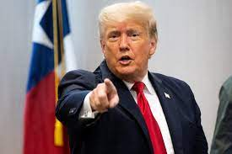
Sixth: Donald trump and Russian Ukraine war& the relative decline in the power of the West and the emergence of the Brics
countries
With the relative decline in the power of the West and the emergence of the brics countries – accelerated by recent developments in the belt of instability around Europe with the rise of Russian Ukraine war and the election someone like Donald Trump as president of the United States – a multipolar order now seems to be emerging in which the (collective) military defense of territorial integrity is once more growing in importance.
Traditional power politics or geopolitics seem to have returned (if indeed they ever went away)
.
Derived from: Hirsch Ballin E, Dijstelbloem H, de Goede P, 2020.

Slide 8
Quiz activity
Donald trump
How did Trump affect foreign and security policies?
Derived from: Hirsch Ballin E, Dijstelbloem H, de Goede P, 2020.

Slide 9
Thanks
Thanks

Slide 10
Bibliography
Hirsch Ballin, Ernst, Huub Dijstelbloem, and Peter de Goede. Security in an interconnected world: A strategic vision for defence policy. Springer Nature, 2020. Chapter2.
Jones, Peter. "Structuring Middle East Security." Survival 51, no. 6 (2009): 105-122.
Møller, B. (2000). The concept of security: The pros and cons of expansion and contraction. Copenhagen Peace Research Institute.
Mosala, Abram, The Impact of Globalisation on Security, Munich, GRIN Verlag, 2001. https://www.grin.com/document/376713

