Slide 1
Common disease between fish and humans

Slide 2
Common disease between humans and animal called (Zoonosis).
‘Zoonosis’ comes from the Greek words ‘zoon’ (animal) and ‘osis’ (ill).
A zoonoses are any diseases or infections that is naturally transmitted from vertebrate animals to humans. Animals thus play an essential role in maintaining zoonotic infections in nature. Zoonosis may be bacterial, viral, or parasitic, or may involve unconventional agents. As well as being a public health problem, many of the major zoonotic diseases prevent the efficient production of food of animal origin and create obstacles to international trade in animal products.
About 75% of human infectious diseases are thought to have come from animals, including wildlife.

Slide 3
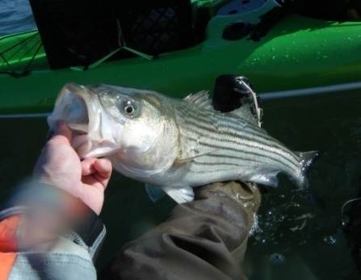
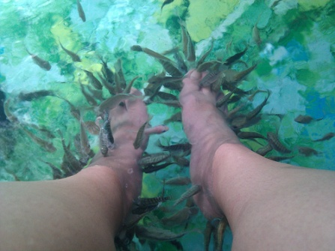
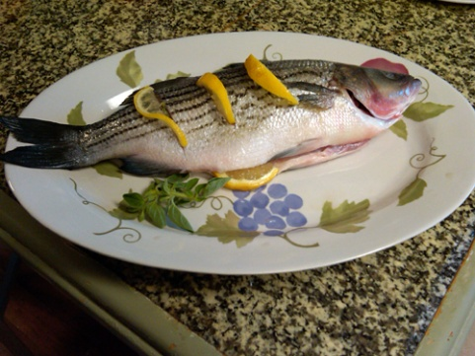
Zoonotic infections can be divided into:
a) Topically acquired infections, caused by contact with aquatic animals or their products
b) Foodborne infections, caused by the ingestion of raw or undercooked aquatic products.

Slide 4
Zoonosis in fish
Types of Fish zoonosis:
Bacteria: e.g. Mycobacterium marinum.
Trematodes: e.g. Heterophyes heterophyes.
Cestodes: e.g. Diphyllobothrium latum.
Nematodes: e.g. Anisakis simplex.
Note: There is no evidence in the literature of viral and fungal diseases transmitted from fish to man. There is concern, however, that pathogenic viruses are transmitted from shellfish and that fish may serve as reservoirs for human pathogens

Slide 5
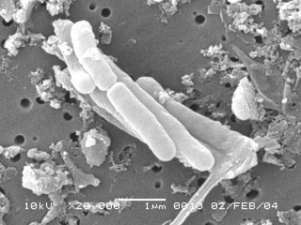
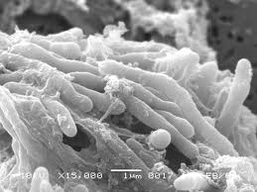
Mycobacterium marinum (Bacteria)
Scientific classification:
Kingdom : Bacteria
Phylum: Actimobacteria.
Family: Mycobacteriaceae
Genus: Mycobacterium
Species: M. marinum

Slide 6
Mycobacterium marinum (Bacteria)
Mycobacterium marinum is a free-living bacterium, found in cold or warm, fresh or salted water. which typically affects individuals who work with fish or keep home aquariums.

Slide 7
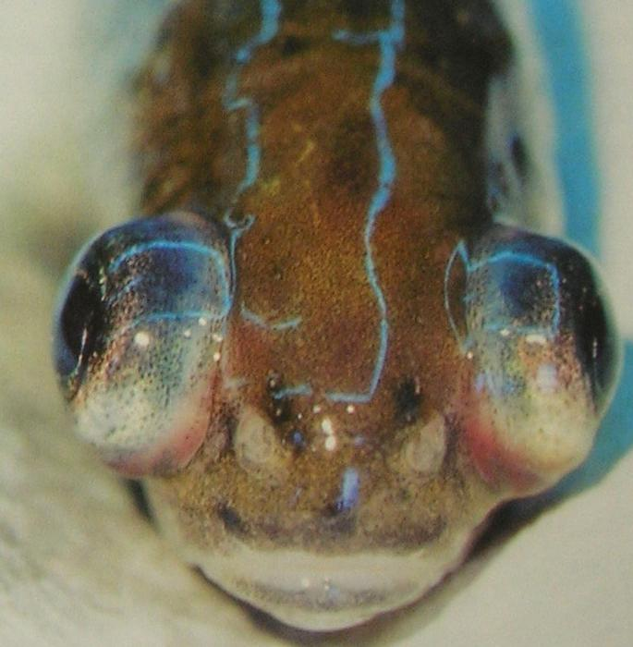
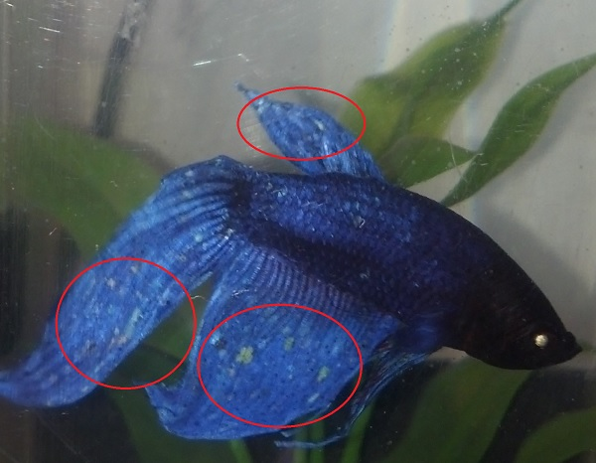
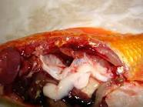
Symptoms in fish
In fish M. marinum causes:
Loss of scales.
Loss of appetite.
Discoloration.
Apathy.
Exophthalmus.
Skin lesions, ulcers fins, followed by death

Slide 8
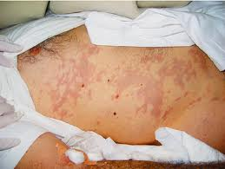
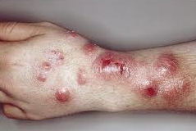
Symptoms in human
In human M. marinum causes:
Granulomatous inflammation and nodular of the skin.
Subcutaneous tissues and tendon sheaths of fingers and hands.

Slide 9
Treatment
treatment of infection by M. marinum is oral antibiotics, Clarithromycin is currently the preferred antibiotic selection.

Slide 10
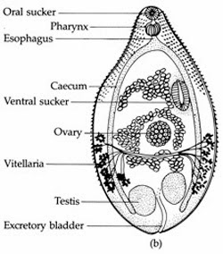
Heterophyes heterophyes (Trematoda)
Scientific classification:
Kingdom: Animalia
Phylum: Platyhelminthes
Class: Trematoda
Order: Opisthorchiida
Family: Heterophyidae
Genus: Heterophyes
Species: H. heterophyes

Slide 11
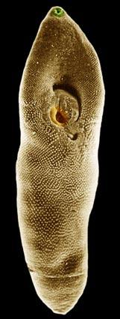
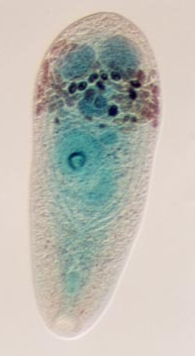
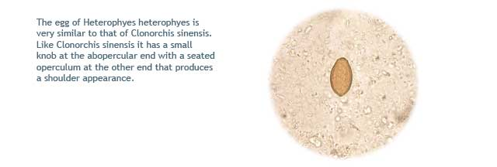
Heterophyes heterophyes (Trematoda)
Is a parasitic worm very small (only 1.7–2 mm long) and live attached at the wall of the intestine. Their body is covered with many spiny scales. Their ventral sucker lies laterally away from the median line.
Infects human by ingesting undercooked or salted fish containing metacercariae

Slide 12
Life cycle

Slide 13
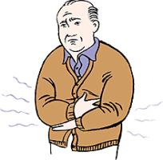
Symptoms :
No symptom on fish (fish is a medium host). Cercariae penetrate the skin of fish and encyst as metacercariae in the tissue of the fish.
In human (final host):
Diarrhea and abdominal pain.
The lining of the small intestine may break down.
Permitting the parasite's eggs to enter the bloodstream and be carried to other organs, especially to the heart, liver, and brain, where they can cause serious disease.
Eggs present in the stool (clinical test).

Slide 14
Treatment
Treatment is with anthelmintic Praziquantel

Slide 15
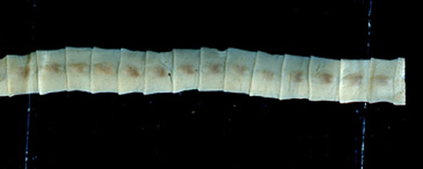
Diphyllobothrium latum (Cestoda)
Scientific classification
Kingdom: Animalia
Phylum: Platyhelminthes
Class: Cestoda
Subclass: Eucestoda
Order: Pseudophyllidea
Family: Diphyllobothriidae
Genus:Diphyllobothrium
Species: Diphyllobothrium latum

Slide 16
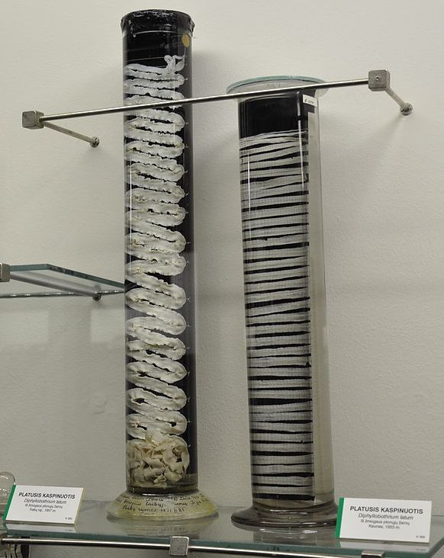
Diphyllobothrium latum (Cestoda)
The largest tapeworms that can infect people, can grow up to 30 feet long.
Humans can acquire the disease by eating intermediate infected host fish raw or undercooked

Slide 17
Life cycle

Slide 18
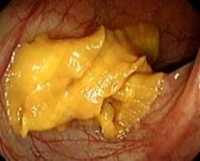
Symptoms
Fish is only a medium host. ingestion of infected crustaceans with larva. Then penetrate the muscle tissue of fish.
In human causes:
Diarrhea.
Abdominal pain.
Vomiting.
Weight loss and fatigue.
Anemia
can survive for 10 years or more in the human intestine without being detected.
vitamin B₁₂ deficiency due to the parasite absorbing 80% or more of the host’s B₁₂ intake.
Eggs present in the stool (clinical test).

Slide 19
Treatment
Praziquantal took orally.
vitamin B12 injections or supplements to treat the vitamin B12 deficiency and anemia that can occur with this infection.

Slide 20
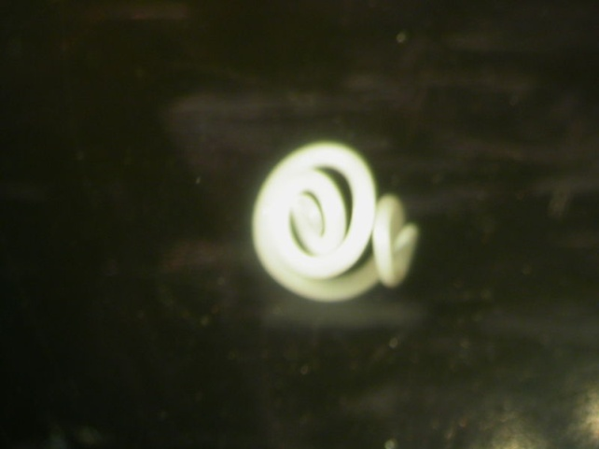
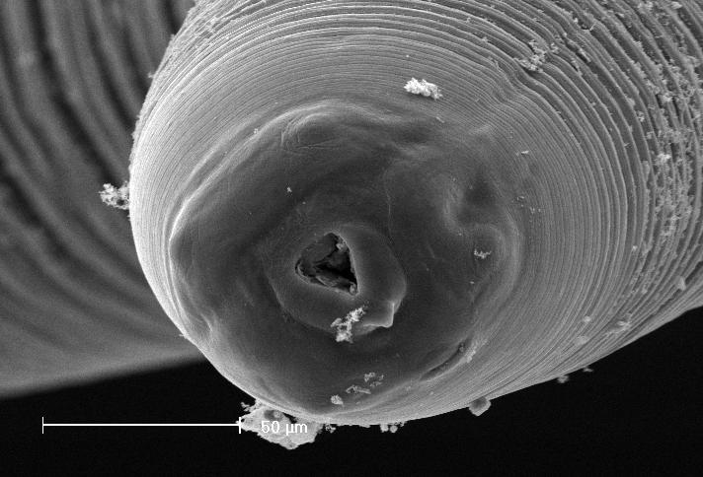
Anisakis simplex (Nematoda)
Scientific classification
Kingdom: Animalia
Phylum: Nematoda
Order: Ascaridida
Family: Anisakidae
Genus: Anisakis
Species :Anisakis simplex

Slide 21
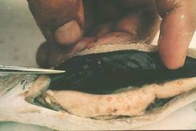
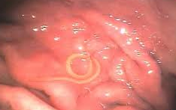
Anisakis simplex (Nematoda)
Is parasitic nematodes, which have life cycles involving fish and marine mammals.
Caused by the eating of raw or undercooked seafood containing larvae of the nematode.

Slide 22
Life cycle

Slide 23
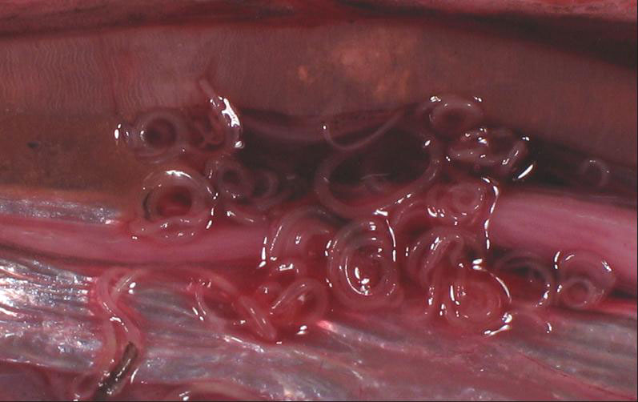
Symptoms
In fish:
Larva can be seen in the muscle tissue.
Can transmit from fish to another.
In human:
Abdominal pain.
Nausea
Vomiting
Diarrhea
Blood and mucus in stool
Mild fever
Allerg

Slide 24
Treatment
Infection can lead to small intestinal obstruction, which may require surgery in case of intestinal perforation.

