Slide 1
Epithelial tissue

Slide 2
Epithelial tissue
The epithelial tissue or epithelium consists of sheets of cells that cover the external surfaces of the body, line the internal cavities, form various organs and glands, and line their ducts.
It is derived from all three germ layers of developing embryo (ectoderm, mesoderm and endoderm).

Slide 3
Classification:
Epithelial tissue classify to:
1. Glandular epithelial tissue
2. Covering and lining epithelial tissue, which also classify to:
Simple:
1. Simple Squamous epithelial tissue (e.g. partial layer of Bowman ,s capsule in section of kidney)
2. Simple Cuboidal epithelial tissue (proximal convoluted tubule of kidney, surface of ovary and liver).
3. Simple Columnar epithelial tissue
a. Non-ciliated columnar epithelial tissue (stomach )
b. Ciliated columnar ep. (section of uterus).
4- pseudostratified columnar epithelial tissue
a. ciliated (section of trachea)
b. non-ciliated (section of male urethra and salivary gland)

Slide 4
B. Stratified:
1- Stratified squamous epithelial tissue
a. keratinized (section of skin)
b. non-keratinized (esophagus , pharynx)
2. Stratified cuboidal epithelial tissue (section of sweet gland).
3. Stratified columnar epithelial tissue
a. ciliated ( section of salivary gland)
b. non-ciliated (section of male urethra).
4- Transitional epithelial tissue ( section of ureter or urinary bladder).

Slide 5
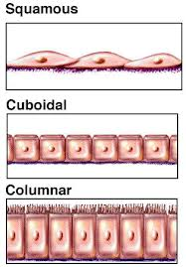

Slide 6
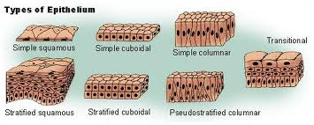

Slide 7
Glands
Exocrine gland
Endocrine gland
Mixed gland

Slide 8
Glands of the body are classified as either exocrine or endocrine types. Exocrine glands are glands that retain ducts to body surfaces. During development, endocrine glands lose their contacts to embryological surfaces (ducts) and become isolated as small blocks of tissues. Endocrine glands are therefore referred to as "ductless" glands.
Endocrine and exocrine glands secrete various products. These include hormones, enzymes, metabolites, and other molecules. In exocrine glands, products of these cells collect in the duct of the gland and flow toward the surface to which the duct is in contact. Since endocrine glands lack ducts, the product is released across the cell membrane into interstitial spaces around the cells. Diffusion of the product into capillaries follows.

Slide 9
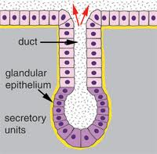

Slide 10
Exocrine gland
Multicellular
Unicellular ( C.S of small intestine or trachea showing goblet cell)
Multicellular are divided into two major categories:
Simple gland:
1. Tubular
a. Straight (C.S in large intestine showing intestinal gland)
b. Coiled ( thin skin showing sweat gland)
c. Branched ( C.S in pyloric stomach showing pyloric gland).
2. Alveolar or acinar
a. Unbranched ( frog , s skin showing poisonous gland)
b. Branched ( thin skin showing sebaceous gland)

Slide 11
Compound gland
a. Tubular (Kidney)
b. Alveolar (mammary gland)
c. Tubulo-alveolar ( salivary gland)
Classification of exocrine gland according to the kind of secretion:
1. Serous gland (Tongue or parotid gland).
2. Mucous gland (section of oesophagus middle part showing oesophageal gland).
3. Sero-mucous gland (section in submaxillary or sublingual gland).

Slide 12
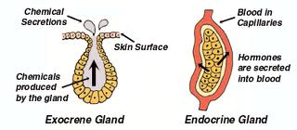

Slide 13
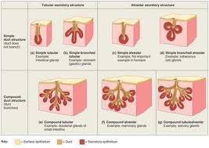

Slide 14
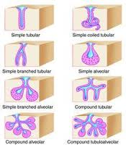

Slide 15
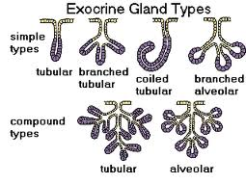

Slide 16
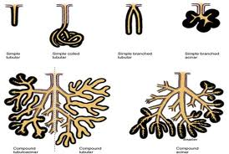

Slide 17
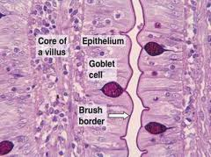
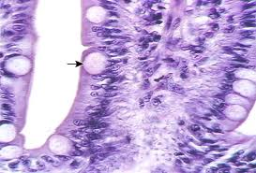

Slide 18
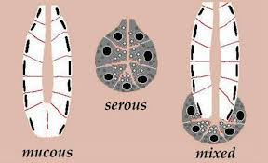

Slide 19
