Slide 1
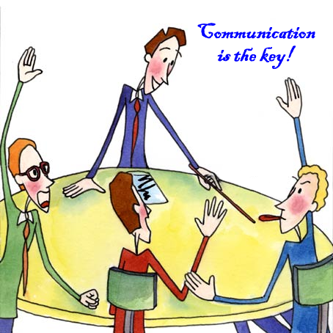
Community Language Learning

Slide 2
Community language learning (CLL) is a language-teaching approach in which students work together to develop what aspects of a language they would like to learn. It is developed by Charles A. Curran, in which the teacher acts as a counselor while the learner is seen as a client and collaborator...

Slide 3
What are the goals of teachers who use the Community Language Learning Method?
Teachers who use CLL want their students to learn how to use the target language communicatively. In addition, they want their students to learn about their own learning, to take increasing responsibility for it, and to learn how to learn from one another. All of these objectives can be accomplished in a non-defensive manner if the teacher and learner(s) treat each other as whole persons, valuing both thoughts and feelings.

Slide 4
What is the role of the teacher? What is the role of the students?
The teacher’s initial role is primarily that of a counselor.
he learners are very dependent upon the teacher. It is recognized, however, that as the learners continue to study, they become increasingly independent.

Slide 5
What are some characteristics of the teaching/learning process?
According to Curran, there are six elements necessary for non-defensive learning.
The first of these is security.
Aggression, by which Curran means that students should be given an opportunity to assert themselves, be actively involved, and invest themselves in the learning experience.
The third element is attention.

Slide 6
Reflection, was when the students reflected on the language as the teacher read the transcript three times.
Retention is the fifth element, the integration of the new material that takes place within the whole self.
The last element is discrimination, sorting out the differences among target language forms

Slide 7
What is the nature of student–teacher interaction? What is the nature of student–student interaction?
The nature of student-teacher interaction in CLL changes within the lesson and over time. Sometimes the students are assertive, as when they are having a conversation.

Slide 8
5. How are the feelings of the students dealt with?
Responding to the students’ feelings is considered very important in CLL. One regular activity is inviting students to comment on how they feel. The teacher listens and responds to each comment carefully. By showing students he understands how they feel, the teacher can help them overcome negative feelings that might otherwise block their learning.

Slide 9
How is the language viewed? How is culture viewed?
Language is for communication and Culture is an integral part of language learning.

Slide 10
What areas of language are emphasized? What language skills are emphasized?
Particular grammar points, pronunciation patterns, and vocabulary are worked with, based on the language the students have generated. The most important skills are
understanding and speaking the language at the beginning, with reinforcement through reading and writing.

Slide 11
What is the role of the students’ native language
Students’ security is initially enhanced by using their native language. It is used when it is necessary

Slide 12
9. How is evaluation accomplished?
Evaluation depends on the requirement of the school.
Teacher-made classroom test would likely be more of an integrative test than a discrete-point one. Students would be asked to write a paragraph or be given an oral interview, rather than being asked to answer a question which deals with only one point of language at a time.
Finally, it is likely that teachers would encourage their students to self-evaluate—to look at their own learning and to become aware of their own progress.

Slide 13
10. How does the teacher respond to student errors?
Teachers should work with what the learner has produced in a nonthreatening way. One way of doing this is for the teacher to recast the student’s error, i.e. to repeat correctly what the student has said incorrectly, without calling further attention to the error.

Slide 14
Techniques
Recording Student Conversation
Transcription
Thinking about the Experience
• Reflective Listening
Human ComputerTM
Small Group Tasks

