Slide 1
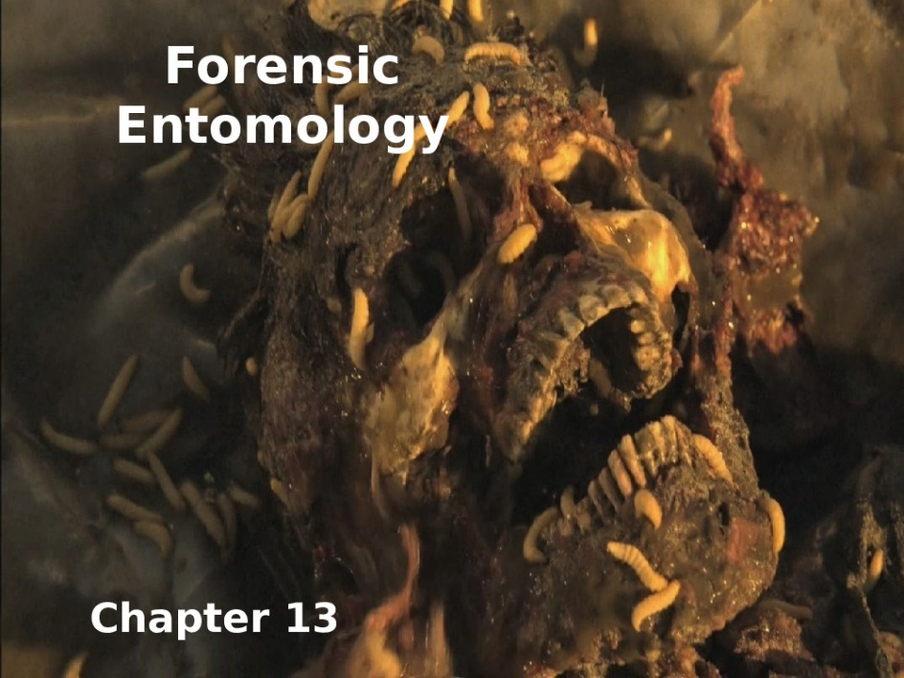
Plant protection
Elective - Forensic insects
Stage- 4th
Lecture 6
11/16/2021
Dr. Shatha H. Ahmed

Slide 2
Late Stage Decomposition
1-House fly: Musca domestica Linnaeus
Order: Diptera
Family:Muscidae
Distribution:
This common fly originated on the steppes of central Asia, but now occurs on all inhabited continents, in all climates from tropical to temperate, and in a variety of environments ranging from rural to urban. It is commonly associated with animal feces, but has adapted well to feeding on garbage, so it is abundant almost anywhere people live.
Life Cycle: The house fly has a complete metamorphosis with distinct egg, larval or maggot, pupal, and adult stages. The house fly overwinters in either the larval or pupal stage under manure piles or in other protected locations. Warm summer conditions are generally optimum for the development of the house fly, and it can complete its life cycle in as little as seven to ten days. However, under suboptimal conditions the life cycle may require up to two months. As many as 10 to 12 generations may occur annually in temperate regions, while more than 20 generations may occur in subtropical and tropical regions

Slide 3
Description:
Egg: white egg, about 1.2 mm in length, is laid singly but eggs are piled in small groups. Each female fly can lay up to 500 eggs in several batches of 75 to 150 eggs over a three to four day period. Eggs must remain moist or they will not hatch.
Larva: Early instar larvae are 3 - 9 mm long, typical creamy whitish in color, cylindrical but tapering toward the head. The head contains one pair of dark hooks. The legless maggot emerges from the egg in warm weather within eight to 20 hours. Maggots immediately begin feeding on and developing in the material in which the egg was laid. The larva goes through three instars and a full-grown maggot, 7 to 12 mm long. Larvae complete their development in four to 13 days at optimal temperatures, but require 14 to 30 days at temperatures of 12 to 17°C. Nutrient-rich substrates such as animal manure provide an excellent developmental substrate. When the maggot is full-grown, it can crawl up to 50 feet to a dry, cool place near breeding material and transform to the pupal stage.
Pupa: The pupal stage, about 8 mm long, which varies in color from yellow, red, brown, to black as the pupa ages. bluntly rounded at both ends, . Pupae complete their development in two to six days at 32 to 37days,but require 17 to 27 days at about 14°C).
Adult: The house fly is 6 - 7 mm long, with the female usually larger than the male. The head of the adult fly has reddish-eyes and sponging mouthparts. The thorax bears four narrow black stripes and abdomen is gray or yellowish with dark midline and irregular dark markings on the sides. Adults usually live 15 to 25 days, but may live up to two months. Without food, they survive only about two to three days. Longevity is enhanced by availability of suitable food. They require food before they will copulate. Oviposition commences four to 20 days after copulation.

Slide 4
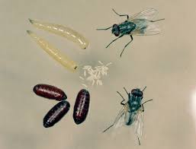
1-House fly: Musca domestica Linnaeus

Slide 5
1- cheese skipper : Piophila casei
Order: Diptera
Family:Piophilidae
The cheese skipper sometimes called the ham skipper. These flies receive their name due to the unusual ability of the larvae to propel themselves through the air. The flies are feeding on decaying matter, and even have been found on the exhumed remains of Egyptian mummies . Because of their delayed infestation of decaying remains, Piophila casei (Linnaeus) have been implicated as useful in the forensic investigation of postmortem remains and the determination of "time since death" .
Often found as pests in meat and cheese, these small flies often are cited as a cause of accidental enteric (intestinal) myiasis .
Distribution:
Cheese skippers have a worldwide distribution, including the United States, and are not limited to any specific geographic location
Habitat :Piophila casei usually feed on overripe (three or more months old) and moldy cheese, and slightly salted or putrid-smelling meats, such as ham, bacon, and beef. Larvae are typically found on high-protein substrates ranging from salted beef to smoked fish and animal carcasses.

Slide 6
Description :
Adults: Cheese skipper adults are usually about half the size of a common house fly. Males are 4.4-4.5 mm , whereas females are slightly larger. The dominant color of both males and females is a metallic black-bronze . Antennae are short. The compound eyes are usually bare and red in color. The thorax has distinct rows of setae. The legs are covered with short spines and often have both yellow and brown colorations. Halteres are typically a pale-yellow color. Adults live for three to seven days
Eggs: The eggs of the cheese skipper are 0.63-0.74 mm long and 0.18-0.2 mm wide. A female usually deposits 140-500 eggs on meat or cheese
The chorion (shell) of each egg is oval/cylindrical and a smooth, pearly white color. Eggs usually hatch between 23 and 54 hours in a temperature range of15° to 27°C.
Larvae: The larvae of the cheese skipper are active as soon as they hatch from the egg and appear fairly cylindrical and white, except for sclerotized black mouthparts. The three larval instars typically last 14 days total . Full-grown larvae are 13-segmented, typically 9-10 mm long and approximately 1 mm wide, and appear white or yellowish-white

Slide 7
Pupae: The dark brown pupae of the cheese skipper are formed approximately 32 hours after the larvae abandon the substrate on which they are feeding. Though they prefer dry, dark locations, Piophila casei larvae will pupate on open concrete floors if such spaces are not available. The oval puparium is typically 2.9-3.9 mm long and 1-1.7 mm wide . Adults emerge after approximately 12 days.
Life Cycle
Piophila casei undergo complete metamorphosis. Females mate almost immediately after adult emergence . Although feeding on protein sources increases fecundity of the insects.
The complete life cycle of a cheese skipper in appropriate nourishment and temperature conditions can be as short as 12 days (1 day for egg development, 5 day larval maturation, 5 day pupal maturation, 1 day of adult feeding before reproduction). However, the typical life cycle is as follows Egg ~23 to 54 hours - Larva ~14 days - Pupa ~12 days - Adult ~3 to 7 days

Slide 8
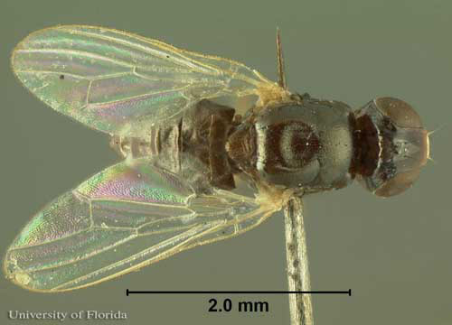
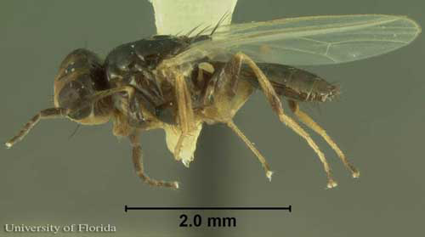
Forensic Importance:
Forensic entomologists have used the presence of Piophila casei larvae as a tool to assist in the estimation of time of death for human remains. The flies sometimes do not appear on an exposed corpse until three to six months postmortem (after death), usually after the body has completed the "active decay" decomposition stage and is beginning to dry . Entomologists utilize knowledge of the current instar of collected larvae, coupled with measurements of weather and temperature conditions, to provide an estimation of the postmortem interval . Furthermore, unlike some other insects used in forensic investigation, the presence of drugs such as heroin do not significantly alter the development of Piophila casei larvae.

Slide 9
Examples of Coleoptera (Beetles)Associated with Forensic invstegation
Early Stage Decomposition
1-Family:Silphidae
Silphidae is a family of beetles that are known commonly as large carrion beetles, carrion beetles or burying beetles. There are two subfamilies: Silphinae and Nicrophorinae. Both subfamilies feed on decaying organic matter such as dead animals. The subfamilies differ in which types of carcasses they prefer. Silphidae are considered to be of importance to forensic entomologists because when they are found on a decaying body, they are used to help estimate a post-mortem interval.
Example of family:
Shore sexton beetle Necrodes littoralis
Is a common silphid beetle that visits and breeds on large vertebrate cadavers. This insect is both a necrophages and a predator of fly larvae (maggots) and is thus a species of interest for forensic entomology . Although many authors reported Necrodes species on human corpses.

Slide 10
Distribution:
This widespread species is locally abundant throughout the Palaearctic region from Portugal to the far east of Russia, China and Japan; in Europe it occurs from lowlands to the upper tree line in mountain regions and extends north to the UK and far above the Arctic Circle in Scandinavia, it is present throughout Asia Minor and on many of the Mediterranean islands but absent from North Africa and the Atlantic islands
Description:
Adult: Necrodes littoralis is a large 15 -25 mm long necrophagous beetle. The adults are shiny black, with a characteristic bump about three-quarters of the way down the tricostate truncated elytra.
Larva: Larvae are campodeiform, with a central longitudinal light-colored line running the entire length of dorsum.
Pupation occurs in pupal cells dug into the ground away from the cadaver.

Slide 11
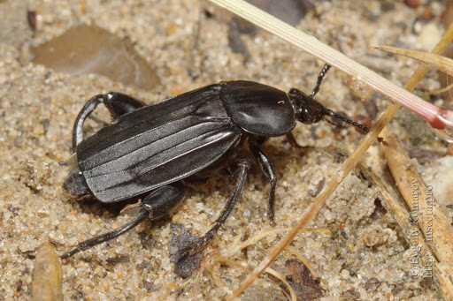
Forensic Importance:
They are a very important tool in determining a post-mortem interval by collecting Silphid progeny from the carcass, and determining the developmental rate. Based on the number of instars and the larval development stage, a time of death can be estimated. This is very useful in medico criminal entomology
Silphidae are being studied to find more exact estimations of post-mortem intervals and possible manners of death. Also, in the future, entomologists will explore the social behavior of the beetles to a greater degree. Members of family Silphidae are typically the first of the coleopterans to come in contact with carrion. Silphidae larvae are predators that will feed on dipteran eggs, larvae, and on the carcass itself.

