Slide 1
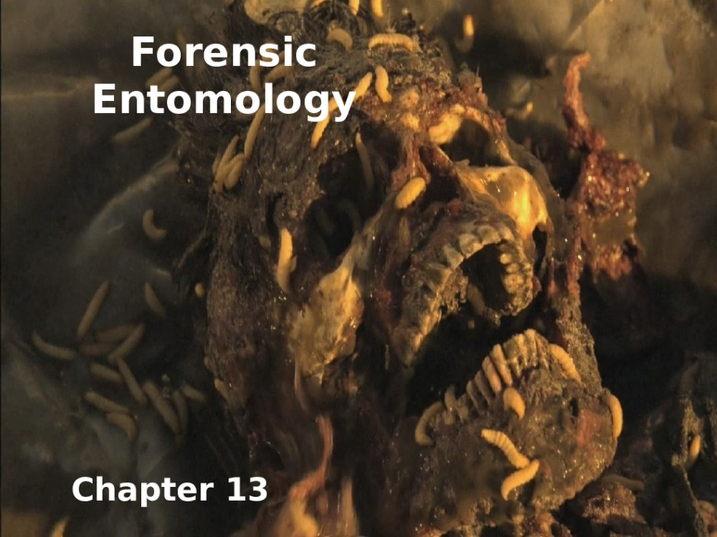
Plant protection
Elective - Forensic insects
Stage- 4th
Lecture 7
12/1/2022
Dr. Shatha H. Ahmed

Slide 2
2-Family :Histeridae
A family of beetles commonly known as clown beetles
or Hister beetles. found worldwide. They can be easily identified by them
1-Shortened elytra that leaves two of the seven tergites exposed
2-Geniculate (elbowed) antennae with clubbed ends. These predatory feeders. Hister beetles have proved useful during forensic investigations to help in time of death estimation.
Distribution:
Hister beetles are found throughout the world in various habitats. The beetles live in dung, carrion, dead vegetation, sandy areas, under tree bark, mammal burrows, and ant/termite colonies.

Slide 3
Importance in forensics:
Flesh eating insects arrive at the dead body within a few hours. Certain species of the Hister beetles follow shortly behind and prey on the maggots and other arthropods present. The Hister beetle is more prevalent in Spring and Summer.The family, Histeridae, is very diverse, so different species can be found on the body at different times because of their various feeding habits. This needs to be noted when examining a dead body. They are predacious beetles and arrive when there is material to feed on, like other beetles or maggots. They do not actually feed on the carrion.

Slide 4
General Description:
Egg: The eggs of most species are off-white and oval in shape.
Larval:The larval stage of the beetle typically goes through two instars, the second instars the longest stage of its entire development, taking up 39% of the overall development time. There is some pigmentation around the body and it is horizontally segmented. The legs are short and do not help much in locomotion. They move mostly through muscular contraction.

Slide 5
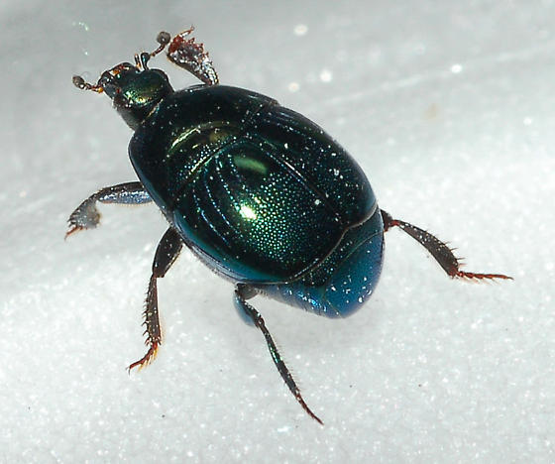
Pupal;
The pupal form of the beetle is similar in appearance to the adult form. They have outer cells produced in the larval stages. While they pupate, they breathe through spiracles on the abdomen. The beetle is non-feeding and immobile in this stage, as their internal structure is breaking down and rebuilding to its adult form. Under good temperature conditions the Hister beetle will stay in the pupal stage for about a week.
Saprinus pennsylvanicus

Slide 6
Late Stage Decomposition
1-Family: (Cleridae)
Ham & Checkered Beetles (Cleridae)
They are commonly known as checkered beetles. The family Cleridae has a worldwide distribution, and a variety of habitats and feeding preferences. Most genera are predaceous and feed on other beetles and larvae; however other genera are scavengers or pollen feeders.
Example for the Family:
red-legged ham beetle, Necrobia rufipes
Description:
Egg: banana-shaped, slightly curved, smooth, shiny, somewhat translucent and stick to the surface. After a few days, the pigmentation of the embryonic eyes and mouthparts and the ends of the body becomes visible.

Slide 7
larva: Elongated and moderately hairy. It has three jointed pairs of legs. The end of the abdomen has a pair of pincers-shaped appendages. larvae can move relatively quickly. As a rule, three to four larval stages can be distinguished.
Pupa
To pupate, the larvae crawl into crevices in the substrate or they leave the substrate and crawl nearby. Then they make a cocoon, which takes about a day. Pre-pupal stage and pupal stage are about the same length, together an average of 13 days

Slide 8
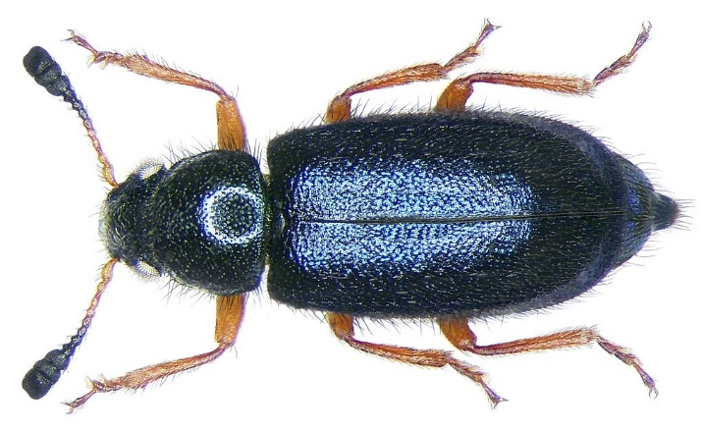
Adult:
They are shiny metallic green or greenish blue. The legs and antennae
are red (dark clubs).
They feed on the meat-infesting larvae of Calliphora or blow flies, Dermestidae and Piophilidae. The adults are surface feeders; the larvae bore into dry or smoked meats and do most damage. The red-legged ham beetle also attacks bones, dried egg, cheese, bone meal, dried figs, Necrobia rufipes has been recorded in Egyptian mummies and were once known as Necrobia mumiarum

Slide 9
distribution:
The species is distributed worldwide today. The specimen for the first description comes from Suriname in South America
Importance in forensics:
Since clerids are predaceous in nature, they have been found
feeding on fly larvae as well as the skin and bones of carrion.
Most clerids are not useful in forensics because of their food choice ,but some species such as Necrobia rufipes can be useful.

Slide 10
2- Family: Dermestidae
Commonly referred to as skin beetles. Other common names include larder beetle, hide or leather beetles, carpet beetles, and khapra beetles. Dermestids have a variety of habits; most genera are scavengers that feed on dry animal or plant material, such as skin or pollen, animal hair, feathers, dead insects and natural fibers. Members of Dermestes are found in animal carcasses, while others may be found in mammal, bird, bee, or wasp nests. These beetles are significant in forensic entomology. Some species are associated with decaying carcasses

Slide 11
Example for family:
Hide beetle Dermestes maculatus DeGeer1
Distrbution:Cosmopolitan.
Description:
Eggs Dermestes maculatus eggs are typically laid in batches. Larvae The bodies of the larvae are covered in rows of hairs of different lengths, called setae. Two long horn-like protrusions are located on the upper surface of the last segment.

Slide 12
Pupae :The pupae are an oval shape, usually smaller than the larvae, and do not have the many long hair-like projections
Adults: Each side of the thorax has a band of white hairs. The underside of the abdomen is white with black spots, and a large black patch on the last segment. The elytra are dark brown or black, with black, yellow, or white hairs. The antennae are short, with a club segmente at the tip.

Slide 13
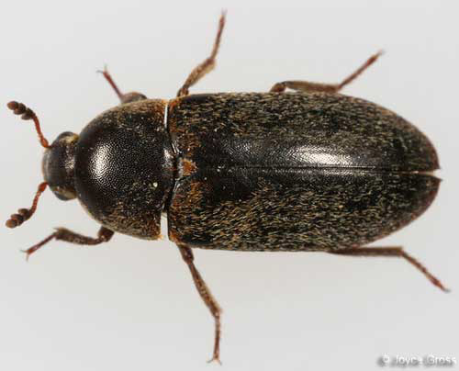
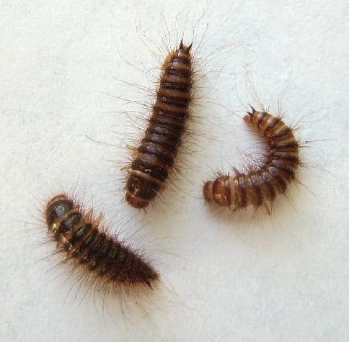
Forensic Importance;
The appearance of D. maculatus on decomposing remains of human and other animals makes it a candidate.
1- insect to estimate postmortem interval in cases of suicide maculates have been collected as late as day 51 following death . While the adults have been detected at early stages of decay, the larvae are the life stage used for post-mortem interval estimation. Larvae do not appear on corpses until the later stages of decay when the body has dried out.
2-The presence of these beetles can be detected through identification of their feces, which appears dark brown and stringy.

Slide 14
3-Due to their ability to clear skin and hair off bodies cleanly, D. maculatus can be used to clean bones to assist with forensic cases. Cleaned bones can offer evidence of demographical information, such as age and gender, or evidence of trauma, and possibly marks left in the bone by knives or saws. The beetles are particularly useful for small, delicate bones, which may be harmed by chemical material.

