Slide 1
Insect Reproductive System
Structure & Functions

Slide 5
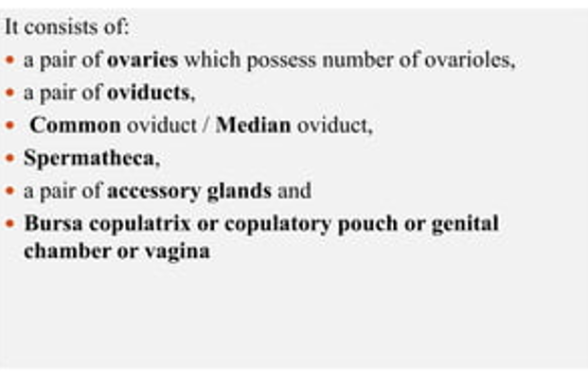

Slide 6
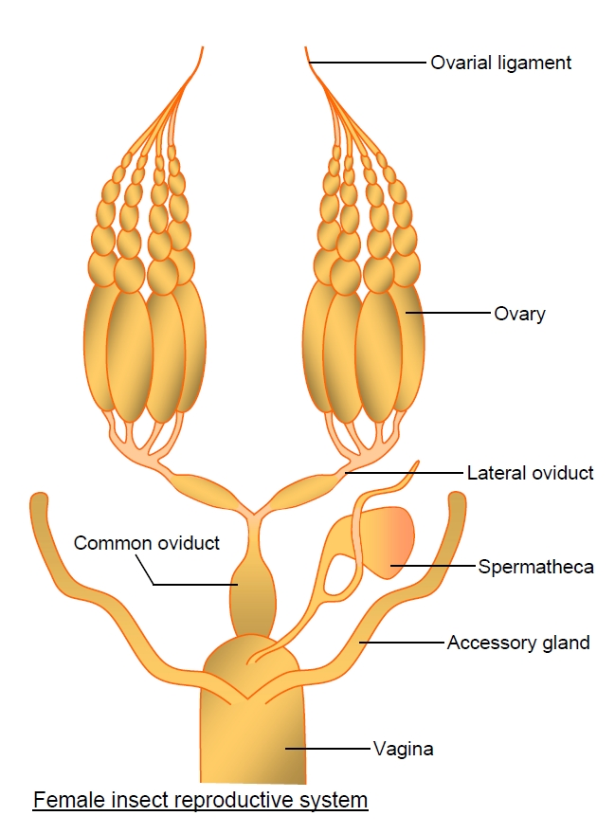

Slide 7
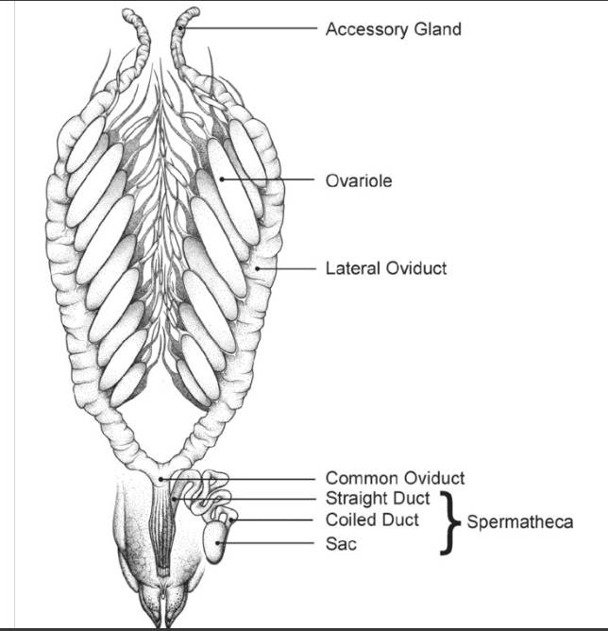
Schematic drawing of the ventral view of the female reproductive system of the African migratory locust (Locusta migratoria migratorioides). For clarity, the paired ovaries are pulled slightly apart and the spermatheca is uncoiled to show the various parts. The figure is modified from Lange (2009b) and is drawn by and reproduced with permission of Paul Hong.

Slide 8
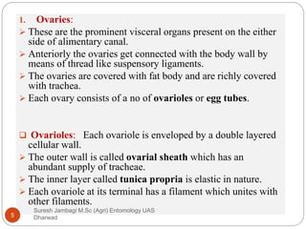

Slide 13
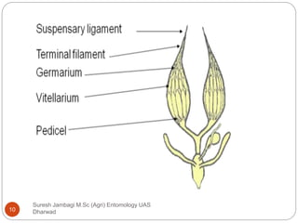

Slide 17
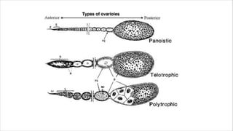

Slide 23
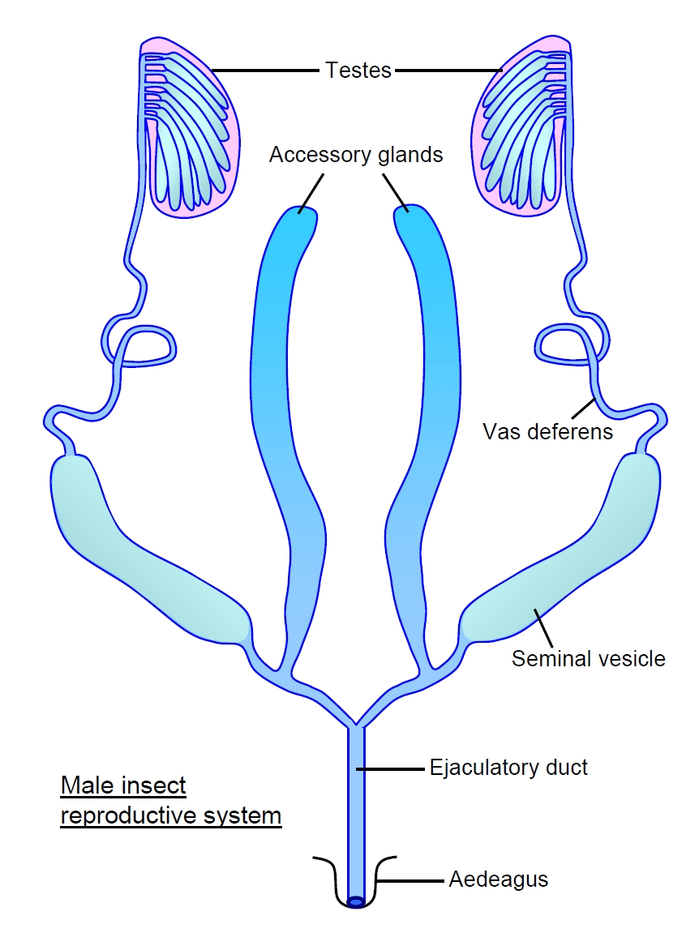

Slide 24
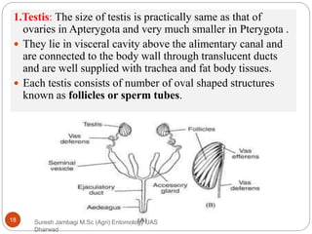

Slide 29
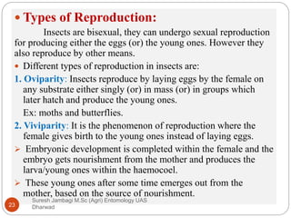

Slide 30
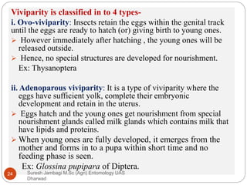

Slide 31
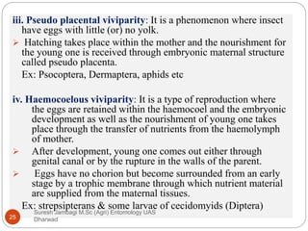

Slide 34
