Slide 1
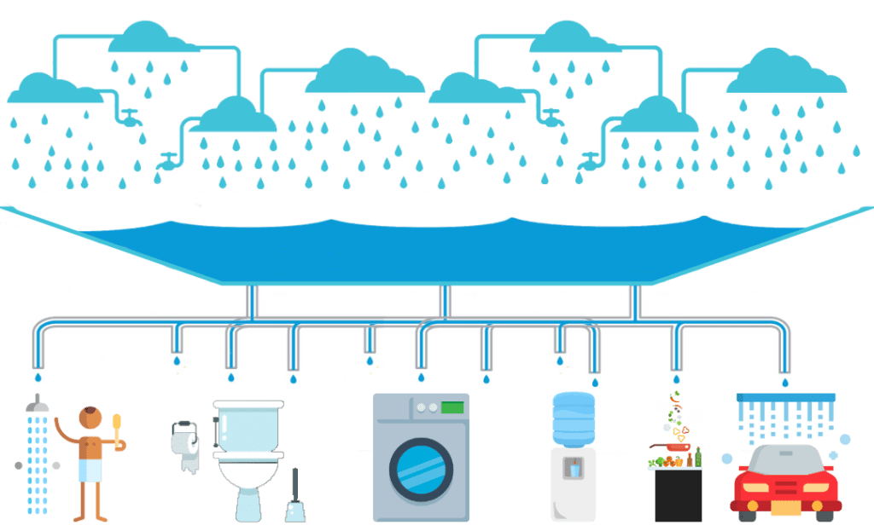
Rainwater Harvesting
Prepared by:
Shawnm M. Saleh

Slide 2
Introduction
Rainwater harvesting is a simple strategy by which rainfall is gathered and stored for future usage. The process involves collection and storage of rainwater with help of artificially designed systems, that runs off natural or man-made catchment areas e.g. rooftop, rocky surface, hillslopes or artificially repaired impervious/semi-pervious land surface.
There are basically three areas where rainwater can be used:
Irrigation use
Indoor, non-potable use
Whole house, potable use
Notes:
Non-potable non drinking water (lundary, toilet flushing, c

Slide 3
Advantages of Rainwater Harvesting
Rainwater is a free source and relatively clean and with proper treatment can be even used as a potable water source.
It uses simple technologies that are inexpensive and easy to maintain.
Helps in reducing the water bill.
Decreases the demand for water.
Promotes both water and energy conservation.
Does not require a filtration system for landscape irrigation.
It is an excellent source of water for landscape irrigation with no chemicals, dissolved salts and free from all minerals.
To reduce the run-off which chokes the drains.
To avoid the flooding of roads.
To raise the underground water table.
To reduce groundwater pollution.
To reduce soils erosion.
It reduces pollution of surface water with fertilizers, pesticides, metals and other sediments.

Slide 4
Disadvantages of Rainwater Harvesting
Regular maintenance is required.
Requires some technical skills for installation.
If not installed correctly, it may attract mosquitoes and other waterborne diseases.
Storage is limits.

Slide 5
Methods of Rainwater Harvesting
1. Rooftop rainwater harvesting : It is a system of catching rainwater where it falls. In rooftop harvesting, the roof becomes the catchments, and the rainwater is collected from the roof of the house/building. It can either be stored in a tank or diverted to artificial recharge system. This method is less expensive and very effective and if implemented properly helps in augmenting the ground water level of the area.
2. Surface runoff harvesting: It is the system that collects rainwater, which flows away as surface runoff. The runoff rainwater is caught and used to recharge aquifers by adopting appropriate techniques.

Slide 6
Rooftop Rainwater harvesting systems consists of the following components:
1. Catchments: The catchment of a water harvesting system is the surface which directly receives the rainfall and provides water to the system.
2. Mesh: Coarse mesh at the roof to prevent the passage of debris.
3. Gutters: Channels all around the edge of a sloping roof to collect and transport rainwater to the storage tank.
The size of the gutter should be according to the flow during the highest intensity rain. It is advisable to make them 10 to 15 per cent oversize.
Gutters need to be supported so they do not fall off when loaded with water.
4. Conduits: Conduits are pipelines that carry rainwater from the catchment area to the harvesting system. Conduits can be of any material like polyvinyl chloride (PVC) or galvanized iron (GI), materials that are commonly available.
5. First-flushing: A first flush device is a valve that ensures that runoff from the first spell of rain is flushed out and does not enter the system. This needs to be done since the first spell of rain carries a relatively larger amount of pollutants from the air and catchment surface.

Slide 7
Rooftop Rainwater harvesting systems consists of the following components:
6. Filter: The filter is used to remove suspended pollutants from rainwater collected over roof. A filter unit is a chamber filled with filtering media such as fiber, coarse sand and gravel layer to remove debris and dirt from water before it enters the storage tank or recharge structure
i. Charcoal water filter: A simple charcoal filter can be made in a drum or an earthen pot. The filter is made of gravel, sand and charcoal, all of which are easily available. ii. Sand filters: Sand filters have commonly available sand as filter media. Sand filters are easy and inexpensive to construct. These filters can be employed for treatment of water to effectively remove turbidity (suspended particles like silt and clay), color and microorganisms.
7. Storage facility: There are various options available for the construction of these tanks with respect to the shape, size and the material of construction. Shape: Cylindrical, rectangular and square. Material of construction: Reinforced cement concrete, (RCC), ferrocement, masonry, plastic (polyethylene) or metal (galvanised iron) sheets are commonly used. Position of tank: Depending on space availability these tanks could be constructed above ground, partly underground or fully underground. Some maintenance measures like cleaning and disinfection are required to ensure the quality of water stored in the container. 8. Recharge structures: Rainwater may be charged into the groundwater aquifers through any suitable structures like dug wells, borewells, recharge trenches and recharge pits.

Slide 8
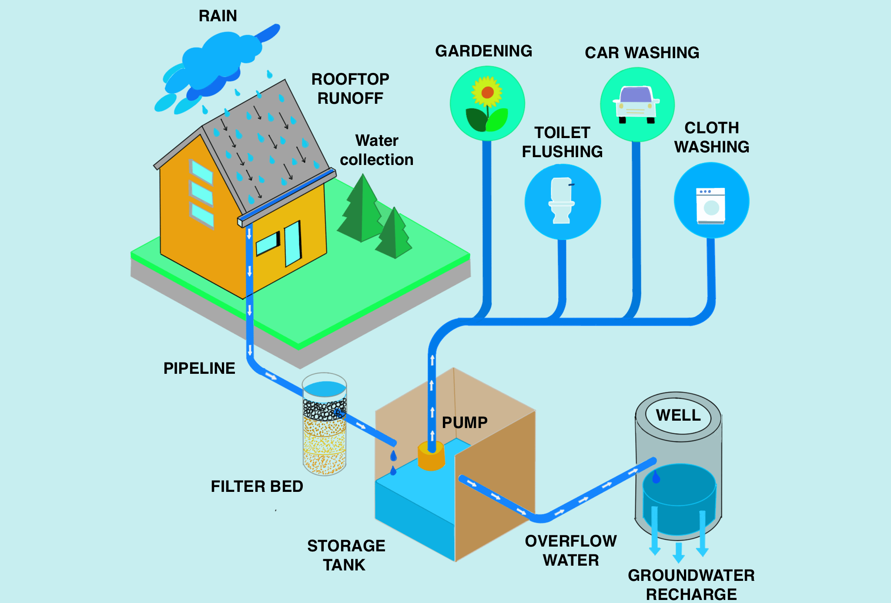

Slide 9
Thank you

