Slide 1
Essential Treatment Processes for Industrial Wastewaters and Reusing for Irrigation
Second International Conference of Engineering and Innovative Technology SU-ICEIT-2019
Shawnm Mudhafar Saleh

Slide 2
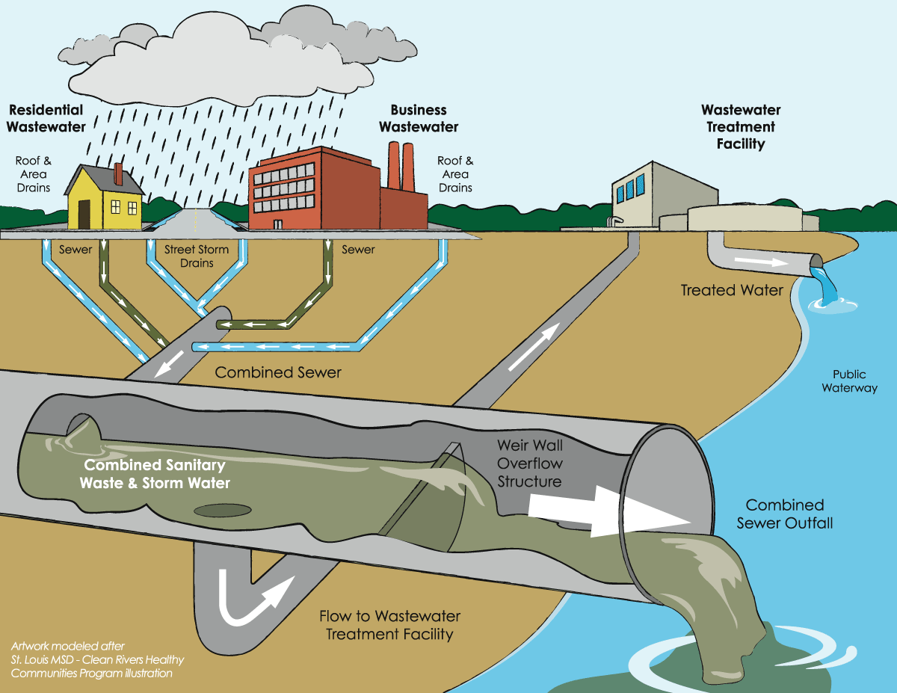
Problem statement:
Untreated industrial wastewaters (WWs) such as food processing factories , dairy factory, Steel factory, beverage,.. ., etc. playing a significant role in environmental pollution.

Slide 3
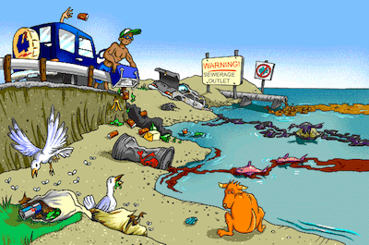
Objectives:
Characterization of dairy and Erbil Steel Factory WWs.
Adequate industrial wastewater Treatment processes.
Reuse industrial wastewater for irrigation.

Slide 4
Site Description:
Yörüksüt Dairy Factory (YDF)
Established in Erbil since 2013
13 km far from Erbil city
The geographical coordinate
Latitude 36° 9' 46" N
longitude 43° 51' 57" E
357 meters above sea level
Produces about 40-50 tons of yogurt and buttermilk per day.
Erbil Steel Company (ESC)
located at the left side of Erbil-Guwer main road
21.6 km far from Erbil City
The geographical coordinate
Latitude 36° 8' 20" N
longitude 43° 47' 52" E
produce 600 tons/day of steel.

Slide 5
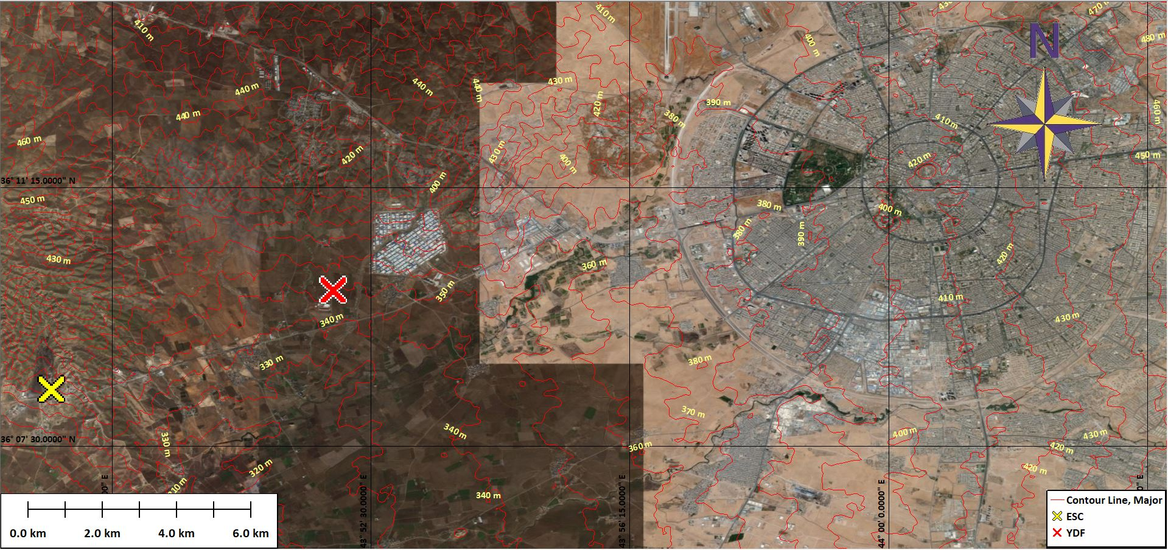
Site Description (Cont.): YDF & ESC

Slide 6
Materials and methods (Cont.):
Wastewater from YDF and ESC were collected and immediately transported to the laboratory of
Sanitary And Environmental Engineering Laboratory, College Of Engineering, Salahaddin University, Erbil, Iraq, and stored in refrigerator at 4 °C.
The samples tested for 21 water quality parameters include:
pH(Mv)
pH
Oxidation-reduction potential (ORP) (mv)
Dissolved oxygen (DO)(%)
DO (mg/l)
Electrical conductivity (EC) (μ mhoss/cm)
EC (μ mhoss/cm²)
Ω. Cm
Total dissolved solids (TDS) (mg/l)
Pressure (P) (PSU)
P (mm Hg)
Temperature (T) (°C)
σt
Nitrite (NO2)(mg/l)
Chemical oxygen demand (COD) (mg/l)
Color (Pt.Co)
Ammonia (NH3-N) (mg/l)
Nitrate (NO3) (mg/l)
Total Acidity (mg/l)
Total Alkalinity (mg/l)
Chloride (Cl) (mg/l)

Slide 7
Characteristic of typical Industrial WW
Results and Discussion: 1) Characteristics of WWs
Type of Wastewater | pH | TSS (mg/l) | BOD(mg/l) | COD(mg/l) | BOD/COD | TDS(mg/l)
Dairy Industry | 4 | 12150 | 4000 | 21100 | 0.19 | 19000
Yeast Industry | 5.3 | 540 | 2100 | 3400 | 0.62 | 35000
Fruits & Vegetable Canning | 5.5 | 2200 | 800 | 1400 | 0.57 | 1270
Textile Industry | 6.5 | 1800 | 840 | 1500 | 0.56 | 17000
Pulp & Paper Industry | 8 | 1640 | 360 | 2300 | 0.16 | 1980
Beverage Industry | 9 | 760 | 620 | 1150 | 0.54 | 1290
Tannery Industry | 10 | 2600 | 2370 | 4950 | 0.48 | 8500

Slide 8
Characteristics of collected wastewater samples
No. | Tests | Dairy wastewater | Cooling Furnal Coils | Cooling Forms | Cooling Steel Bars
1 | pH (mv) | -140.7 | -184.6 | -224.7 | -164.7
2 | pH | 8.8 | 9.59 | 10.32 | 9.22
3 | ORP (mv) | -76.4 | -73.4 | -92.5 | -79.6
4 | DO (%) | 0.1 | 0.1 | 0.1 | 0.1
5 | DO (mg/L) | 0.01 | 0.01 | 0.01 | 0.01
6 | EC (μ mhoss/cm) | 659 | 3201 | 13.79 | 1834
7 | EC (μ mhoss/cmª) | 453 | 2192 | 9072 | 1270
8 | Ω. Cm | 1515 | 313 | 73 | 546
9 | TDS (mg/l) | 330 | 1600 | 6887 | 916
10 | P (PSU) | 0.32 | 1.68 | 7.95 | 0.94
11 | P (mm Hg) | >20.4 | 720.5 | 720.5 | 720.5
12 | T (°C) | 8.75 | 8.41 | 7.09 | 8.87
13 | σt | 0.1 | 1.2 | 6.2 | 0.5
14 | NO₂ mg/L | 81 | 1 | 18 | 10
15 | COD mg/L | 329 | 180 | 534 | 84
16 | Color Pt.co | 922 | 67 | 491 | 240
17 | NH₃-N mg/L | 6 | 0 | 0.31 | 0
18 | NO₃ mg/L | 23.8 | 4 | 3 | 1.4
19 | Total Acidity mg/L | 40 | 32 | 0 | 16
20 | Total Alkalinity mg/L | 244 | 240 | 676 | 156
21 | Chloride (Cl) mg/L | 27.99 | 699.78 | 2499.23 | 299.907

Slide 9
Different levels of treatment are required for wastewater treatment:
Preliminary treatment process
Large solids and large materials in raw wastewater
Primary treatment process remove
organic and inorganic solids
25-50% BOD₅
50-70% SS
55-65% grease
Organic nitrogen
Organic phosphorus
metals
Secondary treatment process remove
organic
Suspended solids
85% of BOD₅ with primary treatment
If BOD₅/COD > 0.6 secondary treatment is required

Slide 10
Tertiary or advanced treatment remove
>99% of contaminants
Organic matter
SS
Nutrient (phosphorus and nitrogen)
Pathogens
Heavy metals
Toxic materials
Disinfection remove
Pathogens (microbes, viruses, and protozoa)
Can be done chemically by (chlorine, ozone, ultraviolet radiation, chlorine dioxide, and bromine)

Slide 11
Wastewater treatment levels
Treatment Level | Process | Indicators | Standard
Primary | Sedimentation | Particle size | <30mg/L
Secondary | Filtration, Biological Chemical | BOD | <30mg/L
 |  | TSS | <30mg/L
 |  | Fecal Coliform bacteria | 100cfu/100 ml. (primary contact)
 |  | Fecal Coliform bacteria | 200cfu/100 ml. (secondary contact)
 |  | E-coli bacteria | 126cfu/100mL
Tertiary | Biological, Chemical | Ammonia | Based on receiving water
 |  | Nitrate | Based on receiving water
 |  | Phosphorus | Based on receiving water
 |  | Pharmaceuticals | Based on receiving water

Slide 12
3) Reusing WW for Irrigation
Re-using Wastewater for Irrigation
Industrial wastewater should be treated to a level that qualify for irrigation purpose.

Slide 13
Guidelines for irrigation water quality
Potential Irrigation Problem | Units | Degree on restriction on use
 |  | None | Moderate | Sever
Salinity
ECw | dS/m | ≤0.7 | 0.7-3 | 3.0
TDS | mg/l | 450 | 450-2000 | 2000
Permeability (effects of infiltration rate of water into the soil. Evaluate using ECw and SAR together
 | SAR=0-3 | ECw≥0.7 | ECw 0.7-0.2 | ECw≤0.2
 | SAR=3-6 | ECw≥1.2 | ECw 1.2-0.3 | ECw≥0.3
 | SAR=6-12 | ECw≥1.9 | ECw 1.9-0.5 | ECw≥0.5
 | SAR=12-20 | ECw≥2.9 | ECw 2.9-1.3 | ECw≥1.3
 | SAR=20-40 | ECw≥5.0 | ECw 5.0-2.9 | ECw≥2.9
Specific ion toxicity
Sodium (NA)
Surface irrigation | mg/l | ≤3 | 3-9 | ≥9
Sprinkler irrigation | mg/l | ≤70 | >70

Slide 14
Guidelines for irrigation water quality (Cont.)
Chloride (Cl)
Surface irrigation | mg/l | ≤140 | 140-350 | ≥350
Sprinkler irrigation | mg/l | ≤100 | >100
Boron (B)
Surface-sprinkler irrigating | mg/l | ≤0.7 | 0.7-3 | ≥3
Miscellaneous effects
Nitrogen | mg/l | ≤5 | 5-30 | ≥30
(Total N)
Bicarbonate | mg/l | ≤90 | 90-500 | ≥500
(overhead sprinkling only)
Residual chlorine | mg/l | ≤1 | 1-5 | ≥5
(overhead sprinkler only)
pH |  | Normal range 6.5-8.4

Slide 15
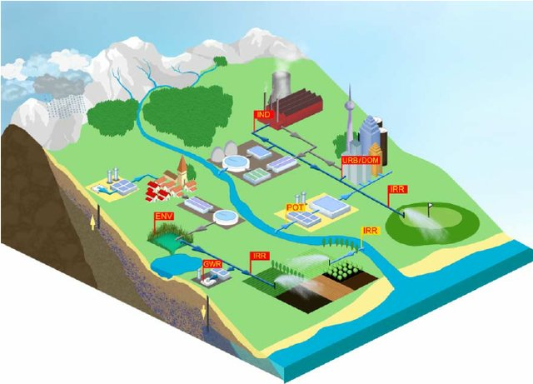
Conclusions:
Untreated wastewater samples from YDF and ESC were collected and analyzed for 21 water quality parameters. Some parameters such as COD, color, TSS etc. were surpassed the standards for disposal of wastewater.
Results revealed that commonly fresh industrial wastewater from YDF and ESC cannot be used for irrigation.
Biological and/or physical-chemical treatment
processes are recommended for the treatment of industrial
wastewater so as to be suitable for irrigation purpose.

Slide 16
THANK YOU

