Slide 1
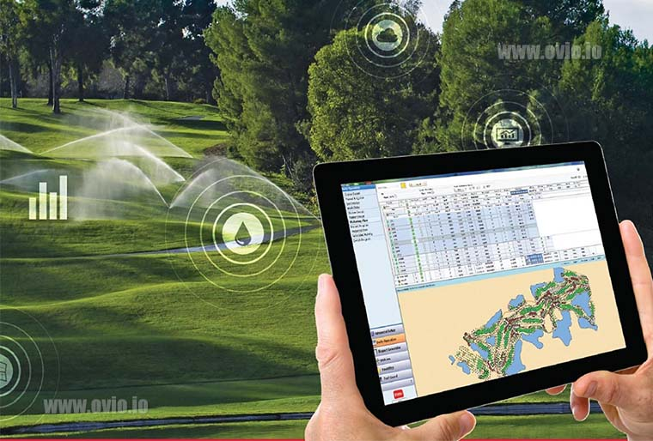
Intelligent Irrigation System
Shawnm M. Saleh

Slide 2
Introduction
Irrigation is an artificial supplying of water to the root of plants
Intelligence irrigation system (IIS) is an automatic water supply according to their crops
The automating irrigation scheduling usually implemented with sprinkle and drip irrigation systems
IIS is useful during water shortage
Soil moisture, air humidity, temperature and water level in the soil are wirelessly transmitted using wireless technology for better production.
An intelligent irrigation system has to have all the components that autonomously monitors or control the level of water available to the plant without any failure.

Slide 3
Objects
Increase crop quality and yield
Save water and energy
Save money on pesticides and fertilizers
Save time and labor
Control irrigation uniformity by monitoring flow rates and pressures
Reduce human work
You can water your plants regularly when you are out for vacation

Slide 4
Components of Intelligent Irrigation System
The Intelligent Irrigation System consisted of a transmitter circuit and a receiver circuit. Data gathered by the transmitter circuit was sent wirelessly to the receiver circuit.
The system also consist of microcontroller, 328P, GSM module, LCD, and Zigbee module.
Solenoid-valve: Is an electromechanics device which allows for an electrical device to control the flow of a gas or liquid
Pesticide control: This mechanism use for mix and spray the fertilizers to the plants in a definite proportion

Slide 5
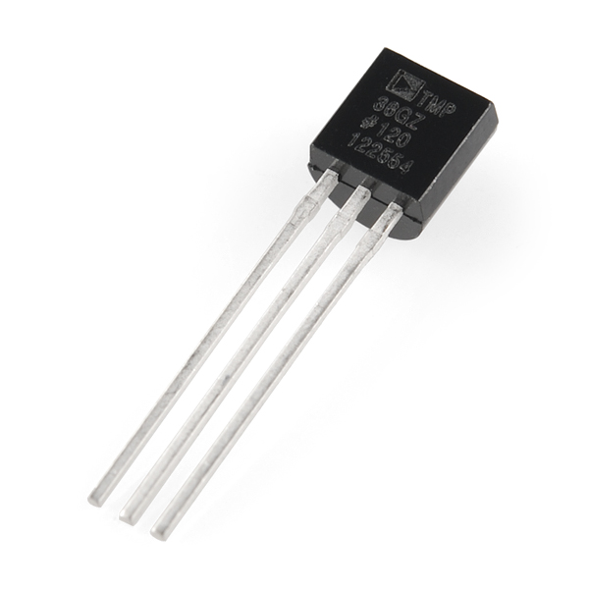
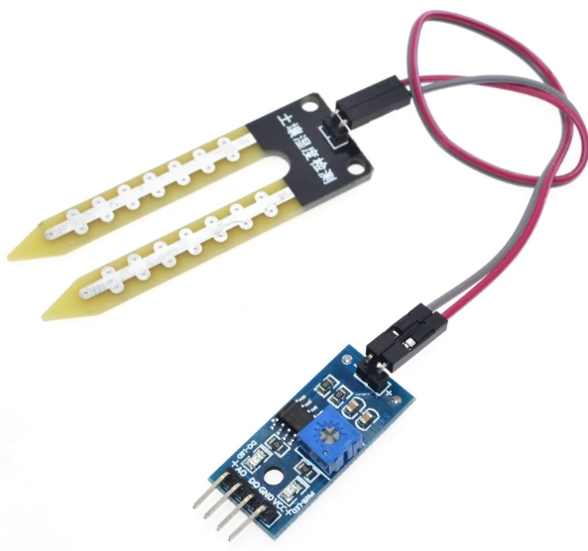
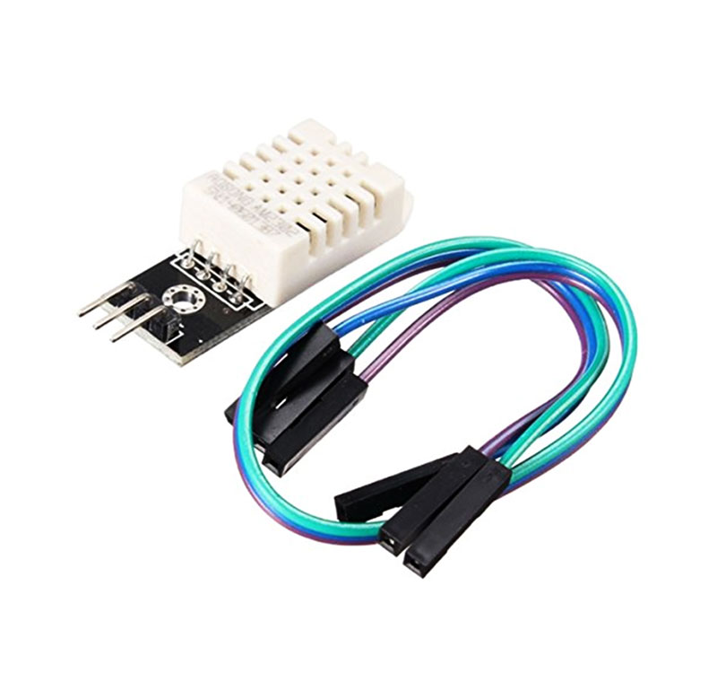
Sensors
Temperature
Soil moisture
Soil moisture sensor will check the moisture of the soil, when the moisture level of the soil goes below the set value, it will direct the Arduino whether it should pump the water or not.
Once the Arduino receives the signal it generates the output that drives a switch and prompts the motor to pump water to the plants.
3. Humidity

Slide 6
Project Steps
User sets the threshold value
Moisture sensor reads the moisture contained in the soil and feeds to the microcontroller
Microcontroller compare the sensor input and the threshold value
If the sensor input value is less than 30%, plants get watered or else it continues the read the moisture value
The watering stops till the moisture contain reaches the threshold value

Slide 7
Thank you

