Slide 1
Parameters affecting the location of inception point
By
Shawnm M. Saleh

Slide 2
Introduction
Stepped spillway is a good structure for dissipating energy because of large surface roughness.
The point where the turbulent boundary layer intersect the free surface called inception point.
Air entrained the free surface from inception point .
Air entrainment in a stepped spillway is very important to protect the spillway from cavitation damage.
Without aeration, the spillway may subjected to cavitation damage.
The flow upstream of the inception point is smooth, while it is very turbulent downstream.

Slide 3
location of inception point is important:
Since cavitation often occurs in the non-aerated flow zone, measurement of the exact location of air entrainment is necessary.
The location of the inception point is very important for measuring the length of the stilling basin, because energy dissipation in a stepped spillway depends on the location of the inception point.
Notes:
The energy dissipation downstream of the inception point is much larger than that upstream. In a smooth spillway, the location of the inception point is further downstream than in a stepped spillway

Slide 4
Different parameters affecting the location of inception point
Discharge
Step Slope
Step Geometry

Slide 5
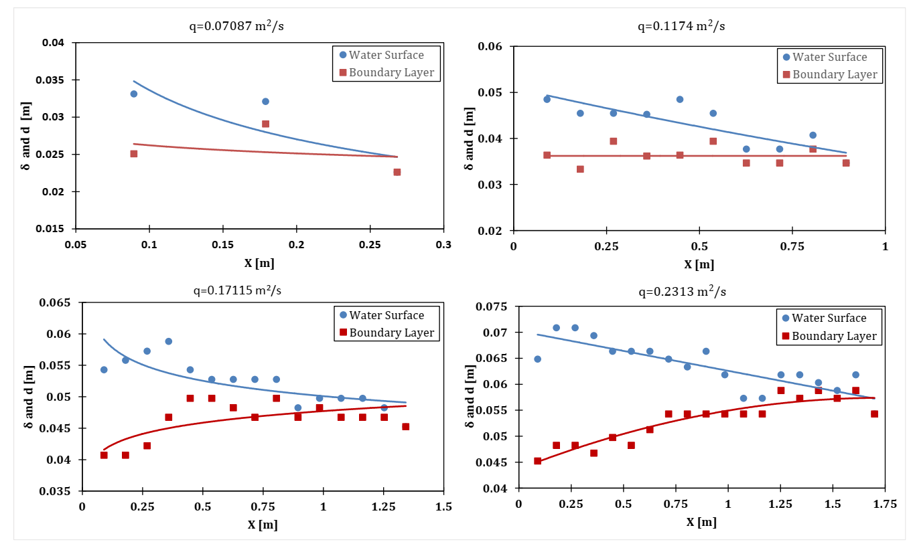
Effect of Discharge on Inception Point
The length of inception point increase when the discharge increases.

Slide 6
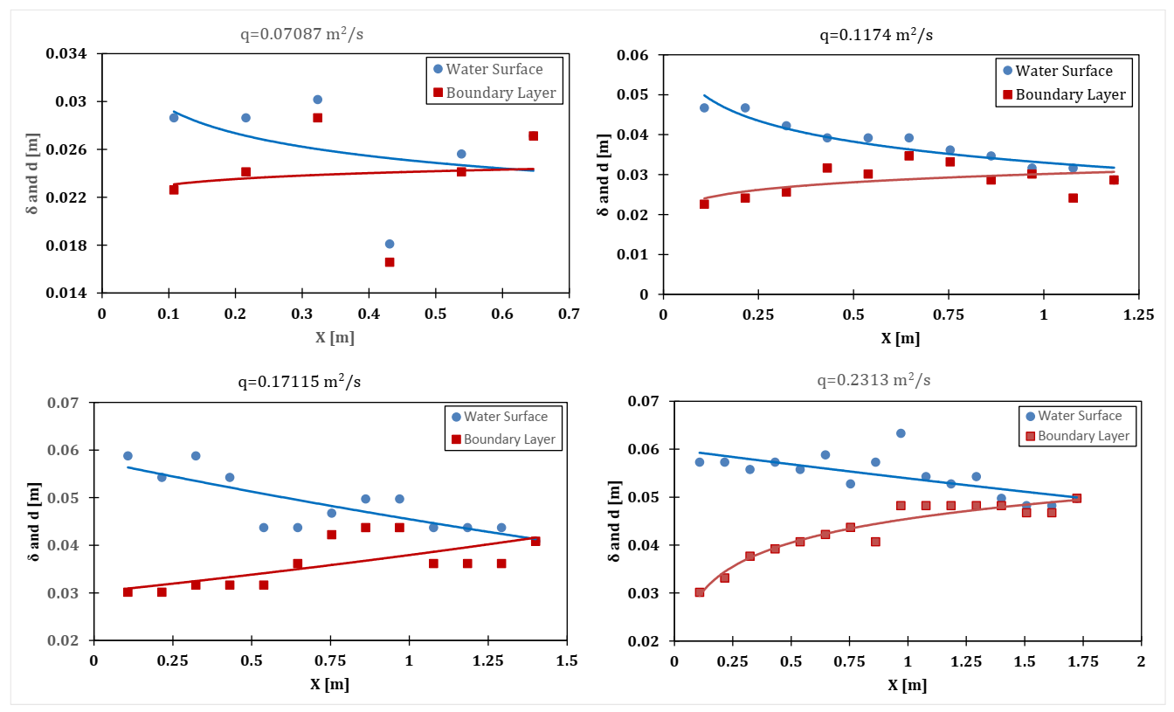
Effect of Chute Slope on Inception Point
The length of inception increase with decreasing chute angle.
1V:2H
1V:2.5H

Slide 7
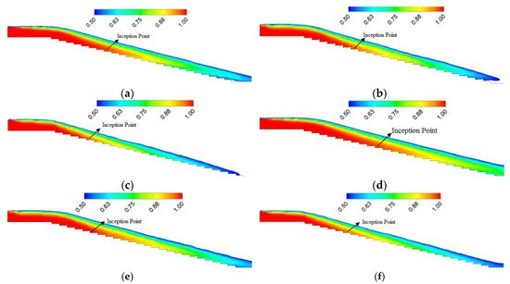
Effect of Step Geometry on Inception Point
The inception point location of the pooled stepped spillway is closer to the spillway crest than that of the flat stepped spillway, but more downstream than that of the round stepped spillway.
Water volume fraction contours of round, pooled, and flat stepped spillway models in the central plane with same number of steps N = 24 (a) flat stepped spillway (N = 24) at unit discharge 0.8 m²/s; (b) pooled stepped spillway (N = 24) at unit discharge 0.8 m²/s; (c) round stepped spillway (N = 24) at unit discharge 0.8 m²/s; (d) flat stepped spillway (N = 24) at discharge 1.0 m²/s; (e) pooled stepped spillway (N = 24) at unit discharge 1 m²/s; and (f) round stepped spillway (N = 24) at unit discharge 1 m²/s.
(Wan et al., 2019)
Notes:
The inception point location of the pooled stepped spillway is closer to the spillway crest than that of the flat stepped spillway, but more downstream than that of the round stepped spillway.

Slide 8
Thank you

