Slide 1
Salahaddin University-Erbil College of Engineering Department of Architectural Engineering First Year Students 2nd Semester
Mathematics I
Application of Derivative
Extreme Value of Function (Maxima and Minima)(Ch.3)
Shawnm Mudhafar Saleh
shawnm.saleh@su.edu.krd

Slide 2
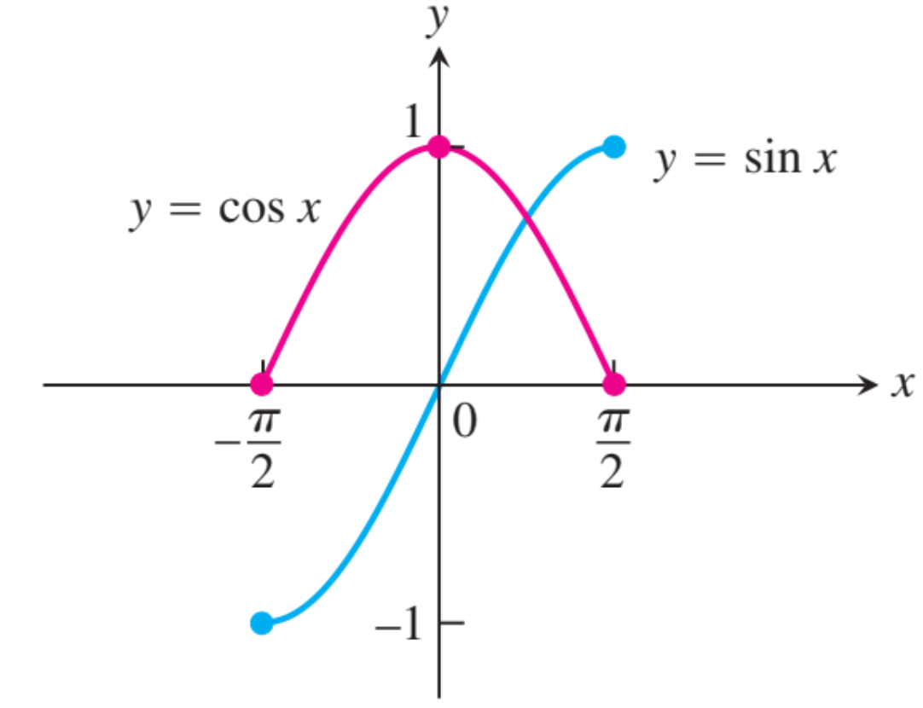
3.2. Maxima, Minima theorem, Local and Absolute
DEFINITIONS Absolute Maximum, Absolute Minimum
Let ƒ be a function with domain D. Then ƒ has an absolute maximum value on D at a point c if
$$f\left(x\right)≤f(c)$$
and an absolute minimum value on D at c if
$$f(x)≥f(c)$$
For example, on the closed interval [-π/2,π/2] the function $f(x)=cos⁡x$takes on an absolute maximum value of 1 and an absolute minimum value of 0 (twice). On the same interval, the function $g(x)= sin⁡x$takes on a maximum value of 1 and a minimum value of -1.

Slide 3
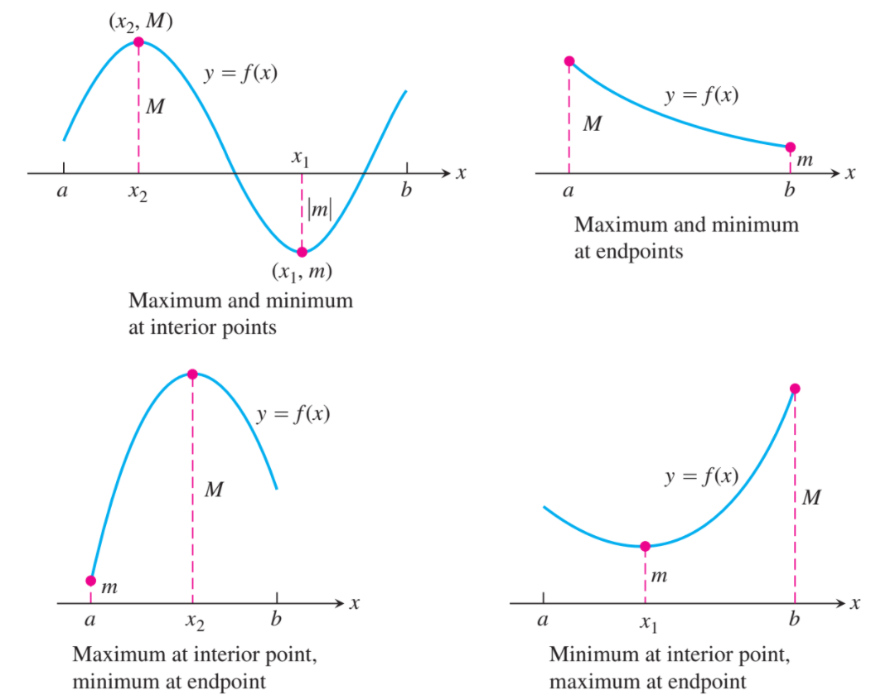
3.2. Maxima, Minima theorem, local and absolute
THEOREM 1 The Extreme Value Theorem
If ƒ is continuous on a closed interval [a, b], then ƒ attains both an absolute maximum value M and an absolute minimum value m in [a, b]. That is, there are numbers x₁ and x₂ in [a, b] with f(x₁)=m, f(x₂)=M, and $m≤f(x)≤M$ for every other x in [a, b]

Slide 4
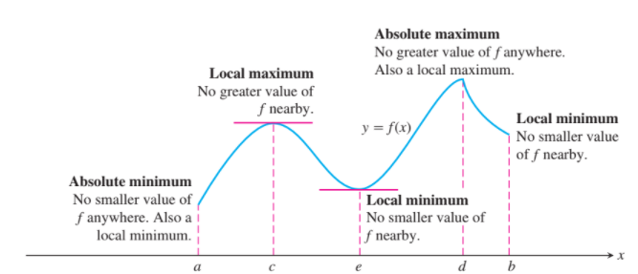
Local Maximum, Local Minimum
DEFINITIONS Local Maximum, Local Minimum
A function ƒ has a local maximum value at an interior point c of its domain if
$$f\left(x\right)≤f\left(c\right) for all x in some open interval containing c$$
A function ƒ has a local minimum value at an interior point c of its domain if
$$f\left(x\right)≥f\left(c\right) for all x in some open interval containing c$$

Slide 5
Finding Extrema
THEOREM 2 The First Derivative Theorem for Local Extreme Values
If ƒ has a local maximum or minimum value at an interior point c of its domain, and if is defined at c, then
$$f^{′}c=0$$
DEFINITION Critical Point
An interior point of the domain of a function ƒ where is zero or undefined is a critical point of ƒ.

Slide 6
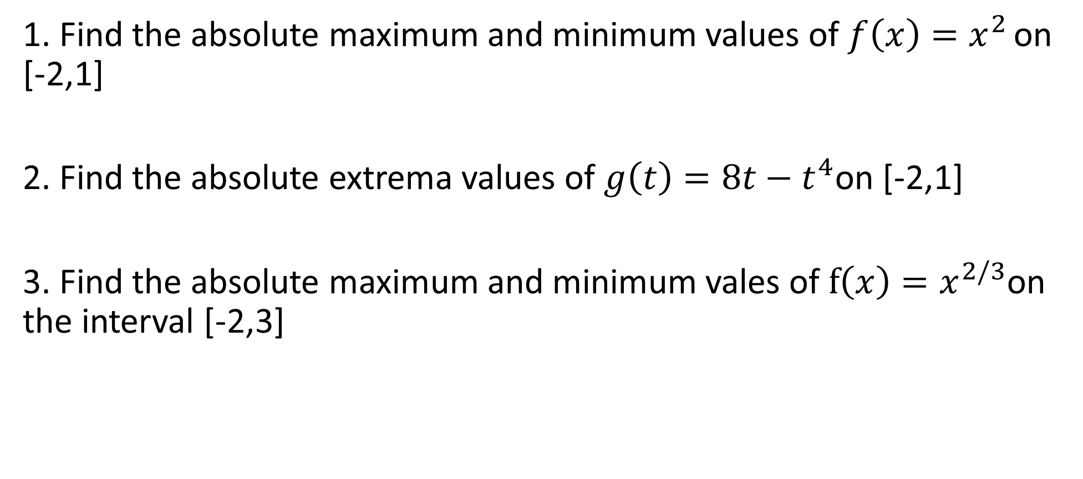
Examples
1. Find the absolute maximum and minimum values of $f\left(x\right)=x^{2 }$on [-2,1]
2. Find the absolute extrema values of $g\left(t\right)=8t−t^{4}$on [-2,1]
3. Find the absolute maximum and minimum vales of $f\left(x\right)=x^{2/3}$on the interval [-2,3]

Slide 7
Examples
1. What is the largest possible area for a right triangle whose hypotenuse is 5 cm long?
2. A highway must be constructed to connect Village A with Village B that 150 mi a part. There is a rudimentary roadway that can be upgraded 50 mi south of the line connecting the two villages. The cost of upgrading the existing roadway is $300,000 per mile, whereas the cost of constructing a new highway is $500,000 per mile. Find the combination of upgrading and new construction that minimizes the cost of connecting the two villages. Cleary define the location of the proposed highway.
3. A drilling rig 12 mi offshore is to be connected by pipe to a refinery onshore, 20 mi straight down the coast from the rig. If underwater pipe costs $500,000 per mile and land based pipe costs $300,000 per mile, what combination of the two will give the least expensive connection?

