Slide 1
Salahaddin University-Erbil College of Engineering Department of Water Resources Engineering First Year Students 1st Semester
Mathematics I
Application of Derivative
Concavity and curve sketching(Ch.3)
Shawnm Mudhafar Saleh
shawnm.saleh@su.edu.krd

Slide 2
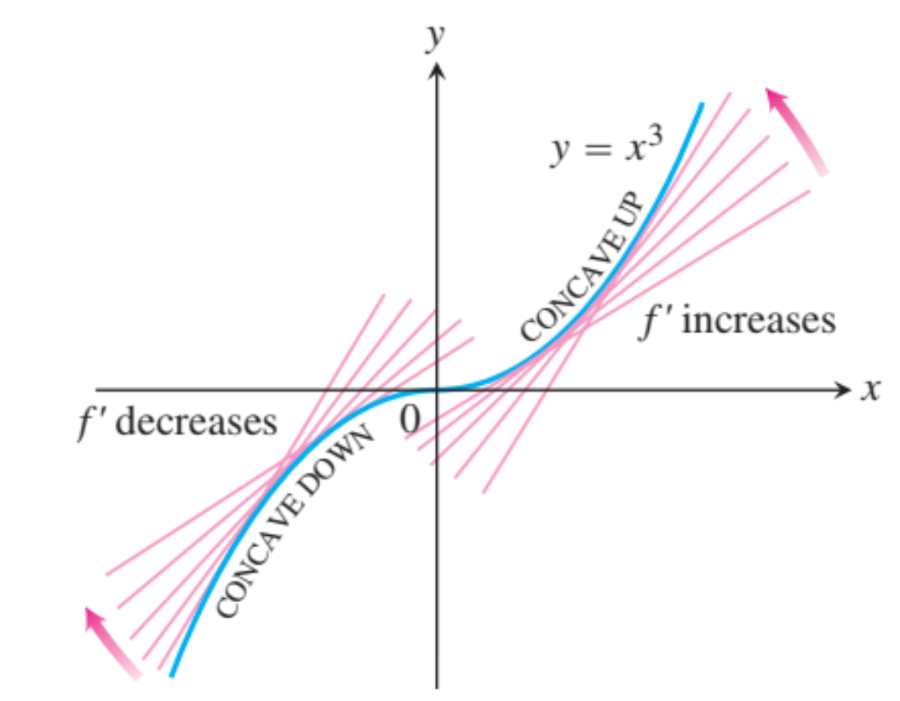
3.2. Graphing with y’ and y’’
It means how to use derivative when it exists to show the curve behavior.
First Derivative Test for Monotonic Functions Suppose that ƒ is continuous on [a, b] and differentiable on (a, b). If ƒ’x>0 at each point x (a,b) then ƒ is increasing on [a, b]. If ƒ’x<0 at each point x (a,b), then ƒ is decreasing on [a, b]
Concavity
DEFINITION Concave Up, Concave Down
The graph of a differentiable function is
(a) concave up on an open interval I if $f’$is increasing on I
(b) concave down on an open interval I if $f’$is decreasing on I.
The Second Derivative Test for Concavity
Let $y=f(x)$be twice-differentiable on an interval I.
1. If $f’’>0$on I, the graph of ƒ over I is concave up.
2. If $f’’<0$on I, the graph of ƒ over I is concave down.

Slide 3
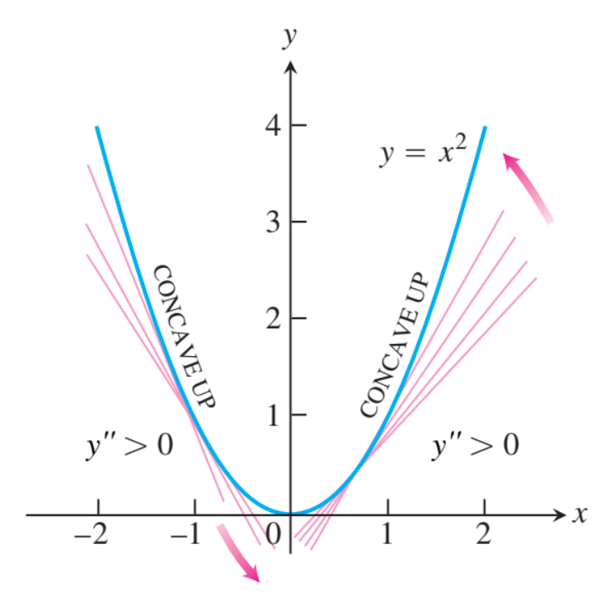
Examples
Ex.1 Applying the concavity test
The curve y=x³ is concave down on (-∞,0) where y’’=6x<0 and concave up on (0,∞) where y’’=6x>0
The curve y=x² is concave up on (-∞,∞) because its second derivative y’’=2 is always positive
Ex.2. Determine the concavity of $y=3+sin⁡x$on [0,2π]

Slide 4
Points of Inflection
DEFINITION Point of Inflection
A point where the graph of a function has a tangent line and where the concavity changes is a point of inflection.

Slide 5
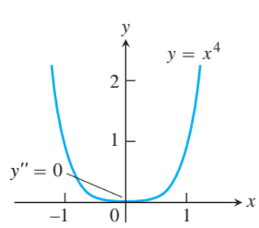
Examples
An Inflection Point May Not Exist Where y’’ = 0
The curve y=x$4$ has no inflection point at x=0. Even though y’’=12x²
is zero there, it does not change sign.

Slide 6
Example
A particle is moving along a horizontal line with position function
$s\left(t\right)=2t^{3}−14t^{2}+22t−5$ t≥0
Find the velocity and acceleration, and describe the motion of the particle.

Slide 7
Strategy for Graphing y ƒ(x) 1. Identify the domain of ƒ and any symmetries the curve may have. 2. Find $y’$and $y”$ 3. Find the critical points of ƒ, and identify the function’s behavior at each one. 4. Find where the curve is increasing and where it is decreasing. 5. Find the points of inflection, if any occur, and determine the concavity of the curve. 6. Identify any asymptotes. 7. Plot key points, such as the intercepts and the points found in Steps 3–5, and sketch the curve. Example:
Sketch a graph of the function
$$f\left(x\right)=x^{4}−4x^{3}+10$$

Slide 8
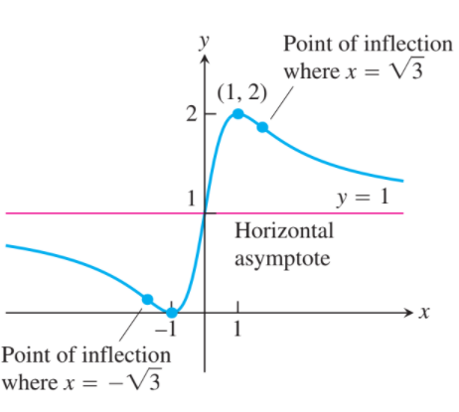

Example
Sketch the graph of
$$f\left(x\right)=\frac{{\left(x+1\right)}^{2}}{1+x^{2}}$$

Slide 9
Next lecture we will learn:
Optimization

