Slide 1
Salahaddin University-Erbil College of Engineering Department of Architectural Engineering First Year Students 2nd Semester
Mathematics I
Optimization (Ch.3)
Shawnm Mudhafar Saleh
shawnm.saleh@su.edu.krd

Slide 2
Optimization
To make something useful or effective as possible as.

Slide 3
Example
A rectangular is to be fitted inside of a semicircle of radius 2, with one side along the semicircles diameter. What is the largest area the rectangle can have? Find the dimensions and area.

Slide 4
Example
You have been asked to design a 1-liter can shaped like a right circular cylinder. What dimensions will use the least material?

Slide 5
Example
A closed container is made from a right circular cylinder of radius r and high of h with a hemispherical dome on top. Find a relationship between r and h that maximize volume for given surface area.

Slide 6
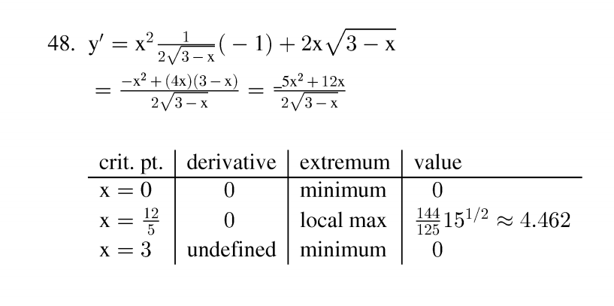
Next lecture we will learn
Integration

