Slide 1
Salahaddin University-Erbil College of Engineering Department of Architectural Engineering First Year Students 2nd Semester
Mathematics I
Integration
Indefinite Integration and Substitution Rule (Ch.4)
Shawnm Mudhafar Saleh
shawnm.saleh@su.edu.krd

Slide 2
Integration
Integration is used to find the length of curved paths, cross section area of machine parts, and volume.
Indefinite integration
The function$f$is called the indefinite integral of f with respect to x, and is symbolized by
$$\int{f\left(x\right) dx}$$
Corollary: if $f’(x)=0$for all x in interval I then f has a constant value of I, that there is a constant c such that $f(x)=c$for all x in I.
Definition
If the function $f(x)$is a derivative then the set of all antiderivatives of $f$ is the indefinite integral of f with respect to x
$$\int{f′\left(x\right) dx}=f(x)+c$$

Slide 3

Power Rule
$$\int{u^{n}du=\frac{u^{n+1}}{n+1}}+c$$
Examples
$$\int{2x.dx}$$
$$\int{\sqrt{1+y^{2}}.2ydy}$$
$$\int{\sqrt{4t−1}dt}$$

Slide 4
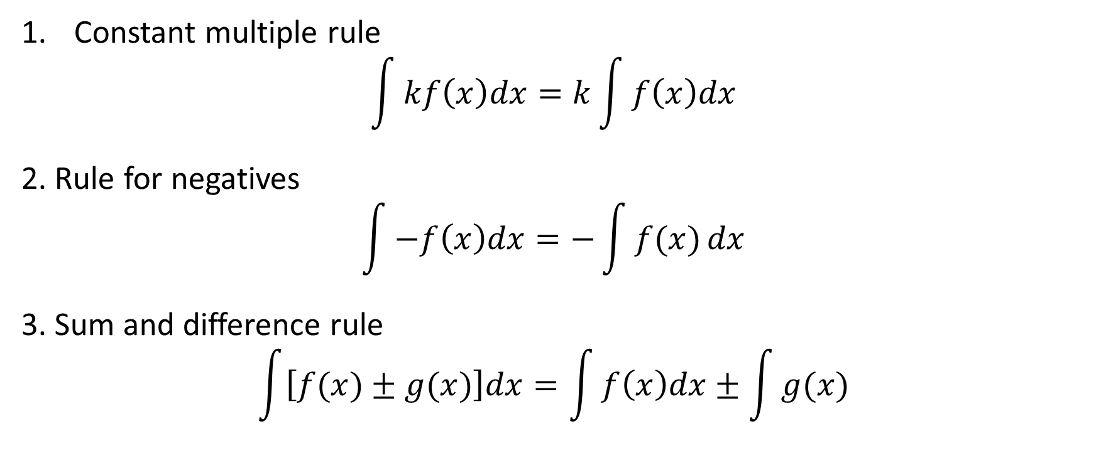
Rules of Algebra for antiderivatives
Constant multiple rule
$$\int{kf\left(x\right)dx=k\int{f\left(x\right)dx}}$$
2. Rule for negatives
$$\int{−f\left(x\right)dx=−\int{f(x)}}dx$$
3. Sum and difference rule
$$\int{\left[f(x)±g(x)\right]dx=\int{f\left(x\right)dx±\int{g(x)}}}$$

Slide 5

Examples:
$$1. \int{28{\left(7x−2\right)}^{−5}dx}$$
$$2. \int{−{\left(r+1\right)}^{2}dr}$$
$$3. \int{\left(5−\frac{x}{2}\right)dx}$$

Slide 6
Basic trigonometric functions integration formulas

Slide 7

Examples:
1. $\int{\csc^{2}{x}dx}$
2. $\int{4\sec{u}}\tan{u}du$
3. $\int{\left(8y^{2}+\sin{y}\right)dy }$

