Slide 1
Salahaddin University-Erbil College of Engineering Department of Architectural Engineering First Year Students 2nd Semester
Mathematics I
Integration
Indefinite Integration and Substitution Rule (Ch.4)
Shawnm Mudhafar Saleh
shawnm.saleh@su.edu.krd

Slide 2

Integration by substitution
$$\int{\cos\left(7θ+5\right)dθ}$$
$$\int{x^{2}\sin\left(x^{3}\right)dx}$$
$$\int{\frac{1}{\cos^{2}2x}dx}$$
$$\int{\frac{2zdz}{\sqrt[3]{z^{2}+1}}}$$

Slide 3
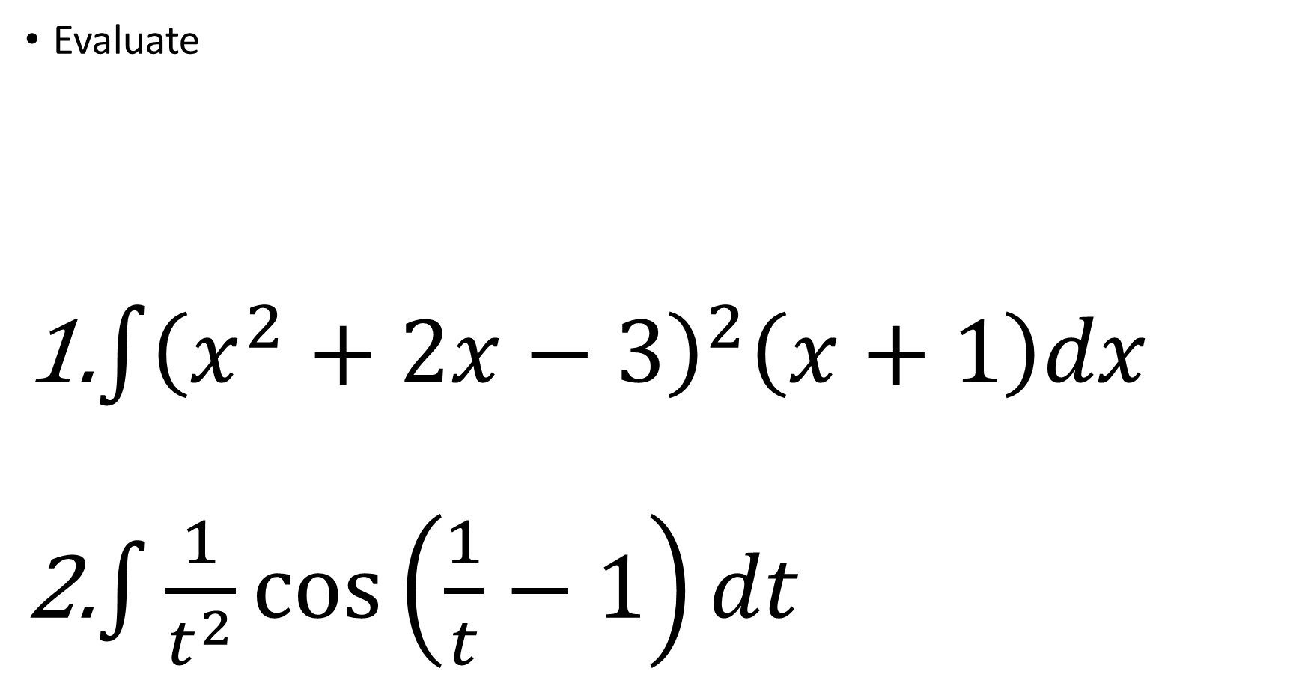
Activity
Evaluate
$\int{{\left(x^{2}+2x−3\right)}^{2}\left(x+1\right)dx}$
$\int{\frac{1}{t^{2}}\cos\left(\frac{1}{t}−1\right)dt}$

