Slide 1
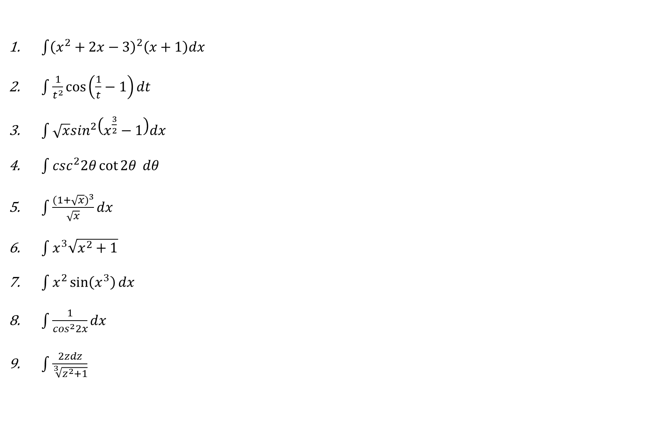
2nd assignment
$\int{{\left(x^{2}+2x−3\right)}^{2}\left(x+1\right)dx}$
$\int{\frac{1}{t^{2}}\cos\left(\frac{1}{t}−1\right)dt}$
$\int{\sqrt{x}\sin^{2}\left(x^{\frac{3}{2}}−1\right)dx}$
$\int{\csc^{2}2θ\cot{2θ} dθ}$
$\int{\frac{{(1+\sqrt{x})}^{3}}{\sqrt{x}}dx}$
$\int{x^{3}\sqrt{x^{2}+1}}$
$\int{x^{2}\sin\left(x^{3}\right)dx}$
$\int{\frac{1}{\cos^{2}2x}dx}$
$\int{\frac{2zdz}{\sqrt[3]{z^{2}+1}}}$

