Slide 1
Salahaddin University-Erbil College of Engineering Department of Water Resouces Engineering First Year Students 1st Semester
Mathematics I
Function and Graphs(Ch.1)
Shawnm Mudhafar Saleh
shawnm.saleh@su.edu.krd

Slide 2
1.2. Function and the Graphs
In each case, the value of one variable quantity, which we might call y, depends on the value of another variable quantity, which we might call x. Since the value of y is completely determined by the value of x, we say that y is a function of x.
A function from a set D (Domain) to a set R (Range) is a rule that assigns a single element of R to each element to D it can be described as in the diagram below
Which means
A special relationship where each input has a single output
Symbolic way to say y is a function of x is $y=f\left(x\right)$

Slide 3
1.2. Function and the Graphs(Cont.)
Intervals: The set of values that the variable may take on.
Open interval: A set of real numbers that does not include its endpoints.
Half open intervals: A set for which one endpoint is a real number and the other is not.
Closed interval: A set of real numbers that includes both of its endpoints.
The end point of the interval called boundary points, the remaining points make up the interval called interior point

Slide 4
1.2. Function and the Graphs(Cont.)
Domain and Range
Domain: The largest set of x-values for which the formula gives real y-values.
Example
Find Dx for $y=x^{2}$
Solution Dx: -∞<x< ∞
Range: The real value of y that gives real value of x.
Example
Find Ry for $y=x^{2}$
Solution Ry=[0, ∞)

Slide 5
1.2. Function and the Graphs(Cont.)
Example Identifying Domain and Range
Verify the domains and ranges of these functions.
Functions
$$y=1/x$$
$$y=\sqrt{x}$$
$$y=\sqrt{4−x}$$
$$y=\sqrt{1−x^{2}}$$

Slide 6
1.2. Function and the Graphs(Cont.)
Graphs of functions
The graph of a function is the set of all points whose co-ordinates (x, y) satisfy the function $y=f(x)$. This means that for each x-value there is a corresponding y-value which is obtained when we substitute into the expression for f(x).
Steps to graph a function
Make a table of xy-pairs that satisfy the function.
Plot the pair (x,y) where coordinate appear in the table
Draw a smooth curve through the plotted points.
Example
Sketch these functions
$$y=x^{2}$$
$$y=\frac{1}{x^{2}}$$
$$y=\sqrt[3]{x}$$

Slide 7
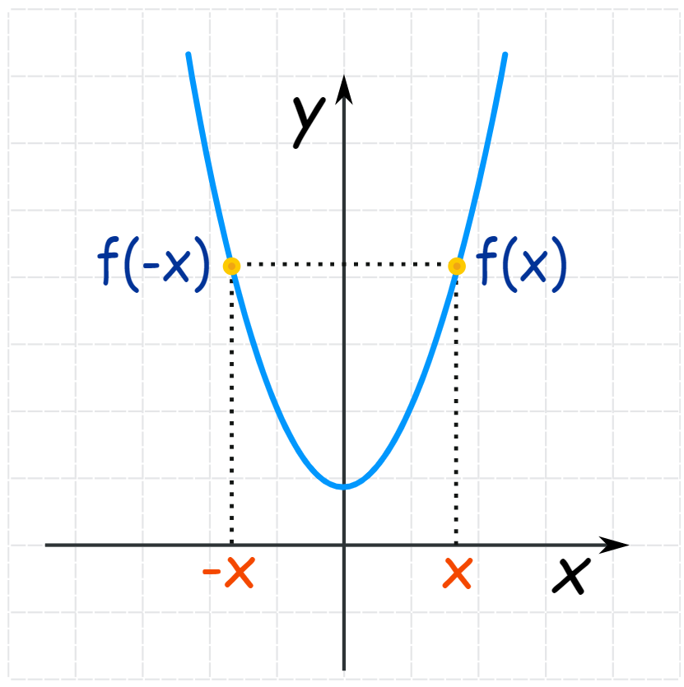
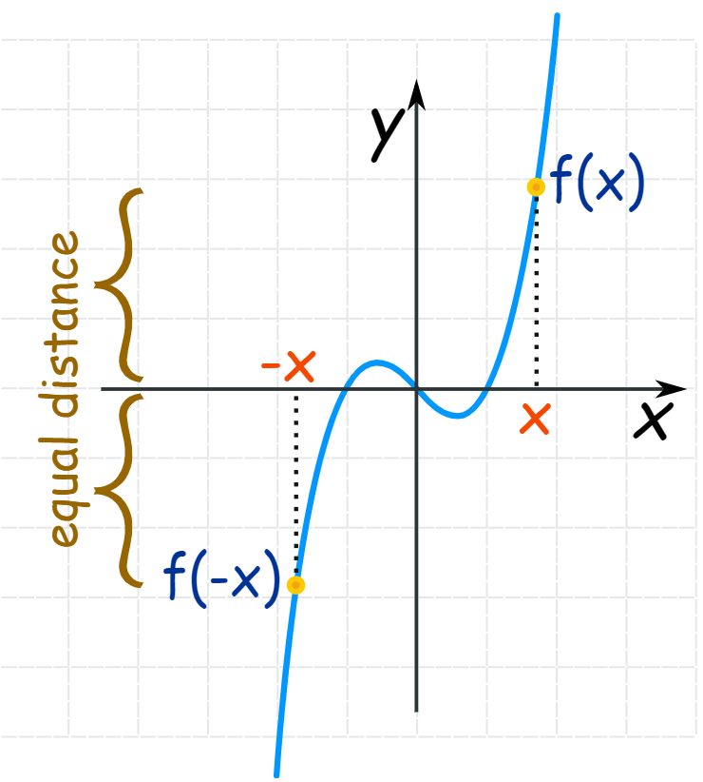
1.2. Function and the Graphs(Cont.)
Even and odd functions
Even
A function is "even" when:
f(x) = f(−x) for all x
in other words there is symmetry about the y-axis:
they got called "even" functions because the functions x², x⁴, x⁶, x⁸, etc behave like that
Odd
A function is "odd" when:
−f(x) = f(−x) for all x
And we get origin symmetry:
They got called "odd" because the functions x, x³, x⁵, x⁷, etc behave like that.
Neither Odd nor Even
in fact most functions are neither odd nor even.
Even
Odd

Slide 8
1.2. Function and the Graphs(Cont.)
Example
These functions are even or odd?
f(x) = x/(x²−1)
f(x) = 0
f(x) =(x+1)²
f(x) = x³+1
f(x) = x+1

Slide 9
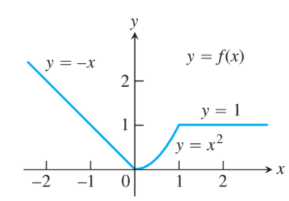
1.2. Function and the Graphs(Cont.)
Functions defined in pieces:
Some functions defined by single formula like
$y=x$, $y=x^{3}$, $y=\sqrt{x}$
Others are defined by applying different formulas to different parts of their domain
$$y=f\left(x\right)=\left\{\begin{aligned}−x x<0 \\ x^{2} 0≤x≤1 \\ 1 x>1\end{aligned}\right.$$

Slide 10
1.2. Function and the Graphs(Cont.)
Integer-valued function
The Greatest Integer Function
The function whose value at any number x is the greatest integer less than or equal to x is called the greatest integer function or the integer floor function. It is denoted as $\left\lfloor x\right\rfloor$
$\left\lfloor 2.4\right\rfloor$ = 2, $\left\lfloor 1.9\right\rfloor$= 1, $\left\lfloor 0\right\rfloor$ = 0, $\left\lfloor −1.2\right\rfloor$= -2,
$\left\lfloor 2\right\rfloor$= 2, $\left\lfloor 0.2\right\rfloor$= 0, $\left\lfloor −0.3\right\rfloor$= -1, $\left\lfloor −2\right\rfloor$= -2.

Slide 11
For the next lecture we will learn:
Function and their Graphs

