Slide 1
Salahaddin University-Erbil College of Engineering Department of Water Resources Engineering First Year Students 1st Semester
Mathematics I
Function and Graphs (Ch.1)
Shawnm Mudhafar Saleh
shawnm.saleh@su.edu.krd

Slide 2
1.2. Function and the Graphs
Sums, differences, products, and Quotients
Like numbers, functions can be added, subtracted, multiplied, and divided (except where the denominator is zero) to produce new functions
Example
The function f(x) and g(x) are defined as $f\left(x\right)=\sqrt{x}$ , $g\left(x\right)=\sqrt{1−x}$
Function Formula Domain
$f+g$ $\sqrt{x}$ +$\sqrt{1−x}$ [0,1]
$f−g$ $\sqrt{x}$- $\sqrt{1−x}$ [0,1]
$g−f$ $\sqrt{1−x}$ -$\sqrt{x}$ [0,1]
$f.g$ $\sqrt{x(1−x)}$ [0,1]
$f/g$ $\sqrt{\frac{x}{1−x}}$ [0,1)
$g/f$ $\sqrt{\frac{1−x}{x}}$ (0,1]

Slide 3
1.2. Function and the Graphs
Composite function
if f and g are functions, the composite function $f∘g$ is defined by
$$f∘g\left(x\right)=f\left(g\left(x\right)\right)$$
The domain of $f∘g$ consists of the numbers x in the domain of g for which g(x) lies in the domain of f.
Example
if $f\left(x\right)=\sqrt{x}$ and $g\left(x\right)=x+1$
Find
$$f∘g(x)$$
$$g∘f(x)$$
$$f∘f(x)$$
$$g∘g(x)$$
$$g∘g(5)$$

Slide 4
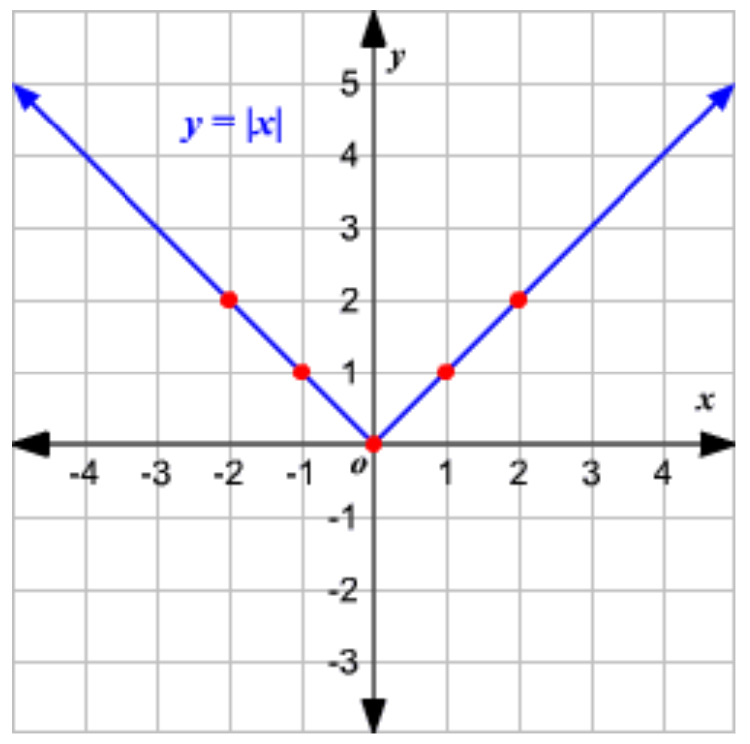
1.2. Function and the Graphs
Absolute values and absolute functions
Definition: An absolute value function is a function that contains an algebraic expression within absolute value symbols. Recall that the absolute value of a number is its distance from 0 on the number line.
The absolute value function written as $f(x)=| x |$, is defined as
$$f\left(x\right)=\left|x\right|=\left\{\begin{aligned}x if x>0 \\ 0 if x=0 \\ −x if x<0\end{aligned}\right.$$
Graph of $f\left(x\right)=\left|x\right|$
Example
Solve $\left|2x−3\right|=11$

Slide 5
1.2. Function and the Graphs
Rules
$\left|−a\right|$= $\left|a\right|$
$\left|ab\right|$= $\left|a\right|$ $\left|b\right|$
$$\left|\frac{a}{b}\right|=\frac{\left|a\right|}{\left|b\right|}$$
Triangle inequality
$$\left|a+b\right|≤\left|a\right|\text{+}\left|b\right|$$
Note: For same signs variables are equal but for differ signs it will be less than
Example
$$\left|−3+5\right|$$
$$\left|−3−5\right|$$
The number $\left|a−b\right|$ are always equal to $\left|b−a\right|$ because
$\left|a−b\right|=\left|(−1)(b−a)\right|=$ $\left|−1\right|\left|b−a\right|=$ $\left|b−a\right|$
1.
2.
3.
4.

Slide 6
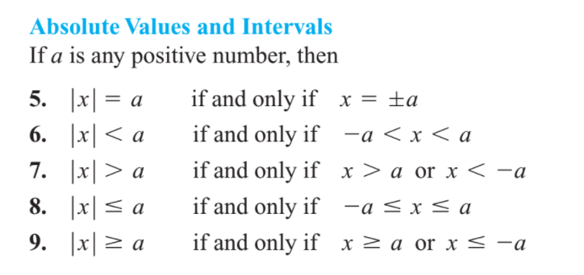
1.2. Function and the Graphs

Slide 7

1.2. Function and the Graphs
Example
What values of x satisfy the inequality
$$\left|x−5\right|<9$$
Example
What value of x satisfy the inequality $\left|\frac{2x}{3}\right|≤1$

Slide 8
For next lecture we will learn
Derivatives

