Slide 1
Salahaddin University-Erbil College of Engineering Department of Architectural Engineering First Year Students 2nd Semester
Mathematics I
Application of Derivative (Ch.3)
Shawnm Mudhafar Saleh
shawnm.saleh@su.edu.krd

Slide 2
3.1. Related Rate of Change:
Example (changing dimensions in a rectangle)
The length l of a rectangle is decreasing at the rate of 2 cm/sec while the width w is increasing at the rate of 2 cm/sec.
when l =12 cm and w=5 cm.
Find the rates of change of :
the area
(b) the perimeter
(c) the lengths of the diagonals of the rectangle.

Slide 3
3.1. Related Rate of Change:
Example a sliding ladder
A 13-ft ladder is leaning against a house when its base starts to slide away. By the time the base is 12 ft from the house, the base is moving at the rate of 5 ft/sec.
How fast is the top of the ladder sliding down the wall then?
At what rate is the area of the triangle formed by the ladder, wall, and ground changing then?
At what rate is the angle 𝛳 between the ladder and the ground changing then?

Slide 4
3.1. Related Rate of Change:
Example a growing sand pile
Sand falls from a conveyor belt at the rate of 10m³/min onto the top of a conical pile. The height of the pile is always three-eighths of the base diameter.
How fast are the height and radius changing when the pile is 4m high?

Slide 5
Example a building's shadow
On a morning of a day when the sun will pass directly overhead, the shadow of an 80-ft building on level ground is 60 ft long. At the moment in question, the angle 𝛳 the sun makes with the ground is increasing at the rate of 0.27˚/min. At what rate is the shadow decreasing? (Remember to used radians)

Slide 6
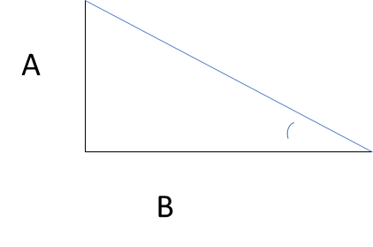
Activity
Example
A and B are walking on straight streets that meet at right angles. A approaches the intersection at 2 m/sec; B moves away from the intersection 1 m/sec. at what rate is the angle 𝛳 changing when A is 10 m from the intersection and B is 20 m from the intersection? Express your answer in degrees per second to the nearest degree.

