Slide 1
Mulching of Vegetable crops:
Mulching: Is the process or practice of covering the soil to make more favorable conditions for plant growth, development and efficient crop production. Materials for mulching can be organic or inorganic (plastic sheeting,). Organic mulches like hay, straw, grass clippings, and compost traditionally are used in backyard gardens and smaller gardening operations, while inorganic plastic mulches have been used by commercial growers in large fields. Tomatoes, peppers and eggplants generally respond well to these plastics.

Slide 2
Kinds of mulches:-
1-Organic Mulches:- Typical materials for organic mulching are straw, leaves, cut grass, wood chips, peat, cut branches and various types of compost. The addition of organic mulches such as leaves or shredded bark brings almost an immediate positive effect these effects are :
1-Physical effects: (infiltration, improved water-holding capacity, soil structure also has a positive effect on aeration).
2- Chemical effects: (soil pH, release of small amounts of nutrients, decomposing) .
3- Biological effects: (temperature regulation for increasing microorganism activity).

Slide 3
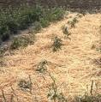
However, if organic mulches are kept to wet disease-causing pests fungi and other undesired microorganism may develop and affect negatively on the crop production

Slide 4
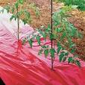
2- Inorganic Mulches (plastic films):- Plastic films are more widely used as mulch. They help in maintaining higher water content in soil resulted from reduced evaporation, induced infiltration, reduced transpiration from weeds or combination of all these factors. There are different colors of plastic film such as black ,blue ,red, orange and grey each one is used for specific purpose.

Slide 5
Advantages of mulching:-
1-Mulches keep the soil underneath moist longer than bare soil and prevent evaporation.
2-Controls soil erosion by cushioning the impact of raindrops and by slowing runoff.
3 -Can prevent weed growth by shading them out.
4-Helps maintaining warm temperatures even at night.
5-Synthetic mulches play a major role in soil solarization processes.
6-Mulching improves soil structure and aeration
7-Some mulch can improve soil fertility

Slide 6
Disadvantages of mulching:-
1-Mulching is labour-intensive
2-Inorganic mulches are costly
3-Too much mulch can create rotting of the root zone
4-Mulch material can introduce new pests and diseases into a field.
5-When plastic mulch starts to break down into non-recyclable bits; it is hard to remove it again

Slide 7
Plastic mulch application:
Installation Considerations
1-Soil Preparation:- The soil must contain adequate moisture for seed germination when the plastic mulch is laid. Temperatures should be at least 10°C, and the soil should be well worked, and free from undecomposed plant .
2-Fertilization: It is best to apply fertilizer during soil preparation, before laying the plastic mulch. After the mulch is installed water soluble fertilizer can be injected through a drip irrigation system
3- Irrigation: Drip irrigation is recommended for use with plastic mulches. Plastic mulch should not be used without irrigation for some kinds of crop.

Slide 8
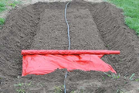
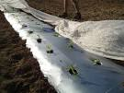
4- Planting the Crop: Vegetable crops can be established in plastic mulch by transplanting or direct seeding. Transplanting can be accomplished by hand or with a mechanical transplanter . 5-Windbreaks:Strong winds can damage or tear plastic mulch. Windbreaks can be helpful in wind-prone areas. Trees or shrubs along the windward side can also protect a field from damage.

Slide 9
Planting Considerations :-
1-Mechanical: For large commercial operations, mechanical trans- planters are used to set plants through plastic. All planters can be adjusted to various spacing and are pulled behind a tractor
2- Hand: While more time consuming, hand transplanting is effective and commonly used on smaller operations. When creating holes for planting, it is better to make circular holes instead of cutting slits or an ‘X’ in the plastic. With holes there is less contact between the transplant and the hot plastic.

Slide 10
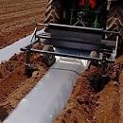

Slide 11
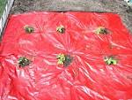
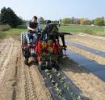
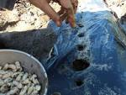

Slide 12
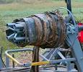
Removing Plastic Mulch
The traditional method of removing plastic mulch was to first loosen the mulch from the “cup” on each side of the bed by passing a cultivator sweep under the cup and then pick up the mulch by hand.

