Slide 1
Micro-teaching
Lead – in activites
Prapared by Deploma Student:
Mahabad Rashad Hussein

Slide 2
Content
Lead in Activities
What’s lead - in activities?
Typical lead - in:
Anecdote
Picture
Write up quote or questions
A short text
Play 'devil's advocate
Write a key word
The aim of lead - in activities

Slide 3
What’s lead in activities?
Lead-in is the first stage of classroom teaching, It includes a few moments of meditation and reflection to prepare students focus on the topic to learn, raise motivation or interest which is about 3-5 minutes at the beginning of a new lesson or before presenting new knowledge.
(eg discussion of a picture related to the topic), or perhaps to focus on language items (eg items of vocabulary) that might be useful in the activity.

Slide 4
Typical lead-ins are:
1- Tell a short personal anecdote related to the subject.
Tell a brief story (one to two minute) at the start of your lesson and then invite your students to do the same.

Slide 5
2- A picture : Show / draw a picture connected to the topic. Ask questions.
Show students a picture and ask them
to make predictions or observations about it.

Slide 6
3- Write up quote or questions:
read out a sentence stating a viewpoint. Elicit reactions. It will generate some interesting discussion.
Ask: Do you need a lot of money to travel?

Slide 7
4- a short text
Hand out a short text on the topic. Students read the text and comment.
A good teacher is someone ………………….

Slide 8
5- Play 'devil's advocate
Play 'devil's advocate' and make
a strong / controversial statement:
(eg I think smoking is very good for people) that students will be motivated to challenge / argue about it. Is is bad if someone around you is smoking?

Slide 9
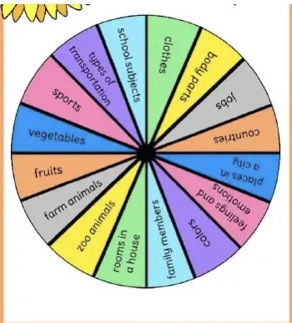
6- Write a key word
Write a key word (maybe the topic name in the centre of a word- sport’ on the board and elicit vocabulary from students which is added to the board.

Slide 10
The aims of a good lead in activities are :
to set the context of the lesson; to engage students in the topic.
to let students warm up.
to activate students’ knowledge/ language knowledge on the topic.
to save time.

