Slide 1
Micro Teaching
Warmer and Warm-up Activities
Prepared By:
Dastan Mohammad Ahmed

Slide 2
Warmer and Warm-up Activities
A warm-up is a short activity or exercise undertaken prior to a more intensive exercise or activity ,and intends to prepare the body and brain for movement.
Warm-up activities are essential teaching techniques for teacher or trainers.
Warm-up activity is a short, fun game which a teacher or a trainer can use with students.

Slide 3
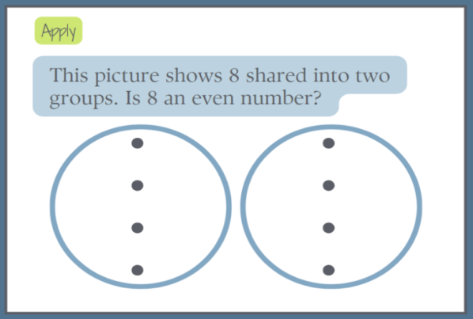
The Structure Of Warm-up Activity:
Lesson warm-ups are a great way to consolidate learning and help students (Recite , Recall , Apply) what they have previously learned.
1_ Recite : This helps the students to remember
important definitions and concepts. It involves
simply reading definition.
2_Recall: This involves remembering key parts of a definition. Teachers remove or hid key words in a definition and students have to write the missing words.
Example:
An even number can be split in to .............. e............... g.............. .
3_ Apply: A short response question which gets the
students thinking about the content and where
they have to apply their knowledge to answer the
question.

Slide 4
The Purpose of doing Warm-up Activities:
1_ To encourage the students to think about the topic that going to be explain during the lesson.
2_To wake them up , first thing in the morning and sometimes after lunch people often sleepy.
3_ To prepare them to learn by stimulating their minds.

Slide 5
Types of Warm-up in teaching:
1_ Ice Breakers: In the first couple of weeks of the classes take the time for you and your students to get to know each others.
2_ Team _ building: Another great way to start off a new course is through team _ building activities , they are also appropriate if new students join the group.
3_ Fun game _ activities: It is a good idea to start the class with a fun engaging activity that allows the students to get excited about the class and renew their energy.
4_ Review previous materials: The first few minutes of class are a great time to review materials that learned or practiced in the previous lesson like reviewing grammar, vocabulary or even content from a reading lesson.
https:\\www.costaricatesol.com

Slide 6
The Role Of Warm-up Activities:
1_ Warm-up activities play a crucial role in the classroom , students often arrive the class feeling tired or preoccupied , making it important to gently transition them in to a learning environment rather than diving in to the challenging grammar or vocabulary tasks.
2_ A well designed warm-up can engage students sparking their interest and encouraging active participation.
3_ It can also serve as a review of previously taught material or as an introduction to a new topic.

Slide 7
Tips For Engaging Lesson Warm-up:
1_ Keep it short , warm-up should be short and to the point .
2_ Keep the pace moving: this keeps the students engaged and prevent them from losing focus , it is also a good way to set an energy level for the lesson.
3_ Make it interactive : engage students by asking them to participate in the warm-up , this could be through discussion , group work, or even a quick game .The more interactive the warm-up is the more students will be involved in the lesson.

