Slide 1
University of Salahaddin - Erbil College of Science
Env. Science and Health Dept.
Introduction to Industrial Hygiene

Slide 2
Definition of Industrial Hygiene

Slide 3
What Is Industrial Hygiene?
Definition
– Industrial Hygiene may be defined as the science of anticipating, recognizing, evaluating, and controlling workplace conditions that may cause workers' injury or illness, impaired health and well-being, or significant discomfort and inefficiency among workers or among the citizens of the community.

Slide 4
What Is an Industrial Hygienist?
A person who by study, training, and experience can:
Anticipate
Recognize
Evaluate
Control
workplace environmental hazards

Slide 5
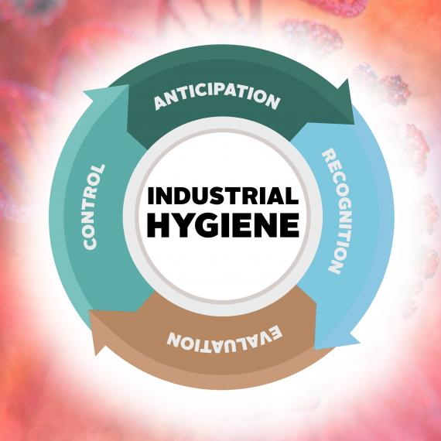

Slide 6
Anticipation – this involves identifying potential hazards in the workplace before they are introduced.
Recognition - this involves identifying the potential hazard that a chemical, physical or biological agent - or an adverse ergonomic situation - poses to health. Chemical agents Gases, vapors, solids, fibers, liquids, dusts, mists, fumes, etc. Physical agents Noise and vibration. Heat and cold. Electromagnetic fields, lighting etc. Biological agents Bacteria, fungi, etc. Ergonomic factors Lifting, stretching, and repetitive motion. Psychosocial factors Stress, workload and work organization.

Slide 7
Evaluation of the extent of exposure to the chemical hazards, physical or biological agents (or adverse ergonomic situation) in the workplace. This often involves measurement of the personal exposure of a worker to the hazard / agent in the workplace, particularly at the relevant interface between the environment and the body, e.g. breathing zone, hearing zone, and assessment of the data in terms of recommended occupational exposure limits (OELs), where such criteria exist.
Control of the chemical, physical or biological agent - or adverse ergonomic situation, by procedural, engineering or other means where the evaluation indicates that this is necessary.

Slide 8
Why is Industrial Hygiene (IH) important
Companies that implement a rigorous industrial hygiene program will benefit from:
Improved worker health
Less absences due to injuries or illnesses
Increase worker productivity and potential
More efficient processes and improved technology
Less employee healthcare costs

Slide 9
What does an Industrial Hygienist do?
As mentioned before, industrial hygienists are charged with anticipating, recognizing, evaluating, and controlling workplace hazards. These broad topics filter into common roles such as the following:
Investigating and examining the workplace for hazards and potential dangers
Making recommendations on improving the safety of workers and the surrounding community​
Conducting scientific research to provide data on possible harmful conditions in the workplace

Slide 10
4. Developing techniques to anticipate and control potentially dangerous situations in the workplace and the community
5. Training and educating the community about job-related risks
6. Advising government officials and participating in the development of regulations to ensure the health and safety of workers and their families
7. Ensuring that workers are properly following health and safety procedures.

Slide 11
What Are Different Types of Industrial Hygiene Hazards?
Chemical Hazards
Physical Hazards
Biological Hazards

Slide 12
Some Occupational Hazards
Chemical agents
Gases, vapors and particulate aerosols
Physical (energy) agents
Noise, ionizing / non-ionizing radiation, heat and cold stress
Biological agents
Infectious agents, allergens
Psychological stressors
Ergonomic/safety

