Slide 1
Vertebrate animal Class: Reptilia
University of Salahaddin Lab: 11
College of Science
Lecture Dr. Shelan Mustafa Khudhur

Slide 2
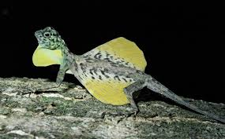
Introduction
Class: Reptilia
These were the first class of organisms to adapt to life on land.
They are believed to have evolved from millions of years ago.
There are about 10,000 different species of reptiles on earth.
They are cold-blooded animals belonging to the phylum Chordata of Animal kingdom.

Slide 3
Characteristics of Reptilia
Following are the important characteristics of the animals belonging to Class Reptilia:
These are creeping and burrowing terrestrial animals with scales on their body.

Slide 4
2. They are cold-blooded animals found in most of the warmer regions of the world.

Slide 5
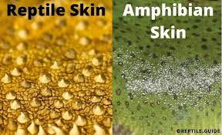
3. Their skin is dry, and rough, without any glands.

Slide 6
4. The body is divided into head, neck, trunk, and tail.
5. Few of these shed the scales on their skin as skin cast.

Slide 7
6 . The respiration takes place with the help of the lungs.

Slide 8
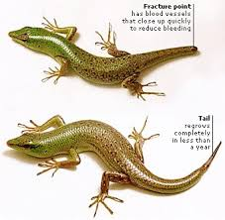
7. They have two pairs of pentadactyl limbs, each bearing claws. Snakes are an exception.
8. A post-anal tail is present.

Slide 9
9. Except for snakes, all the reptiles have well-developed ears.
10. They possess a typical cloaca.

Slide 10
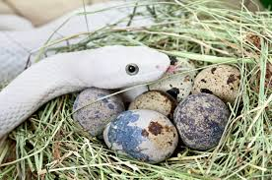
11. They are oviparous and the eggs are very yolky.

Slide 11
CLASSIFICATION
On the basis of presence or absence of certain openings in the temporal region of the reptilian skull the class Reptiles can be divided into five subclasses.
Subclass II: EURYAPSIDA(Extinct)
Subclass-III PARAPSIDA (Extinct)
Sub-class – IV – SYNAPSIDA (Extinct)

Slide 12
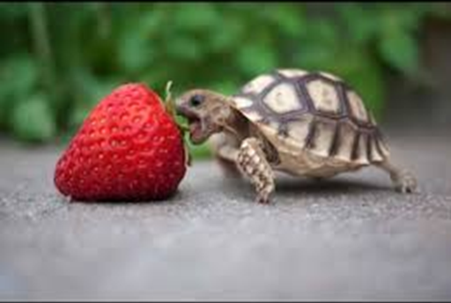
Subclass I: ANAPSIDA
Anapsid reptiles are those in which the dermal bones form a complete roof over the skull, Skull roof is solid, temporal openings are absent.
Turtles, tortoises, and terrapins belong to this group.

Slide 13
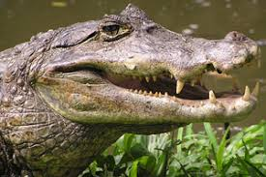
Sub-class – V – DIAPSIDA:
Skull with two temporal openings on either side separated by the bar of postorbital and squamosal bones. This subclass includes 4 orders

Slide 15
Scientific classification of snake
Domain: Eukaryota
Kingdom: Animalia
Phylum: Chordata
Class: Reptilia
Order: Squamata

Slide 16
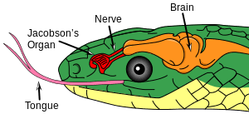
Smell seems to be a snake’s best thing .
The snake analyzes scents by flicking (quick movement) its long tongue into the air to gather scent molecules, which are then transferred to the Jacobson’s organ (The organ helps snakes hunt and track their prey) located inside its mouth.
Most snakes have awesome eyesight. Tree-dwelling snakes have binocular vision. These snakes can focus both eyes on the same point.

Slide 17
The word snake is derived from old English snaca, meaning to crawl or to creep.
• some snakes kill their prey by injecting venom before eating it.
•A spitting cobra can spit venom at a perceived target about 3-7 feet away
•Snake sleep with their eyes open, and they lack eye lids.
•After a heavy meal , snakes tend to sleep for days even weeks.

Slide 18
Some poisonous snakes in Iraq

Slide 19
Saw-Scaled Viper ( Echis carinatus )
Desert Horned Viper (Cerastes cerastes)
Lebetine Viper (Macrovipera lebetina)
Kurdistan Viper (Vipera raddei kurdistanica)
Desert Cobra (Walterinnesia aegyptia)
Two-headed snake found in Kurdistan Region

