Slide 1
Ministry of Higher Education and Scientific research
Department of Mechanical Engineering College of Engineering University of Sallahaddin
Subject: Strength Of Materials Course Book – 2nd Year
Lecturer's name, MSc, Shereen Amin AbdulRahman
Academic Year: 2017/2018

Slide 2
Ministry of Higher Education and Scientific research
Course Book
1. Course name | Strength Of Materials
2. Lecturer in charge | Shereen Amin AbdulRahman
3. Department/ College | Mechanical Eng./Engineering Collage
4. Contact | shereen.abdalrahman@su.edu.krd,she59rahman@gmail.com
5. Time (in hours) per week | Theory: 2 hr/week Tetural: 2 hr/week
6. Office hours | 6 hours office time availability for students questions
7. Course code | ME -202
8. Teacher's academic profile | Education:- University of Technology – Baghdad – Iraq M.Sc./Engineering Metallurgy – 1988 University of Technology – Baghdad – Iraq B.Sc / Production Engineering &Metallurgy -1982 Work Experience: University Of Technology – Baghdad – Iraq – from 1982 to Aug. 2006 -as a lecturer in Production engineering and Metallurgy Department, and, at the Materials Eng. Departments. University of Salahaddin – Erbil – Iraq – from Sep. 2006 till now- Engineering Collage – Mechanical Engineering Department. Subjects will have been taught before: Metal deformation. Plasticity. Engineering metallurgy. Strength of materials. Mechanics of solids –dynamic. Corrosion Engineering.
9. Keywords | Strength of materials, mechanics of materials ,Stress, Strain ,Torsion ,Bending ,Stress Analysis ,Mohr ′s circle, deflection, Buckling,
10. Course overview: ͞StreŶgth of Materials͟ is a well estaďlished topiĐ iŶ MeĐhaŶiĐal EŶgiŶeeriŶg, taught to the seŶior studeŶts ;2Ŷd yearͿ, through a theoretiĐal weekly prograŵ of four hours supported ďy ͞laďoratory appliĐatioŶs͟ whiĐh is a separate ͞ŵulti disĐipliŶe suďjeĐt͟ with its owŶ Đredit hours . Mechanics of Solids or Strength of Materials is a popular branch of Engineering Mechanics. It deals with the relation of externally applied loads and its internal effect on the bodies. In general study we assume bodies and objects to be rigid but in Mechanics of Solids we do consider the deformation/deflection however small they may be. The subject of mechanics of materials involves analytical methods for determining the strength, stiffness (deformation characteristics), and stability of the various members in a structural system. The behaviour of a member depends not only on the fundamental laws that govern the equilibrium of forces, but also on the mechanical characteristics of the material.
11. Course objective: The main objective of the study of mechanics of materials is to provide the students with the means of analyzing and designing various mechanics and load bearing structures, to ensure that the structure used will

Slide 3
Ministry of Higher Education and Scientific research
be safe against the maximum internal effects that may be produced by any combination of external loading. After completing, a student should be able to: Solve axially loaded members in statically Determinate or Indeterminate cases Solve torsionally loaded shafts in statically Determinate or Indeterminate cases 3- compute the principal stresses, principal angles, maximum shear stress and angles, and stresses on any arbitrary plane, given the state of stress at a point. 4. Solve beams under bending for stresses. Solve transversely loaded beams for internal shear forces, bending moments and deflection. Apply singularity functions to beam problems. Solve for stresses in beams with combined axial and transverse loads. Know the basics of mechanical design of process vessels that they use in the processing industry. Use some of the available computer packages which solve strength of materials problems. Communicate effectively by writing technical reports.
12. Student's obligation Class attendance is imperative, because we will do many problems and show animated learning tools which contribute strongly to your understanding of the subject. All students are expected to maintain professional behavior in the classroom setting, Students are strongly encouraged to attend all lectures. On administrative level if the student absence rate exceeded (15 %) of the total lecture hours, the student will be expelled, i.e., when there are (4) lecture hours a week and there is (30X4) lectures per academic year, the total lecture hours is (120). NO CELL PHONES are allowed during lectures. PLEASE turn them off before lecture! (not silent or vibrating mode) Quizzes may be given unannounced throughout the term. During examinations, you must do your own work. Talking or discussion is not permitted during the examinations, nor may you compare papers, copy from others, or collaborate in any way. Any collaborative behaviour during the examinations will result in failure of the exam, and may lead to failure of the course and Collage disciplinary action.
13. Forms of teaching The essence of the teaching program is prepared on MS power point presentations and. Elaborations and explanations of the details are done verbally and when needed on white board. As an assisting instruction tool, multimedia presentations are used to demonstrate the presented ideas through basic diagrams or real life applications. There are also assignments and seasonal projects appointed to individual students or groups that help the evaluation process and also support the team work effort.
14. Assessment scheme Attaining the requirements set to succeed in this study subject requires developing an engineering sense, related to this topic, based on emergent analytical and problem solving skills and memorizing topics cannot secure success. All Exams are Closed book and notes In this system the maximum mark is (100%). The grading system is based on the summation of two categories of evaluations: First, (40%) of the mark is based on the academic year effort of the student which includes but is not restricted to the following: Two end of semester examinations (17% X 2) = 34%, for which the study material is set for the topics reviewed in that particular semester Quizzes (6%), for which the study material is limited and assigned by the instructor. There will be an optional third exam of 17%,When students attend for this exam Whatever the degree of exam is it will be added to the 17% for the highest degree of one of the former exams

Slide 4
Ministry of Higher Education and Scientific research
-Second, (60%) of the mark is based on final examination that is comprehensive for the whole of the study material reviewed during the academic year and it usually occurs during the month of June At the end of the evaluation process, if the students could not secure a minimum of (50%), they are given a chance to repeat the final exam in September and they should be able by then to equal or exceed the (50%) limit otherwise they will have to repeat this subject during the next academic year if it did not contradict with the administrative regulations.
Student learning outcome: The mechanics of materials course is one of the core courses for students in mechanical, civil, aerospace, metallurgical, ceramic, geotechnical, and architectural engineering programs. The course is also included in architecture, engineering mechanics, engineering physics, engineering management, and engineering technology curricula. This course provides a comprehensive coverage of important topics in strength of materials with emphasis on problem solving, applications and design of mechanical devices and systems, Our student outcomes are what students are expected to know and be able to do by the time of their graduation: an ability to design systems, components, or processes for broadly-defined engineering technology problems appropriate to program educational objectives; an ability to function effectively as a member or leader on a technical team; An ability to design and conduct experiments, as well as to analyze and interpret data An ability to function on multi-disciplinary teams An ability to identify, formulate and solve engineering problems An understanding of professional and ethical responsibility An ability to communicate effectively A recognition of the need for and an ability to engage in life-long learning An ability to use the techniques, skills and modern engineering tools necessary for engineering practice
16. Course Reading List and References: Text books: 1. R. C. Hibbeler, Mechanics of Materials, (6th Edition) .The book is available for all students by the Department. Please note all homework problems and reading assignments are from this book. 2. Pytel Andrew, Jaan Kiusalaas., Mechanics of Materials Second Edition 3. Ferdinand P Beer, E Russell Johnston, Jr. John T Dewolf. Mechanics of Materials, 5th Edition. All students can have the References as pdf e-book. The core material of the course consists of the above books, articles from media and internet, and lecture's notes. Video Flashes used to illustrate the topics and examples of each lecture http://web.mst.edu/~mecmovie/ The students will be able to use a software program to solve the problems & to be able to make problems by themselves. http://www.mdsolids.com/ 17. The Topics: Lecturer :Shereen Amin Abdulrahman
Types of loading, types of stresses, Stress & strain Shear force, shear stress, shear strain. | October2017
Stress- strain relation, tensile & compressive stresses, Elastic limit, Hook's Law.

Slide 5
Ministry of Higher Education and Scientific research
DuĐtile ŵaterials, Brittle ŵaterials, PoissoŶ’s Ratio, ŵodulus of elastiĐity, modulus of rigidity, allowable working stress, factor of safety.
Percentage reduction in area ,percentage elongation, deformation due to self weight, bars of varying sections, Stresses on Oblique Sections
Mechanical Properties of Materials
Stress in compound bars
Statically indeterminate members | November 2017
Thermal stresses.
Strain Energy, Strain Energy due to shear.
Torsion of circular shafts- solid and hollow.
Power Transmitted by a Shaft, shafts in sense and parallel.
Types of Beams, types of loading, internal forces and moment in beams, resisting shear and resisting, (S.F.) & (B.M.) sign convention. | December ₂₀₁₇
Graphical construction of S.F. and B.M. diagrams, Section method for point loading, UDL, VDL, External moment
Bending stress, Theory of pure Bending, Assumptions, neutral surface, Neutral axis, location of neutral axis ,Section modulus | January 2018
The flexure formula bending stress distribution, Section modulus for different sections, stress concentrations
Bending of composite beam
Shear stress in beams ,the shear formula
Distribution of shear stress
Shear flow | February2018
Stress Analysis ,Stress transformation
Principle Stresses, Principle Planes, two dimensional stress transformations
Mohr’s CirĐle of Stress | March2018
Thin-Walled Pressure Vessels Thin cylindrical & Spherical shells
Combined stresses, Stress in shafts due to axial load, torsion, and bending.
Deflection of beams | April2018
Relationship between loading, S.F. ,B.M., slope and deflection
methods of determining beam deflection for different types of loading , integration method
MoŵeŶt area ŵethod ; MaĐaulay’s ŵethodͿ
Statically Indeterminate Beams | May2018
Column ,Buckling
 | Final Exams
18. Practical Topics (If there is any): It is a separate multi subject Labs. with its own credit hours
19. Examinations: An Example shown below
Directorate of Quality Assurance and Accreditation
ΏوڕێوهΏورΎیوتیدڵϨیΎییجۆریومتمΎنوبوخشین

Slide 6
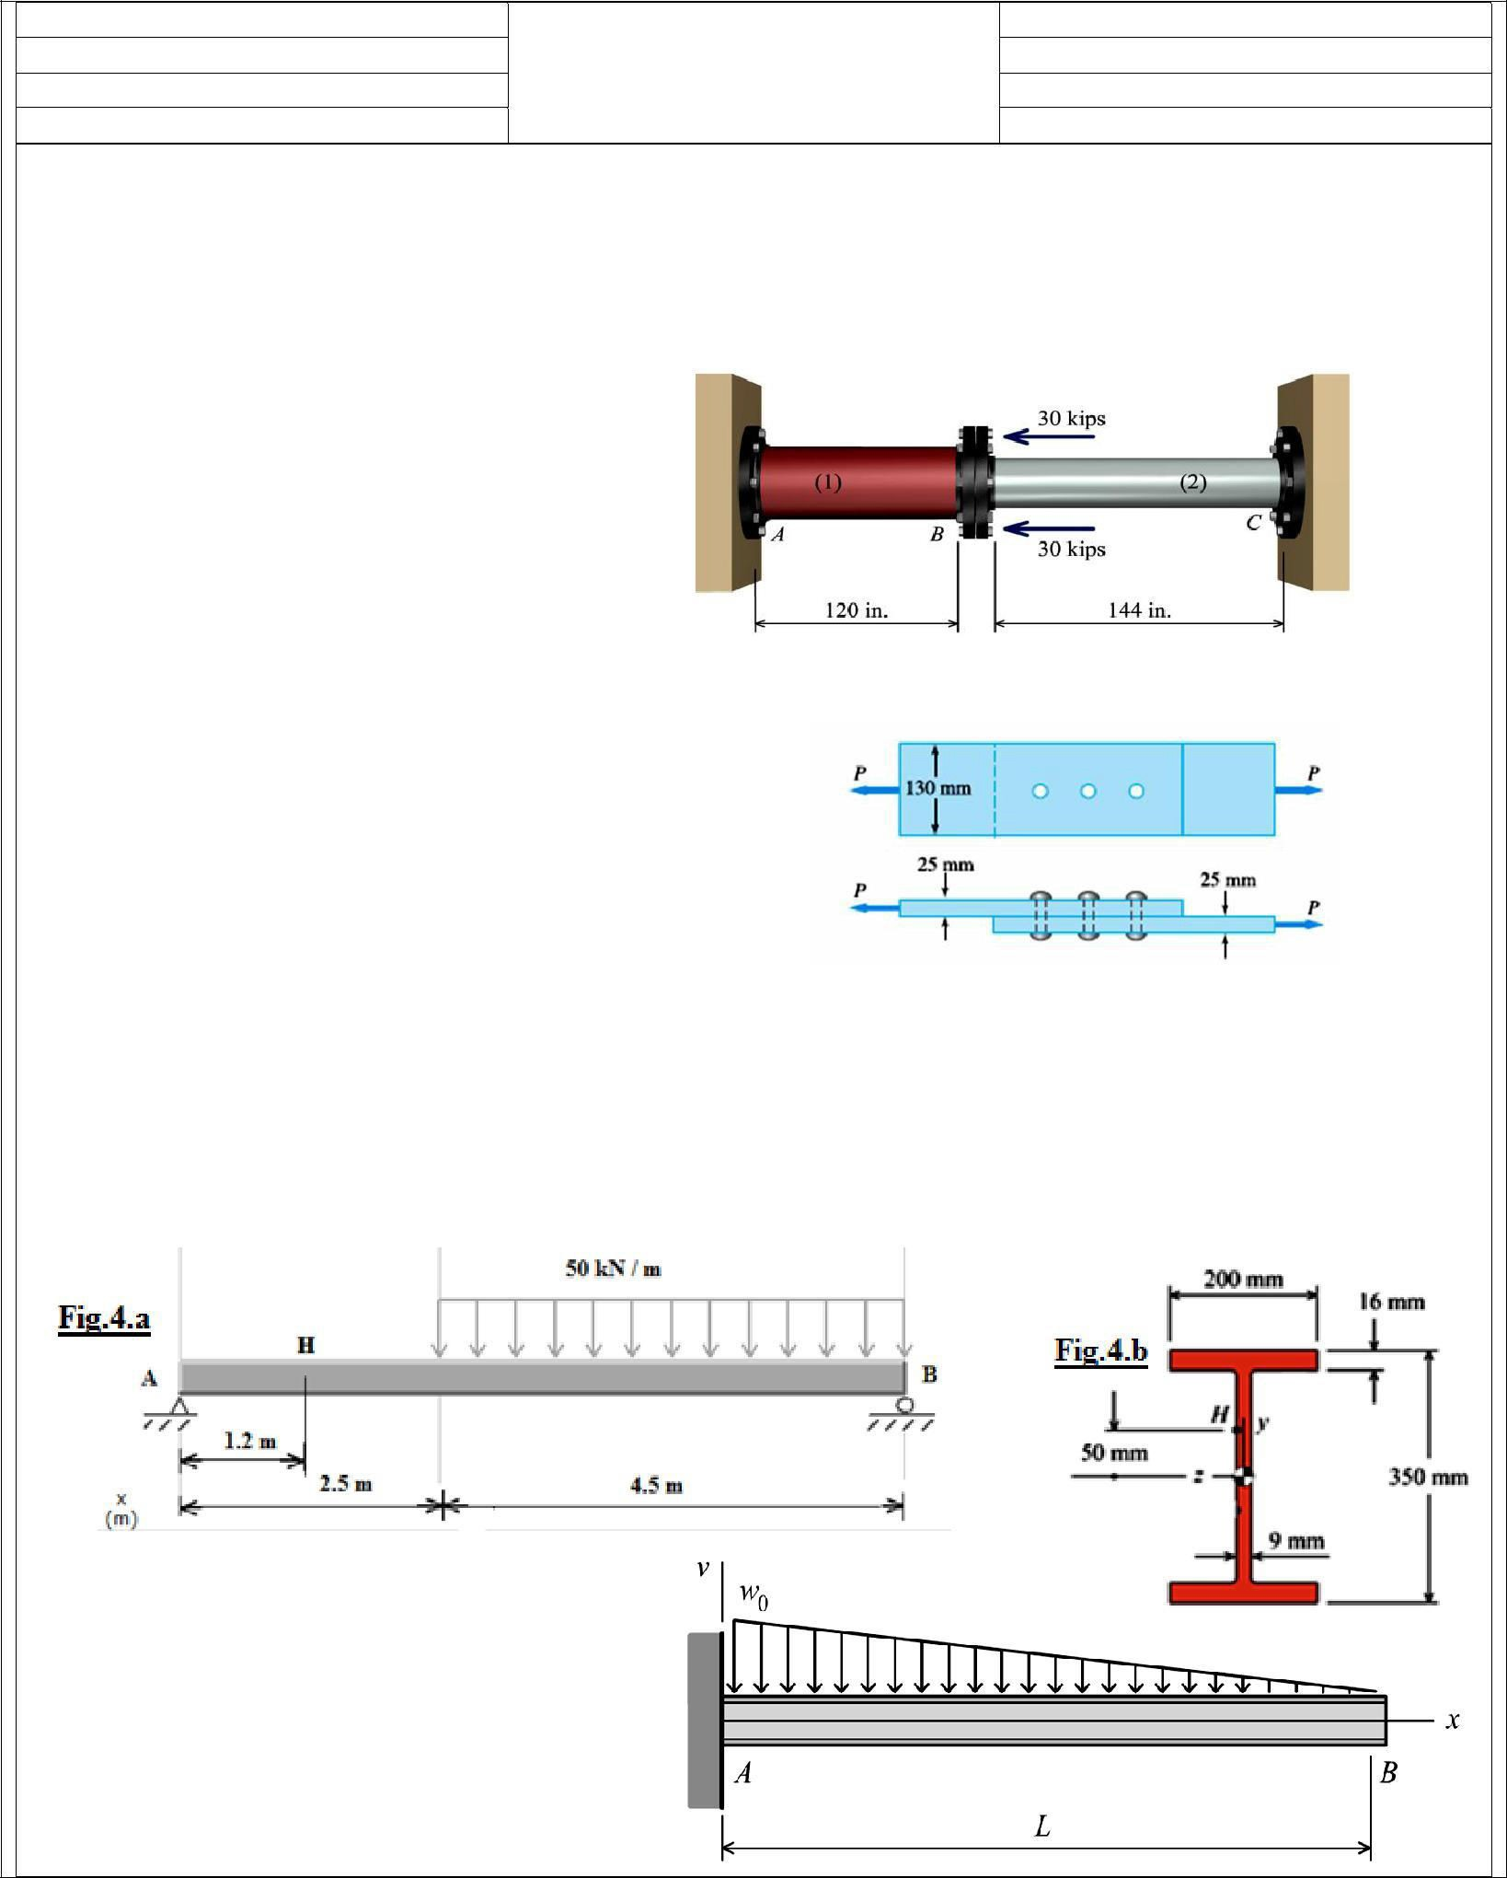
Ministry of Higher Education and Scientific research
Final Examinations 2015-2016/1st Attempt
Salahaddin University -Hawler Collage of Engineering Mechanical Engineering Dept. Date: 4- 6-2016
Q 1/ 15 Marks
Subject : Strength Of Materials Time: 3 hrs
2nd Year Students
Lecturer: Shereen A.A-Rahman
A steel [E = 30,000 ksi, α = 6.6 ×10⁻⁶/°F] pipe (1) with a cross sectional area of A1 = 5.60 in.² is connected at flange B to
an aluminum alloy [E = 10,000 ksi, α = 12.5 × 10⁻⁶/°F] pipe (2) with a cross sectional area of A2 = 4.40 in. ². The assembly (shown in Fig.1) is connected to rigid supports at A and C. It is initially unstressed at a temperature of 90°F.
At what temperature will the normal stress in steel pipe (1) be reduced to zero?
Determine the normal stresses in steel pipe and aluminum pipe when the temperature reaches (–10°F).
Fig.1
Q 2/ 10 Marks
The lap joint is connected by three 20-mm-diameter rivets (Fig.2). Assuming that the axial load P = 50 kN is distributed equally among the three rivets, find (a) the shear stress in a rivet; (b) the bearing stress between a plate and a rivet; and (c) the maximum average tensile stress in each plate.
Fig.2
Q3 /20 Marks
A tubular steel [G = 80 GPa] shaft is being designed to transmit 150 kW at 30 Hz. The maximum shear stress in the shaft must not exceed 80 MPa and the angle of twist is not to exceed 6° in a 4-m length. Determine the minimum permissible outside diameter if the ratio of the inside diameter to the outside diameter is 0.80.
Q 4/ 30 Marks
For the simply supported beam shown, determine the principal stresses and the maximum shear stress acting at point H, as shown on Figs.5.a and Fig.5.b. Show these stresses on an appropriate sketch.
Q 5 / 25 Marks
For the loading shown in Fig .5, use the double integration method to determine
the equation of the elastic curve
the deflection at the free end
the slope at the free end. Assume that EI is constant.
Directorate of Quality Assurance and Accreditation
ΏوڕێوهΏورΎیوتیدڵϨیΎییجۆریومتمΎنوبوخشین

Slide 7
Ministry of Higher Education and Scientific research
20. Extra notes:
Extra notes:
ـــــــــــــــــــــــــــــــــــــــــــــــــــــــــــــــــــــــــــــــــــــــــــــــــــــــــــــــــــــــــــــــــــــــــــــــــــــــــــــــــــــــــــــــــــــــ
Peer review :
نیشخوبونΎمتمویرۆجییΎیϨڵدیتویاروبϩوێڕوب
Directorate of Quality Assurance
and Accreditation

