Slide 1
Microbiology First Course
Lec. 1
Introduction to Microbiology
Assist. Lec. Sherko M. Abdul-Rahman
MSc. in Microbiology
Email: sherko.abdulrahman@su.edu.krd

Slide 2
What is Microbiology? Micro - too small to be seen with the naked eye Bio - life logy - study of
Microbiology: Is a branch of medical science concerned with the identification, diagnosis, prevention, and treatment of infectious diseases. In addition, this field of science studies various clinical applications of microbes for the improvement of health.
There are four kinds of microorganisms (m.o.) that cause infectious disease such as bacteria, fungi, parasites and viruses

Slide 3
Organisms included in the study of microbiology:
1. Bacteria – Bacteriology
2. Protozoans – Protozoology
3. Algae – Phycology
4. Parasites – Parasitology
5. Yeasts and Molds (Fungi) – Mycology
6. Viruses – Virology
Microorganisms = Microbes = Germs

Slide 4
Characteristics of Life:
All living things have certain traits in common:
Growth and development
Reproduction and heredity – genome composed of DNA packed in chromosomes; produce offspring sexually or asexually.
Metabolism – chemical and physical life processes
Movement and/or irritability (homeostasis), respond to internal/external stimuli.
Cell support, protection, and storage mechanisms – cell walls, vacuole and granules.
Transport of nutrients and waste.

Slide 5
Five Kingdoms of Living Organisms
Animalia
Plantae
Fungi
Protista
Monera - Bacteria and Cyanobacteria
Taxonomic Classification
Man
Animalia
Chordata
Mammalia
Primate
Hominidae
Homo
sapien
Cat
Animalia
Chordate
Mammalia
Carnivora
Felidae
Felis
domestica
Kingdom
Phylum
Class
Order
Family
Genus
species

Slide 6
Naming Microorganisms
Binomial (scientific) nomenclature,Carolus Linnaeus (1735)
Gives each microbe two names:
Genus - noun, always capitalized
species - adjective, lowercase
Italicized for example: Staphylococcus aureus (S. aureus) or underline for example: Staphylococcus aureus (S. aureus)

Slide 7
Classification System
Three Domains Classification, Carl Woese (1978),
Bacteria: Unicellular prokaryotes with cell wall containing peptidoglycan
Archaea: Unicellular prokaryotes with no peptidoglycan in cell wall
Eukarya, Protista, Fungi, Plantae, and Animalia.

Slide 8
Characteristics of Microbes:
Procaryotes: Microscopic, unicellular organisms. Lack nuclei and membrane-bound organelles.
Eucaryotes: Unicellular and multicellular organisms. Have nuclei and membrane-bound organelles
Viruses: Acellular, parasitic particles composed of a nucleic acid and protein.
Microbial Dimensions:
Procaryotes are measured in micrometers.
Viruses in nanometers
Helminths are measured in millimeters.

Slide 9
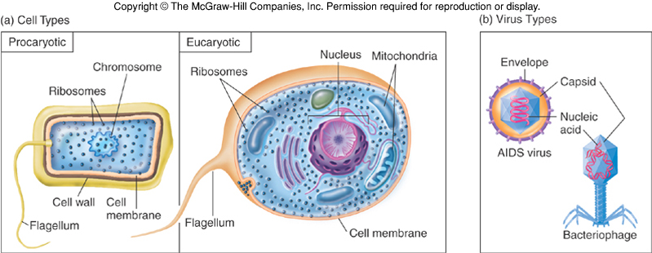

Slide 10
Microbes Benefit Humans:
For example, each human body hosts 10 microorganisms for every human cell, and these microbes contribute to digestion, produce vitamin K, promote development of the immune system, and detoxify harmful chemicals. Microbes are essential to making many foods we enjoy, such as bread, cheese, and wine.
Six great things microbes do for us
Microbes play defense
Microbes boost the immune system
Microbes protect us from auto-immune diseases
Microbes keep us slim
Microbes detoxify and may even fight off stress
Microbes keep babies healthy.

